Slide 1
Introduction to
Pathology Informatics
Session 9:
System Implementation and Management
James Harrison, MD PhD
University of Virginia
2024
API distribution, version 1.0.1
Notes:
These 10 slide sets and term lists are being provided through the Association for Pathology Informatics (API) with a license that allows free use, modification, and redistribution with attribution (see the permitted uses slide at the end of each presentation). The design has been kept relatively basic to make editing and adaptation easier. Users are encouraged to modify and improve the slides, share the changes (with attribution of the original material), and possibly contribute the improved slide sets back to the API or other distributors. As designed, the slides are relatively wordy so that they are easier to follow without an instructor’s guide (though one may appear in the future). Feel free to edit the slides to streamline them and optimize them for local teaching style and available time. Some sessions contain optional slides with extra detail, and these are indicated in the slide notes. Some sessions contain slide builds (most are simple) that don’t print well; these sessions have optional slides for printing, and these are indicated in the slide notes.
The goal of these slide sets is to provide foundational information that will allow pathology trainees to more effectively learn and practice pathology, not to teach the performance of specific tasks in pathology. The overall learning objectives are listed on the third slide of session 0 with some explanatory comments in the notes. Subsequent sessions have agendas but not separate learning objectives because the learning objectives remain the same.
The slides have been used with a teaching schedule in which the orientation is given during the summer and then the remaining sessions are give once a month (with lunch) from September to May. They could also fit into a 2, 4, or 5-6 week teaching module if taught on a weekly/semiweekly basis.

Slide 2

Implementation and management agenda
Appreciate the breadth of activities in pathology IT
Understand the major tasks and governance of the pathology IT team
Understand pathologists’ responsibilities related to IT, red on slides
Understand the general outlines of the software selection
and installation process
Be aware of continuing pathology informatics and data challenges

Slide 3
Management of IT systems
Improvement
Strategy
Evaluation
Process
improvement
Culture change
Clinical &
business alignment
Portfolio management
Strategy
Design
Change control
Operation
Improvement
Ops management
Service desk
Event
management
System architecture
Capacity
management
Service catalog
Operation
Design
Change management
Deployment & release
Knowledge management
Change control

Slide 4
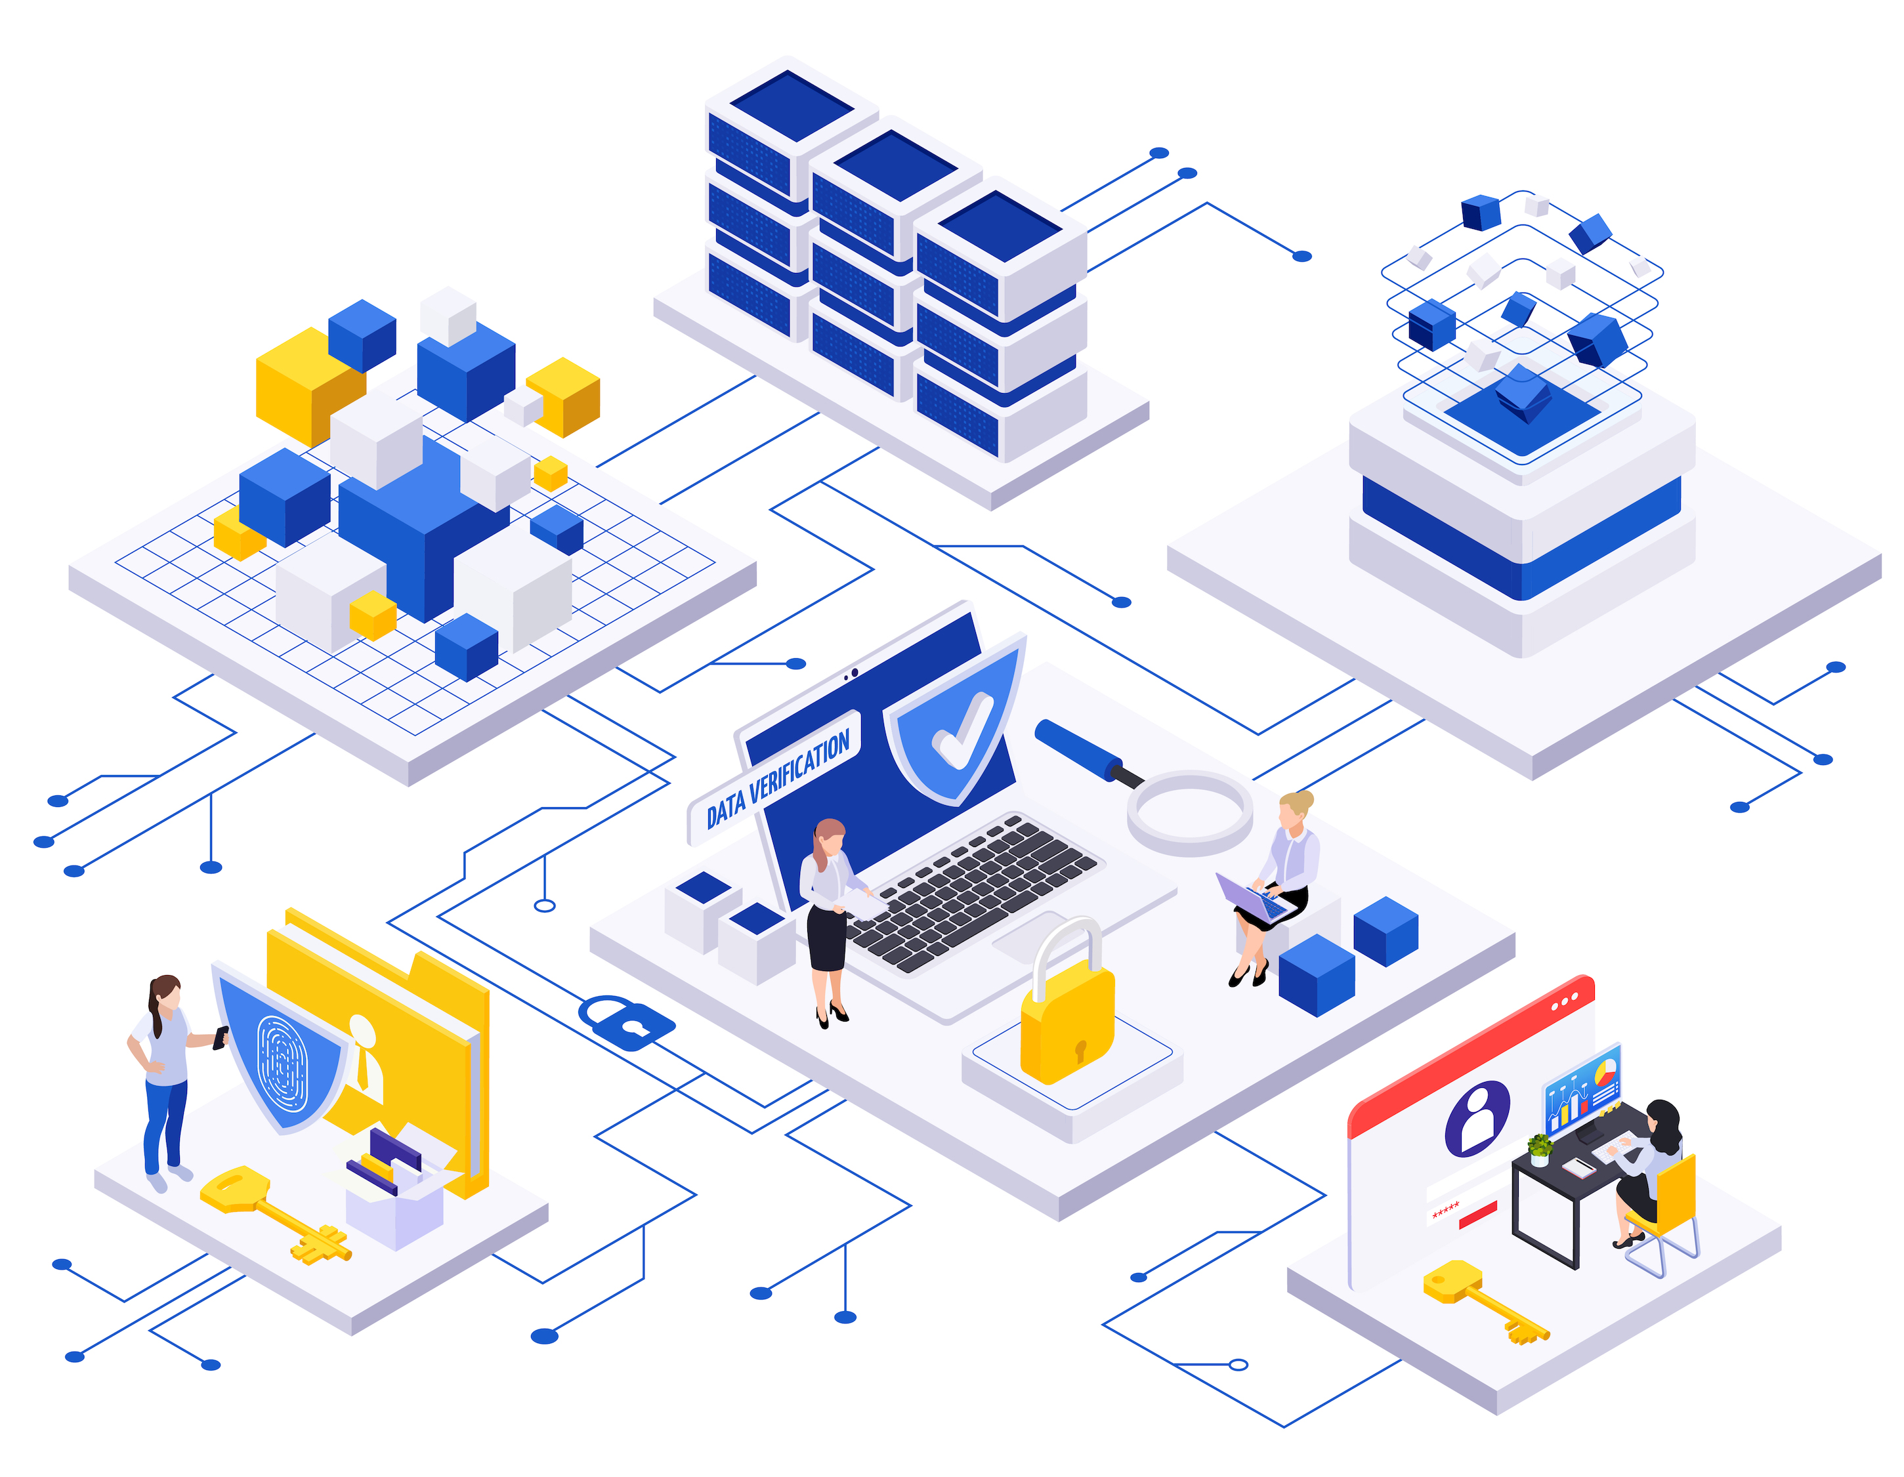
Scope of pathology IT
Systems
Tasks
LIS, APLIS, middleware, instruments
Blood bank system
Point of care base stations/devices
Outreach and reference lab order/result and interface systems
Voice recognition/dictation systems
PACS and image digitization
Document management system
Fax & print servers
End-user computers
Issue tracking system
Update maintenance tables/dictionaries
  Orders, tests, instruments, comments, rules
  Personnel and location information
  Interface mappings
Train users
Resolve user problems (24/7)
Resolve system/interface errors (24/7)
Schedule & install software/fixes/upgrades
Change management and testing
Backup and restore/rebuild/verify
Regular checks for correct operation
Operational reporting & data extracts
Image by macrovector on Freepik

Slide 5
Pathology IT application management group
Application management & support
  Pathology software applications
  Sysadmin and network admin
  by central IT
Makeup
  Combination of IT and med tech
Governance
  Pathology dept. & hospital IT
  Changing with consolidation
  of EHR software
  Specifics of governance matter less than focus, makeup, and collaboration
Laboratory IT administration
Hospital
Medical
IT Admin
Lab Director
IT Super
Pathologists*
Techs
Notes:
*May include a pathologist-informaticist as the specialty expert and section director

Slide 6
Pathology IT application management group
Application management & support
  Pathology software applications
  Sysadmin and network admin
  by central IT
Makeup
  Combination of IT and med tech
Governance
  Pathology dept. & hospital IT
  Changing with consolidation
  of EHR software
  Specifics of governance matter less than focus, makeup, and collaboration
Laboratory administration
Hospital
Medical
Lab Admin
Lab Director
Lab Super
Pathologists*
Techs
Notes:
For pathologists, relationship with IT organization is similar to relationship with lab administration
*Specialty experts, section directors

Slide 7

Key software application management tasks
Content and configuration management (previously discussed)
Performance monitoring
Interface management
Change management
Data and system backup
Procedure manual
Image by vectorjuice on Freepik

Slide 8

Performance monitoring
System testing
  Regression testing, repeating previous testing
    Automated testing with a test data library and test scripts
    Every two years for calculations, executable rules, reports, display
  Unit, integration, system, acceptance testing in later slides
Network testing (in-lab networks)
  Throughput, collision rate, downtime
Scheduled and unscheduled system downtime
System response times and interface transfer rates
Stored data volume and disc space
Total accounts used and available licensed accounts
System and interface error logs
Issue tracking
Image by vectorjuice on Freepik

Slide 9
Interface management
LIS
Coordination of vendors of systems to be interfaced ($10-40K)
Creation of a test data library
Mapping data elements between the two sides of the interface
Installation of the interface
  Configuration of an interface engine if using
Testing and validation of the interface (test library and scripts)
  Signoff of testing
Documentation of the interface
  Written procedures with signoff
EHR
Out-reach
Interface Engine
Dec Supp
Inst
Mgr
Public
Health

Slide 10
Change management
(“change control”)
Change control documentation
Goals
  Avoid unnecessary and unauthorized changes; protect the data; maintain defined architecture
  Make necessary changes efficiently with minimal disruption (requires planning)
Test and validate changes
  Library of test data and automatic testing scripts to check all functions
  Review and signoff of testing results
Document and monitor all changes
Extensive validation for blood bank systems
Item | Comment
Description of change | Detailed explanation
Reason for change | Needs and benefits
Personnel responsible | Who will perform the change
Category | Hardware, software, process, or procedural
Magnitude | Minor vs. major based on impact
Signoff | Acceptance responsibility
Risk assessment | Anticipation and planning for problems
Evaluation/ monitoring | Assessment of success, problem detection
Adapted from Cucoranu IC, 2015.

Slide 11

Data and system backup
Tape commonly used; slow but inexpensive
and high data volume
Frequency: What you can lose and/or reconstruct
from database logs
Multiple backups in case of backup corruption
Rotating backups
  Daily, weekly, monthly
  Incremental backup
  Rotate to off site storage and back
“Hot backup:” may be off-site
  Disks or full duplicate systems
  Failover, manual or automatic
  External interfaces often need manual resetting to new addresses
Traditional GF-F-S backup rotation
Sons: 4 daily backups
M
T
W
Th
1
Fathers:
4 weekly
backups
2
3
4
1
2
3
4
5
6
7
8
9
10
11
Grandfathers: 11 monthly backups

Slide 12
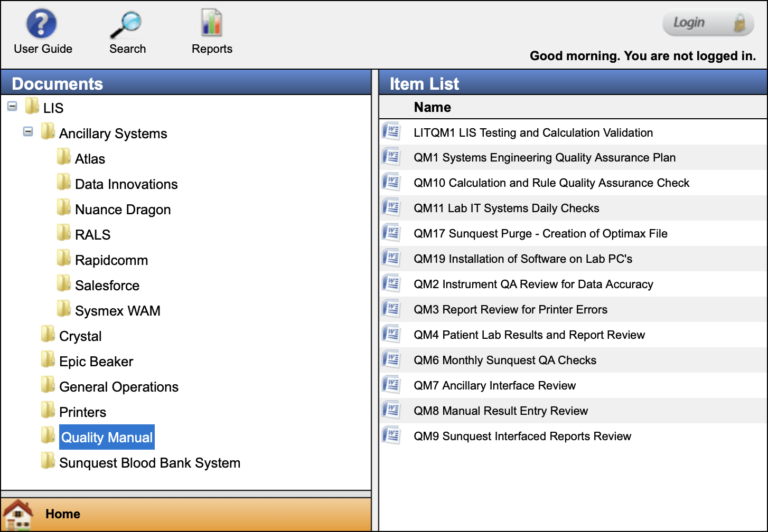
Laboratory IT procedure manual
Lab Procedure Manual
73 total procedures in this example
Major sections (see Harrison, Table 6-6)
  General operation
  LIS: System description, startup and
  shutdown, backup and data archiving,
  downtime procedures, error resolution,
  printer management
  Other systems, docs similar to LIS
  Interfaces
  Reports
  Quality assurance
  Security
  Disaster recovery
Pathologist signoff
Adapted from Harrison J, 2019.

Slide 13

Software selection and installation
LIS lifecycle
Software project/development styles
Defining requirements
System selection process
Software licenses
Installation and testing
User training
Go-live
Software as a service (SaaS) vs. local hosting
Image by storyset on Freepik

Slide 14
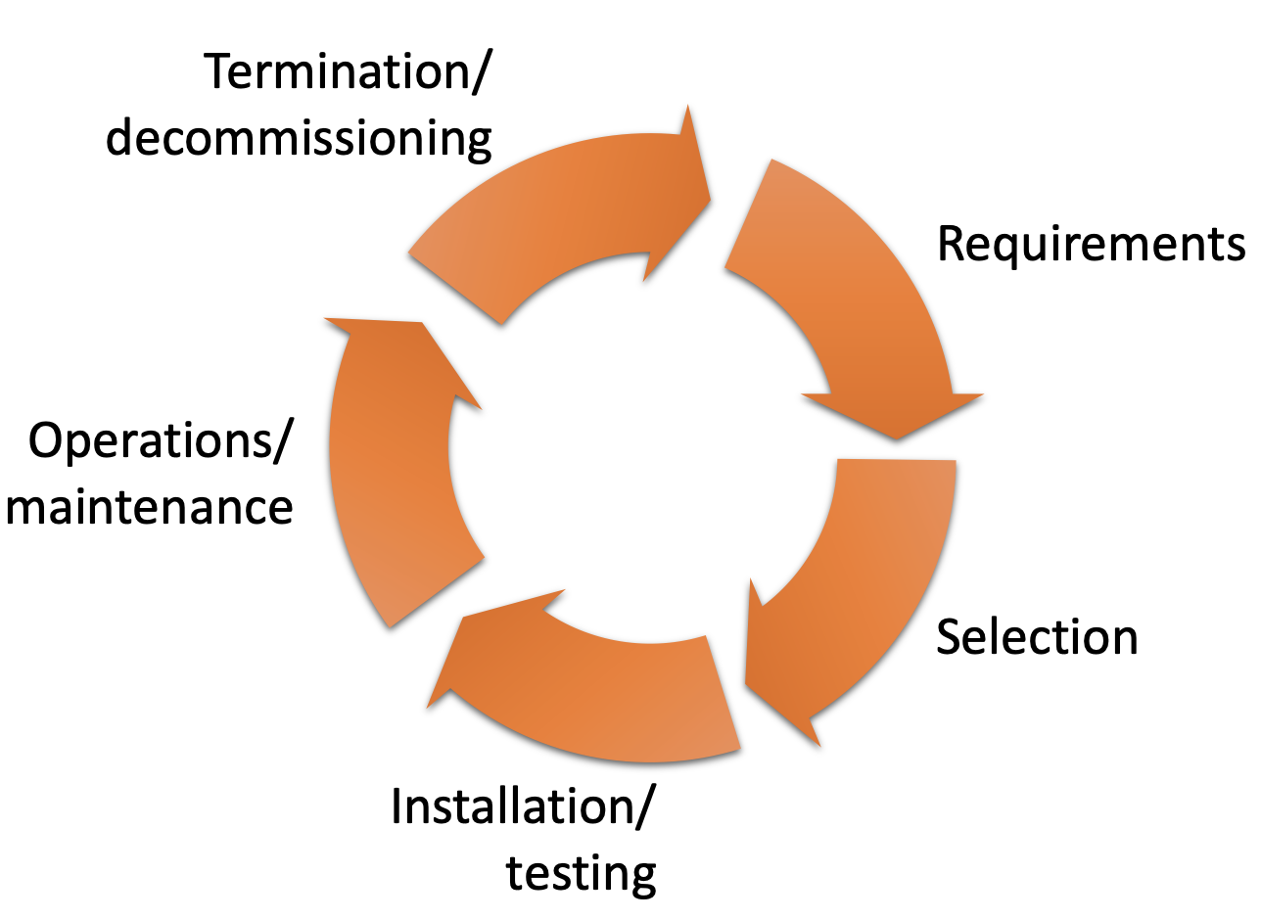
LIS system lifecycle
Lifespan 10-20 years or more
Recent replacements
more related to EHR adoption
than lab needs
Stages
  Requirements & goals
  System selection
  Installation and testing
  Operations and maintenance
  Termination and decommissioning (SaaS?)
Selection and installation may take 1-2 years, less for smaller systems
Software
Lifecycle

Slide 15
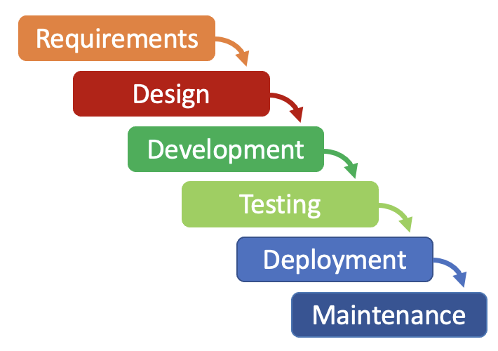


Software/IT project styles
Waterfall
  Progressive from requirements definition
  to software deployment
  Software available at end
Spiral/Incremental
  Development/deployment cycle that progressively adds features
  Interim software available for review and use
Agile
  Users and developers work together
  in short sequential bursts (sprints) to
  finish components of the project
Spiral/Incremental Model
Test
Plan
Maintenance
Waterfall
Model
Develop
Design
Agile Model
Developers
Users
Plan – Design – Develop – Test – Deploy – Review – Launch

Slide 16


Setting requirements and goals
Identify stakeholder groups
Identify project management, possibly from a project management office
Establish steering committee with stakeholder representation
  Stakeholder workgroups
  Project champions in stakeholder areas
Define desired business outcomes
Determine current barriers
needing removal
Develop requirements document
  Functional and non-functional
Briefly review available vendors
Functional
Requirements
Non-functional
Requirements
What the system should do
Features
Organizational and user needs
How the system should do it
Properties
Expectations

Slide 17
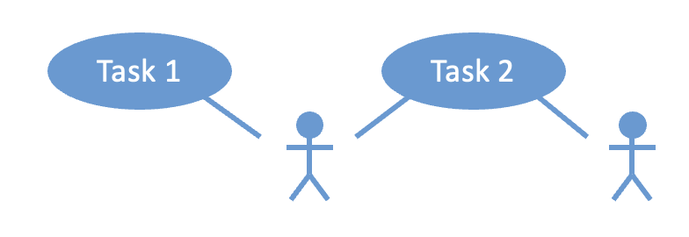
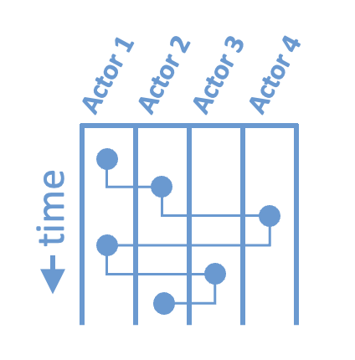
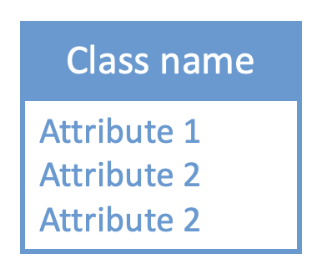
Tools for discussing system requirements
Actions
Use case graphs
  Who does what
Activity (swim lane) graphs
  Flow of work and information
Class diagrams
  Data model
Actors (human or system)
Actors (human or system)
Flow of tasks and
transfer of data
Detailed description of
complex data objects
and their elements
See Harrison J, 2019, pp. 114-116.

Slide 18


System selection: RFI
Request for information (RFI) to promising vendors
Customer self-description
  Description of the organization and its culture
  Goals, needs, and desired outcomes
  Functional requirements and constraints
  Support requirements
Request for vendor and software description
  Brief overview of how software meets goals
  Vendor’s organizational philosophy, history, size, financial status, and stability
  Number and characteristics of installed sites
  Contact information for reference sites
Criteria for evaluation of RFI responses
RFI
Request for information
RFP
Request for proposal
Exploring market
Looking for overviews
Understanding products
Understanding cost
Detail on process
Finding strategic partner
Educates
Compares
RFI
RFP
Adapted from the RFP360 infographic

Slide 19
System selection: Initial ranking
Review RFIs and rank
Schedule vendor demos with stakeholders
Visit reference sites
  See Harrison 2019 chapter appendix for questions to ask
Go beyond the feature checklist and company size
  Evaluate implementation quality and workflow fit

Slide 20
System selection: RFP
Requests for proposals (RFP) to top vendor(s)
  Prepare in collaboration with procurement office
  Vendor may have RFP templates
  Extend RFI with additional sections
    Description of installation process, including handling legacy data
    Cost and licensing terms
    Support style and cost
Select vendor and negotiate contract (procurement office)
RFI
Request for information
RFP
Request for proposal
Exploring market
Looking for overviews
Understanding products
Understanding cost
Detail on process
Finding strategic partner
Educates
Compares
RFI
RFP

Slide 21
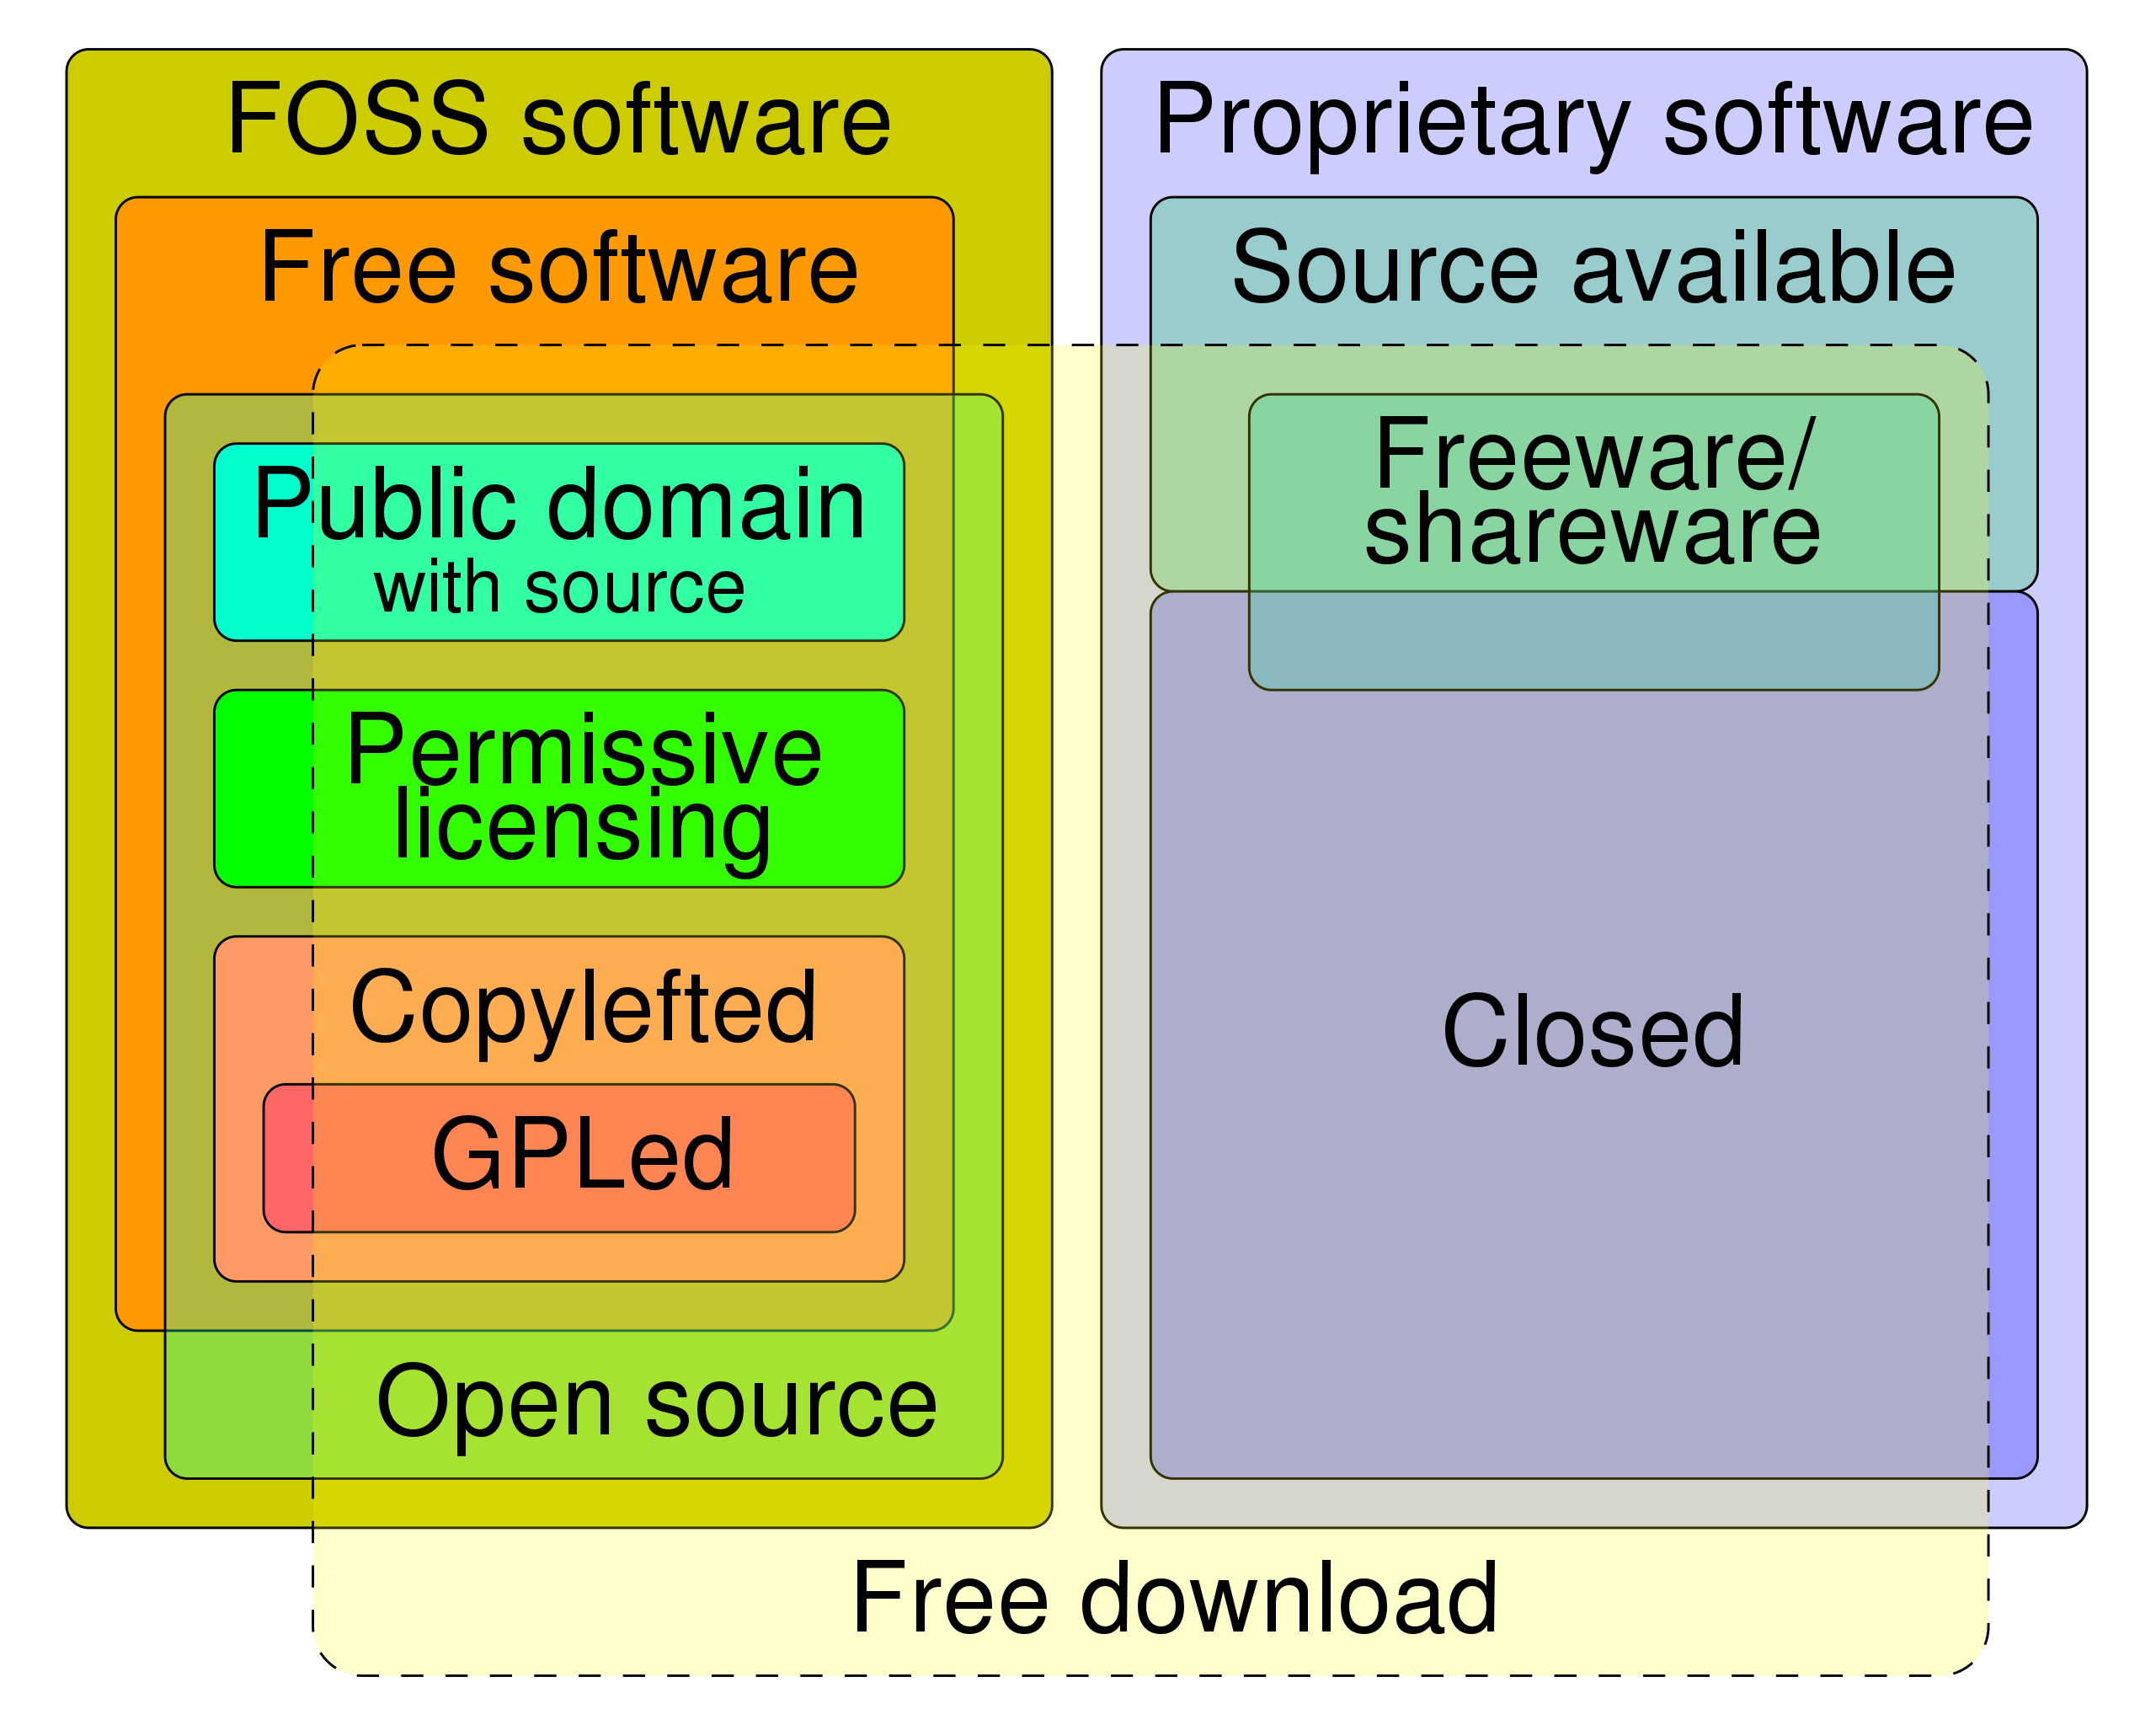
Software licenses
Types of software licenses
Software is copyrighted or patented
  Users are licensed
  License specifies how software can be used and redistributed
Proprietary
  Seat licenses (# accounts)
  Connection licenses
  Subscription vs. purchase/upgrade
Free and open source (FOSS)
  Public domain
  Permissive (BSD, MIT)
  Restrictive (GPL, copyleft)
    Redistribution must maintain the same license
https://en.wikipedia.org/wiki/Software_license

Slide 22

Installation
Detailed implementation plan on contract completion
  Overall timeline and milestones for system construction
  Vendor resources provided and customer resources required
  User training plan and schedule
  Vendor and customer deliverables (local configuration, review, and signoff)
  Projected go live date
For large systems, installation managed by vendor & customer jointly
  SaaS less involved but also requires configuration, data loading, training, etc.
Notes:
Large software systems are more like erector sets than complete finished programs like word processors or spreadsheets. Don’t count on the vendor to know how to do everything, systems and sites aren’t that standardized yet.

Slide 23

New software testing
Testing using vendor test scripts and customer data
  Testing plans with established acceptance criteria
Unit testing
  Internal operations of software modules in isolation
Integration testing
  Operation of a new module in combination with interacting modules
System testing
  Evaluation of the system as a whole; focus on many modules working together
Acceptance testing
  Evaluation of satisfaction of business and regulatory requirements
  Customer review and signoff of testing results
Notes:
Large software systems are more like erector sets than complete finished programs like word processors or spreadsheets. Don’t count on the vendor to know how to do everything, systems and sites aren’t that standardized yet.
These testing types are easy to write multiple choice questions about and often end up on board and recertification exams.

Slide 24

User training
System managers trained early
and help with installation
Superusers extend managers in
stakeholder areas and help train routine users
User training ideally about two weeks prior to go live
  Earlier training tends to fade
Organization of ongoing training for refresh and changing user roles
  May be transferred to customer after go-live, or available at extra cost

Slide 25

Go-live
Each has unique challenges
  New system startup vs. replacement of old system
  with changeover
Contingency plans for failure and fallback, extra staff
Followed by a period of lower productivity and error risk
Workflow design issues may be revealed
Dealing with errors or “edge cases” may be challenging
Possibility of adjustment period before operation is routine
  May require extra vigilance and work
  Possible negative perceptions of the new system

Slide 26


What about SaaS?
SaaS Application
Application logic and
data in the cloud
LIS “in the cloud”
  Expert system administration at SaaS cloud site
  No local hardware management/maintenance
  Application management can be
  local team or vendor staff
  Does not change pathologist responsibilities
  Control of data (cost of reporting/termination)
IT procedure manual
  Should be accurate and shared with local site
  Signed off by pathologist (CAP checklist requirement)
Testing including validation of rules and interfaces initially and ongoing
  Reviewed and signed off by pathologist (CAP checklist)
API
Interfaces
Other Local Systems

Slide 27
Pathology informatics and data challenges
Checklist items
  31 items in Lab Gen; a few others scattered
AP report formatting in downstream systems
  No consensus on an open document formatting/display standard
    Plain text formatting, lack of useful tables, line wrap problems, overall suboptimal display
    RTF, OpenDoc, HL7 CDA, XML or xhtml with style sheets are possibilities
  Flexible formatting necessary for different displays (ie, handhelds)
    PDF/RTF/OpenDoc designed for physical pages, not electronic displays
  Narrative and structured data for interoperability, analytics, & decision support
  XML/CSS meets requirements, need consensus & editing software
  Vendors don’t standardize themselves; customers don’t know what to ask for
    Government regulation: APLIS (and LIS) system certification
For more detail, see Wilkerson ML et al., 2015
Notes:
CAP checklists may evolve to provide structured data, but how to incorporate into standard report formats?

Slide 28
Pathology informatics and data challenges
Test naming
  Analyte, synonyms, use context, draw/handling instructions (TRUU-Lab?)
Interoperability of results
  Can lab data be transmitted, displayed, and interpreted clinically across systems?
  When should results display together in a lab flow sheet or graph?
  No data elements currently included with lab results to indicate clinical interoperability
  Regulation and system certification (likely soon)
Representation of gender
  How is gender represented in the system? Is the representation adequate for clinical needs?
  Which representation should be used for eGFR calculation? For choice of reference range to display?
Future orders, implementation and processing
  Valid date range and order release, matching to correct encounter, and duplication with multiple providers
Duplicate orders
  Auto-cancellation vs. display of previous, communication of cancellation, reinstatement?
For more detail, see Wilkerson ML at al., 2015.

Slide 29

Key points
Governance of pathology IT systems is a cooperative activity
  Similarities to managing the clinical laboratory
Understand the important tasks in system management
  Content and configuration management, performance monitoring, interface management, change management, data and system backup, procedure manual
Understand the important tasks in software selection and installation
  Software lifecycle, setting requirements, product ranking using RFI and RFP processes, software licensing, installation/testing, user training, go-live, SaaS
Challenges in pathology data and system management
  Informatics in lab inspections, AP report formatting, test naming, interoperability, representation of sex & gender, future orders and duplicate orders

Slide 30

Readings
Harrison J. Management of Pathology Information Systems, Chapter 6. In: Laboratory Administration for Pathologists. 2nd ed. CAP Press; 2019. pp. 106-112, 114-116 (“Diagramming tools”), and appendix. Available for download from the Pathology Informatics Essentials for Residents curriculum page.
Cucoranu IC. Laboratory information systems management and operations. Surgical Pathology Clinics. 2015;8(2):153-157. doi:10.1016/j.path.2015.02.002
Wilkerson ML, Henricks WH, Castellani WJ, Whitsitt MS, Sinard JH. Management of laboratory data and information exchange in the electronic health record. Arch Pathol Lab Med. 2015;139(3):319-327. doi:10.5858/arpa.2013-0712-SO

Slide 31

Permitted uses
© 2024 James H. Harrison, Jr. except as noted below. The original material in this slide set is made available under a Creative Commons Attribution 4.0 (CC BY 4.0) International License. The contents may be used without restriction, modified, and redistributed if they are attributed and any changes are indicated. Some graphical elements are used with permission or according to their own licenses requiring attribution. Attribution links are provided on the slide of use or on the Permitted Uses slide (this slide). These elements may be used and included in modified and redistributed work consistent with the licenses specified at the linked sites, provided that the links are included in the redistributed material.
The cover image is a composite of two laboratory images from Pixabay available for use without attribution.
Sitting icon created by Prosymbols Premium – Flaticon
Dedicated hosting icon created by phatplus – Flaticon
Agile icon created by Flat Icons – Flaticon
Spiral icon created by Pixelmeetup – Flaticon
Agenda, functional, and quote icons created by Freepik – Flaticon
Organization icons created by Smashicons – Flaticon
Bulb icon created by logisstudio – Flaticon
Compare icon created by Buandesign – Flaticon
Testing icon created by smashingstocks – Flaticon
Training icon created by Nikita Golubev – Flaticon
Launch icon created by nawicon – Flaticon
Key icon created by juicy_fish – Flaticon
Book icon created by Good Ware – Flaticon

