Slide 1
Introduction to
Pathology Informatics
Session 7:
Clinical Decision Support
James Harrison, MD PhD
University of Virginia
Ronald Jackups , MD PhD
Washington University in St. Louis
2024
API distribution, version 1.0.2
Notes:
These 10 slide sets and term lists are being provided through the Association for Pathology Informatics (API) with a license that allows free use, modification, and redistribution with attribution (see the permitted uses slide at the end of each presentation). The design has been kept relatively basic to make editing and adaptation easier. Users are encouraged to modify and improve the slides, share the changes (with attribution of the original material), and possibly contribute the improved slide sets back to the API or other distributors. As designed, the slides are relatively wordy so that they are easier to follow without an instructor’s guide (though one may appear in the future). Feel free to edit the slides to streamline them and optimize them for local teaching style and available time. Some sessions contain optional slides with extra detail, and these are indicated in the slide notes. Some sessions contain slide builds (most are simple) that don’t print well; these sessions have optional slides for printing, and these are indicated in the slide notes.
The goal of these slide sets is to provide foundational information that will allow pathology trainees to more effectively learn and practice pathology, not to teach the performance of specific tasks in pathology. The overall learning objectives are listed on the third slide of session 0 with some explanatory comments in the notes. Subsequent sessions have agendas but not separate learning objectives because the learning objectives remain the same.
The slides have been used with a teaching schedule in which the orientation is given during the summer and then the remaining sessions are give once a month (with lunch) from September to May. They could also fit into a 2, 4, or 5-6 week teaching module if taught on a weekly/semiweekly basis.

Slide 2

Clinical decision support agenda
A bit of background on behavior and behavior modification
Electronic clinical decision support (eCDS)
  Definition
  General guidelines: The five “rights”
eCDS to support optimal laboratory utilization
  Targets, methods, and challenges
Common limitations and problems in eCDS deployment
Examples of success
Evaluation of eCDS interventions

Slide 3



Getting people to do the right thing
Anti-Theft
Location: Petrified Wood National Park (Arizona)
Problem: Visitors frequently removed petrified wood for souvenirs.
Solution: Put up signs reading, “Your heritage is being vandalized every day by theft losses of petrified wood, mostly a small piece at a time.”
Result: Theft increased from 5% to 8%.
Grant A & Sandberg S. New York Times. Dec 6, 2014.
Images: nps.gov

Slide 4

Getting people to do the right thing
Behavioral time-course study of 2655 visitors to PWNP
Signage was randomized, locations baited with loose pieces of wood
Message type | Message text
Negative command | “Please don’t remove the petrified wood from the park.”
Positive command | “Please leave petrified wood in the park.”
Negative descriptive | “Many past visitors have removed the petrified wood from the park, changing the state of the Petrified Forest.”
Positive descriptive | “The vast majority of past visitors have left the petrified wood in the park, preserving the natural state of the Petrified Forest.”
Theft (%)
1.67
5.33
7.92
5.00
Short, direct messages work best; perception of norms is important.
Cialdini et al. Managing social norms for persuasive impact. Social Influence 2006;1(1):3-15. doi: 10.1080/15534510500181459

Slide 5
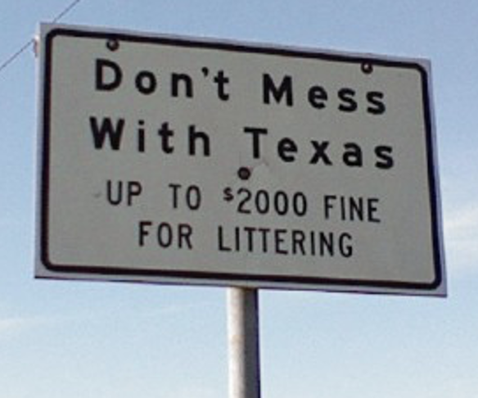

Getting people to do the right thing
Anti-littering
Location: Texas, 1985
Problem: High rate of littering on state highways
Intervention: Signs, “Don’t Mess With Texas!”
  Extensive campaign launched by Stevie Ray Vaughn, multiple other celebrities contributed
  Significant penalties, messaging maintained over years
Result: Littering decreased by 72% over 4 years.
Conclusion: How you do it is important
  Short, direct messages that invoke social norms can change behavior
  Most effective as part of multi-pronged effort
wikipedia.org
McClure T & Spence R. Don't Mess with Texas: The Story Behind the Legend. 2006
txdot.gov

Slide 6









Systems of decision-making (Kahneman)
Fast
Slow
Type I
Automatic
Real-world, imperfect
decisions based on
limited information and time
Cognitive heuristics
(“rules of thumb”)
Cognitive biases
Unconscious
Conscious
Type II
Reflective
Rational, analytical
decisions based on careful consideration
Evidence-based medicine
Risk-benefit analysis
Automatic
Effortful
Everyday
decisions
Complex
decisions
Error
prone
Reliable
Make the right decision easy
Kahneman D. Thinking Fast and Slow. 2011
Thaler RH & Sustein SR. Nudge. 2008
Notes:
Automatic subject to jumping to conclusions and answering the wrong question
Reflective difficult and time consuming, requires training and practice

Slide 7
Using cognitive heuristics in eCDS
Default heuristic
  Busy people are more likely to pick the pathway requiring no additional action.
  Pre-check optimal orders, uncheck or remove deprecated orders.
Bandwagon effect
  People are likely to emulate what their peers are doing.
  Provide brief statements that establish the desired action as the norm.
  May include feedback on utilization within the system.
Make the “right” decision easier to choose and perceived as
more popular; make the “wrong” decision harder to choose.

Slide 8

Clinical Decision Support
*
Definition of electronic CDS (eCDS):
  Methods that provide clinically relevant information at decision time during use of healthcare information systems to enhance patient care and improve clinical workflow.
Designing effective eCDS involves:
  Clinical decision-making as target
  Evidence-based medicine
  Health information technology, e.g., computerized provider order entry (CPOE)
  Principles of good user interface design and human-computer interaction
    Human factors engineering applied to computers

Slide 9
Guidelines for effective CDS
*
The Five Rights of CDS
The right information
To the right person
In the right CDS intervention format
Through the right channel
At the right time in the workflow
Adapted from Sirajuddin AM et al. Implementation pearls from a new guidebook on improving medication use and outcomes with clinical decision support: Effective CDS is essential for addressing healthcare performance improvement imperatives. J Healthc Inf Manag 2009;23(4): 38–45.

Slide 10
Guidelines for effective CDS
*
The Five Rights of CDS
The right information
To the right person
In the right CDS intervention format
Through the right channel
At the right time in the workflow
Well-supported recommendation?
Simple, concise message?
Guideline meets intended objective?
Adapted from Sirajuddin AM et al. Implementation pearls from a new guidebook on improving medication use and outcomes with clinical decision support: Effective CDS is essential for addressing healthcare performance improvement imperatives. J Healthc Inf Manag 2009;23(4): 38–45.

Slide 11
Guidelines for effective CDS
*
The Five Rights of CDS
The right information
To the right person
In the right CDS intervention format
Through the right channel
At the right time in the workflow
Target the decision-maker
  Attending physicians are more likely to change decisions
  Residents and nurses may feel pressured to continue current course
Adapted from Sirajuddin AM et al. Implementation pearls from a new guidebook on improving medication use and outcomes with clinical decision support: Effective CDS is essential for addressing healthcare performance improvement imperatives. J Healthc Inf Manag 2009;23(4): 38–45.

Slide 12
Guidelines for effective CDS
*
The Five Rights of CDS
The right information
To the right person
In the right CDS intervention format
Through the right channel
At the right time in the workflow
How information is presented
Start with the least disruptive method
Respect the user interface and workflow
Make the right decision easy
Adapted from Sirajuddin AM et al. Implementation pearls from a new guidebook on improving medication use and outcomes with clinical decision support: Effective CDS is essential for addressing healthcare performance improvement imperatives. J Healthc Inf Manag 2009;23(4): 38–45.

Slide 13
Guidelines for effective CDS
*
The Five Rights of CDS
The right information
To the right person
In the right CDS intervention format
Through the right channel
At the right time in the workflow
Computer
Text message
Pager
Phone
Posters/flyers
Adapted from Sirajuddin AM et al. Implementation pearls from a new guidebook on improving medication use and outcomes with clinical decision support: Effective CDS is essential for addressing healthcare performance improvement imperatives. J Healthc Inf Manag 2009;23(4): 38–45.

Slide 14
Guidelines for effective CDS
*
The Five Rights of CDS
The right information
To the right person
In the right CDS intervention format
Through the right channel
At the right time in the workflow
Target the place and time of the decision
  For CPOE, in the computer
  Before the order has been signed
Adapted from Sirajuddin AM et al. Implementation pearls from a new guidebook on improving medication use and outcomes with clinical decision support: Effective CDS is essential for addressing healthcare performance improvement imperatives. J Healthc Inf Manag 2009;23(4): 38–45.

Slide 15

CDS targets related to laboratory utilization
Lab test orders
  Unnecessary duplicate testing
  Excess testing frequency
  Misordering of tests with similar names [e.g. 1,25-(OH)₂ vitamin D]
  Contra-indications and errors (PSA, pregnancy)
  Drug monitoring and pharmacogenomics
  Complex testing requirements or diagnostic algorithms
Blood orders
  Unnecessary or inappropriate blood use
  Adherence to blood product ordering guidelines
    Maximum surgical blood order schedule (MSBOS)

Slide 16
Choosing Wisely examples for lab utilization
AABB
Society of
Hospital
Medicine
American
Society of
Hematology
Choosing Wisely items items related to pathology are available from the ASCP, see Readings
Notes:
Choosing Wisely was an initiative between multiple healthcare professional organizations that created best practice recommendations improve medical practice. It ran for about 10 years, ending around 2022. The recommendations are no longer available on the Choosing Wisely web site but remain available on the contributing organizations’ sites. Core pathology Choosing Wisely items are available from the ASCP, and the ASCP has initiated an effort maintain and expand them. Links related to CW are on the Readings slide.

Slide 17
Common eCDS applications
Category | CDS intervention
Ordering | Order search and display
 | Order templates and instructions
 | Order sets
 | Protocol orders
 | Order reflexes and cascades
 | Order alerts
 | Non-interruptive
 | Interruptive
Education | Electronic reporting and interpretation
 | Electronic references
 | Electronic feedback and benchmarking
 | Individualized
 | By department
 | By institution
Diagnostics | Decision algorithms
 | Within electronic health record
 | On handheld/mobile devices
 | Predictive analytics/machine learning
Resource
utilization
Result
value
Adapted from Jackups Jr R et al. Clinical decision support for hematology laboratory test utilization. Int J Lab Hematol. 2017;39(S1):128-135. doi:10.1111/ijlh.12679

Slide 18
Order search and display
Make orders easy to find and read
  Familiar names and common synonyms, sort order, mixed case
Order names should be clear
  Avoid ambiguity
  May name by usage context or include usage-related synonym
  Control order creation and remove obsolete orders from view
Collect orders commonly placed together into panels or order sets
Intelligent handling of ordering and patient location
  Important with healthcare networks that have multiple sites
  Orderable list display and specimen acquisition, testing location, result reporting
Efforts to standardize test and order names
  Local test-naming rubrics, TRUU-lab
Notes:
May rename obsolete orders with dot in front of name
Handling location correctly can be important for available order list display (local vs. sendout), triaging specimen acquisition, transport to lab, and result reporting within a provider organization

Slide 19
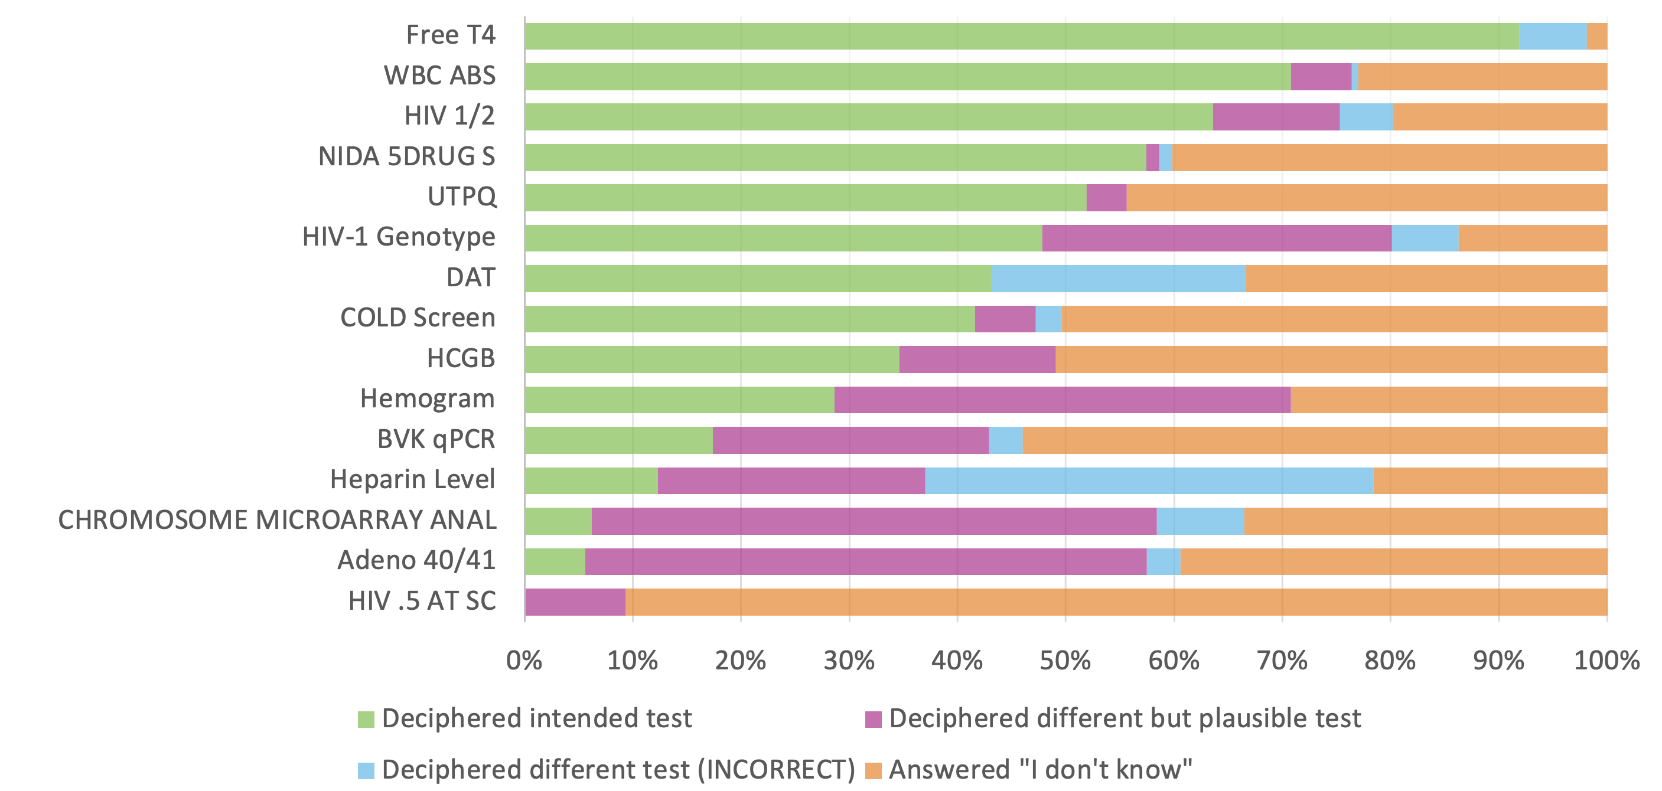
Test naming examples (actual EHR listings)
Do physicians know what they mean?
Carter AB, Berger AL, Schreiber R. Laboratory test names matter: A survey on what works and what doesn’t work for orders and results. Arch Pathol Lab Med. 2024;148(2):155-167. doi:10.5858/arpa.2021-0314-OA

Slide 20
Test naming example: GTT
GESTATIONAL DIABETES SCREEN GESTATIONAL DIABETES SCREEN
GLUCOSE TOLERANCE, 3HR (GESTATIONAL) GTT PANEL GLUCOSE TOLERANCE (GESTATIONAL DIABETES) PANEL
GLUCOSE TOLERANCE, 3 HOURS PANEL -
GLUCOSE TOLERANCE, 2HR W 90 MIN PANEL GLUCOSE TOLERANCE (GROWTH HORMONE SUPPRESSION) PANEL
GLUCOSE TOLERANCE, 2 HR NO 30 MIN PANEL -
GLUCOSE TOLERANCE, 2HR PANEL -
GLUCOSE TOLERANCE (FAST & 2HR ONLY) PANEL GLUCOSE TOLERANCE (NON-GESTATIONAL DIABETES) PANEL
GLUCOSE TOLERANCE, 4 HOURS PANEL -
GLUCOSE TOLERANCE, 5 HOURS PANEL -
FASTING GLUCOSE TOLERANCE -
2020
2022
Notes:
Hide for PDF, and unhide next slide

Slide 21
Test naming example: GTT
GESTATIONAL DIABETES SCREEN GESTATIONAL DIABETES SCREEN
GLUCOSE TOLERANCE, 3HR (GESTATIONAL) GTT PANEL GLUCOSE TOLERANCE (GESTATIONAL DIABETES) PANEL
GLUCOSE TOLERANCE, 3 HOURS PANEL -
GLUCOSE TOLERANCE, 2HR W 90 MIN PANEL GLUCOSE TOLERANCE (GROWTH HORMONE SUPPRESSION) PANEL
GLUCOSE TOLERANCE, 2 HR NO 30 MIN PANEL -
GLUCOSE TOLERANCE, 2HR PANEL -
GLUCOSE TOLERANCE (FAST & 2HR ONLY) PANEL GLUCOSE TOLERANCE (NON-GESTATIONAL DIABETES) PANEL
GLUCOSE TOLERANCE, 4 HOURS PANEL -
GLUCOSE TOLERANCE, 5 HOURS PANEL -
FASTING GLUCOSE TOLERANCE -
2020
2022
Notes:
Slide for handout or PDF. Hide this slide for presentation.

Slide 22
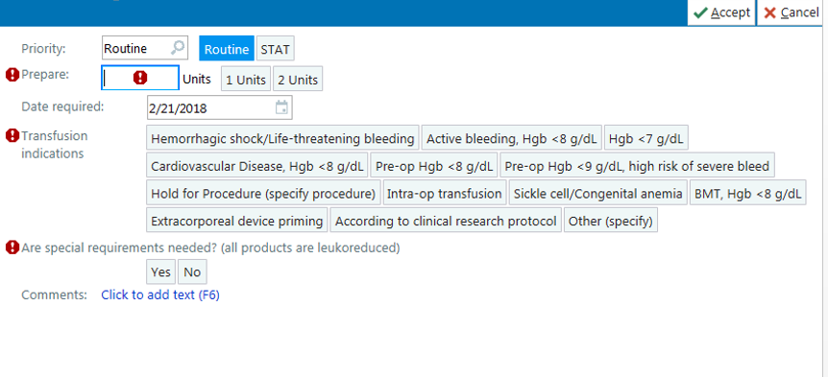
Test indications built into order
RBC transfusions
A valid indication must be selected.
Requests outside indications must be justified.

Slide 23
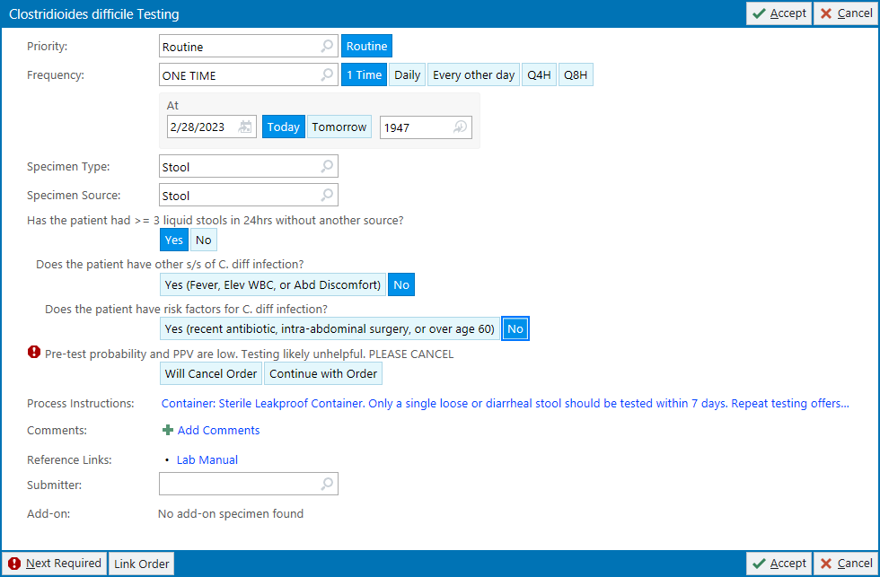
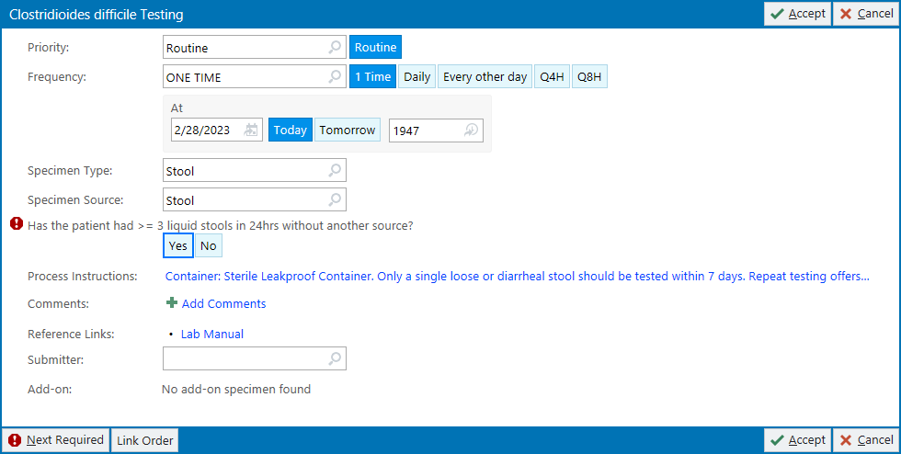
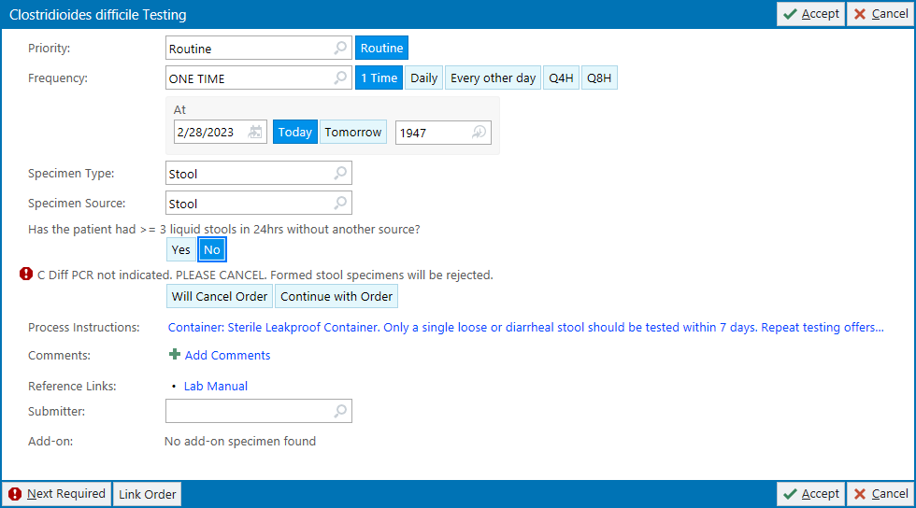
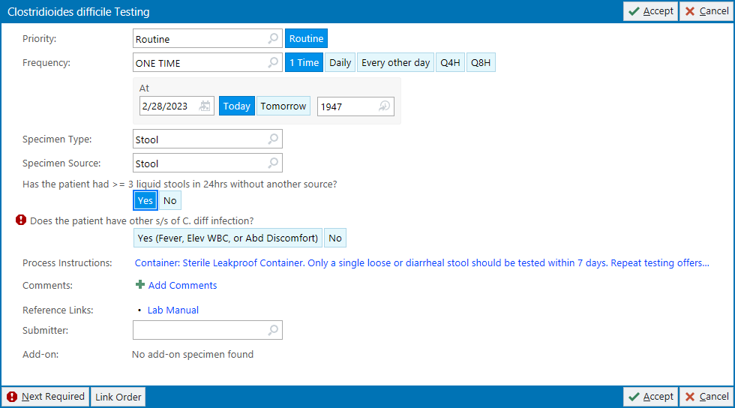
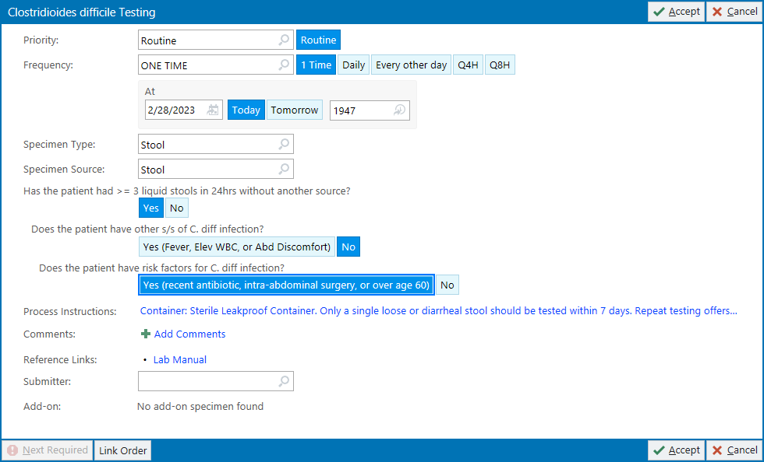
Order templates/instructions
C. difficile testing

Slide 24
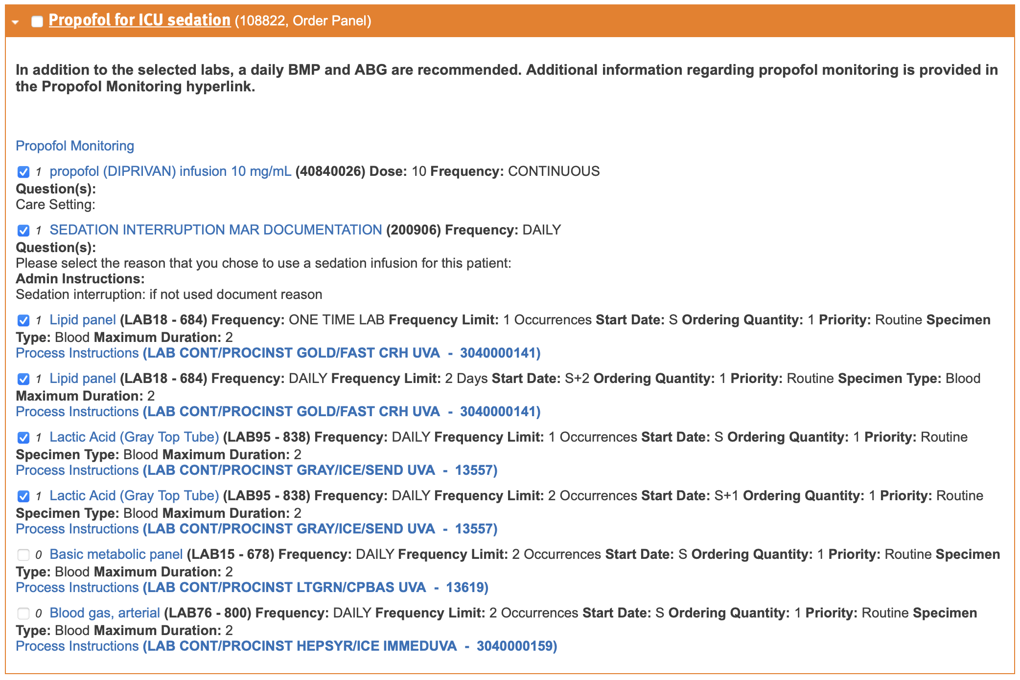
Order sets to guide test selection
Propofol monitoring
Increased triglycerides with pancreatitis, rare propofol infusion syndrome (metabolic acidosis, rhabdomyolysis)
Monitor triglycerides, be alert for other changes
Existing order set
Combines drug and lab orders
Daily lipid panels
Daily lactic acids
Propofol monitoring hyperlink was dead
Notes:
Hide this slide for presentations, show for handouts/PDFs.

Slide 25
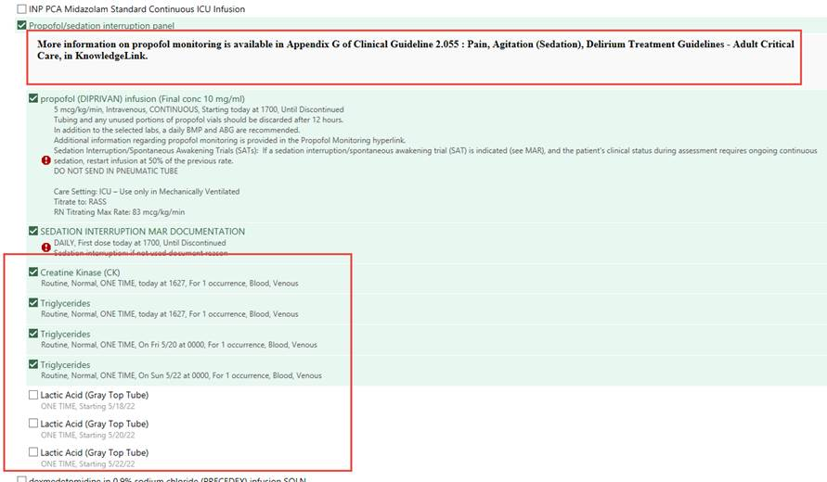
Order sets to guide test selection
Propofol monitoring
Increased triglycerides with pancreatitis, rare propofol infusion syndrome (metabolic acidosis, rhabdomyolysis)
Monitor triglycerides, be alert for other changes
Reference to guideline
Existing order set
Combines drug and lab orders
Daily lipid panels
Daily lactic acids
Propofol monitoring hyperlink was dead
Baseline CK by default
TG q 48 hr x 3 by default
Lactic acid q 48 hr x3
not default
Notes:
Order sets can drive inappropriate testing if not well-constructed.

Slide 26
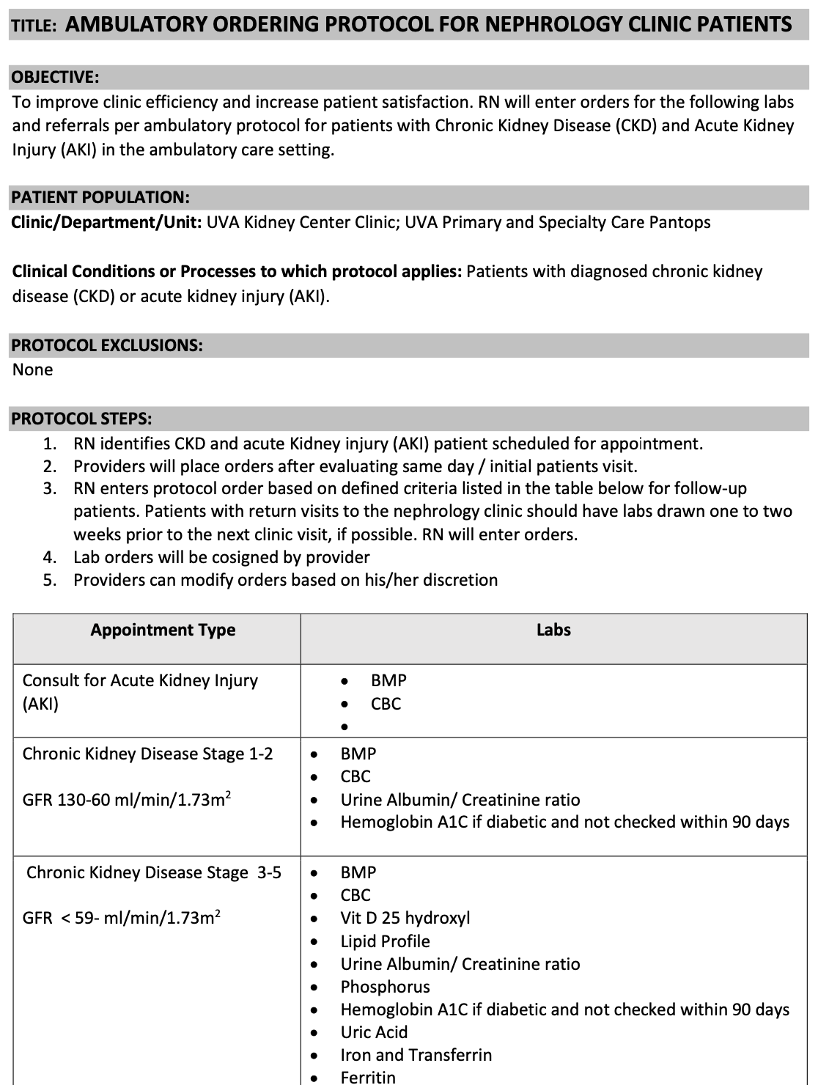
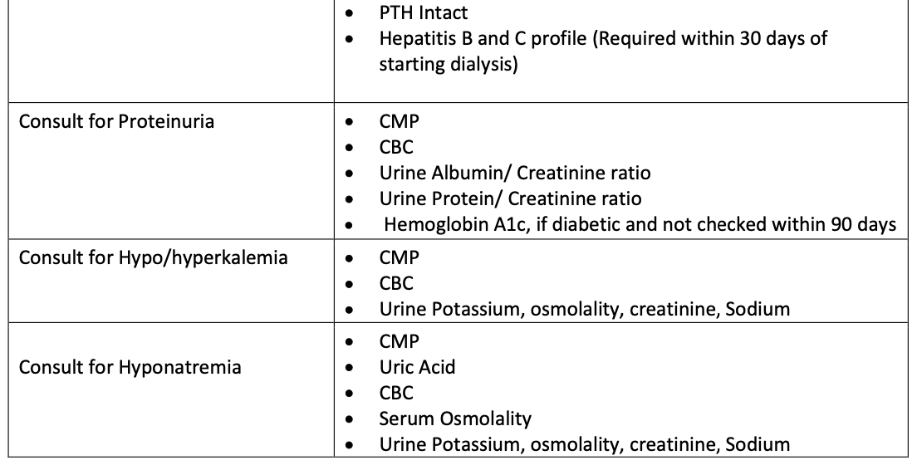
Protocol orders
Instructions for the choice of orders
and order sets based on
defined patient characteristics
Reviewed and formally approved by
the clinical staff
Allows ordering by non-physicians
Can “lock in” good or bad ordering practices

Slide 27

Reflex orders
Pre-defined order sequence usually dependent on intermediate results
Process efficiency when the follow-up order is known
  Often has a “screen-confirm” pattern executed by the lab
  Can prevent incorrectly ordering the confirmatory test first
Must be requested and formally approved by the clinical staff
Examples
  TSH reflexes to free T4 if < 0.45 or > 4.5
  Calcium reflexes to intact PTH if abnormal
  Urine buprenorphine reflexes to urine fentanyl if there is a suspicious peak
  The Solid Tumor Expanded Panel (STEP) reflexes to pyrosequencing prioritizing EGFR, BRAF, and KRAS if DNA recovery is inadequate for STEP

Slide 28

Order alerts
Messages that appear during CPOE in response to order provider activity, to direct or re-direct ordering behavior
Non-interruptive: does not interfere with provider workflow
  Available supplemental information
  Infobutton (HL7: context-aware knowledge retrieval application)
  “Hover” text
Interruptive: prevents further action in workflow until addressed
  “Soft stop”: may be bypassed by provider after acknowledgement
  “Hard stop”: cannot be bypassed, must accept one of the offered actions
Infobutton graphic from Wikimedia Commons

Slide 29
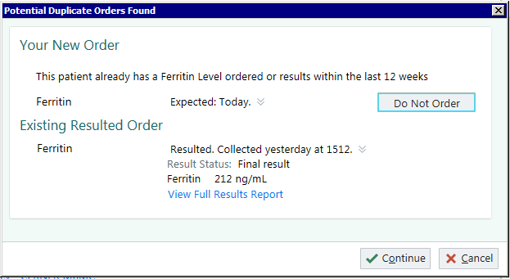
Order alert (soft & hard stops)
Duplicate check alert that can be dismissed (soft stop)
Notes:
Slide for handout. Hide this slide for presentation.

Slide 30
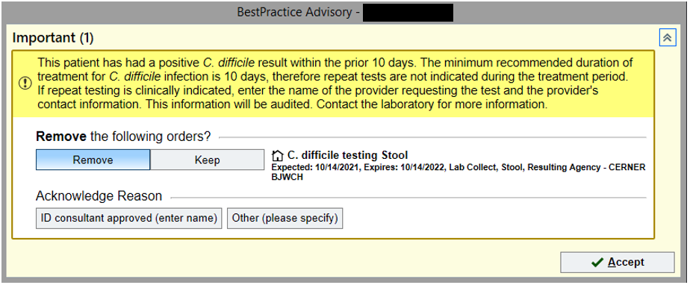
Order alert (soft & hard stops)
Duplicate check alert that can be acknowledged or dismissed (soft stop)
Alert with required entry (hard stop)

Slide 31
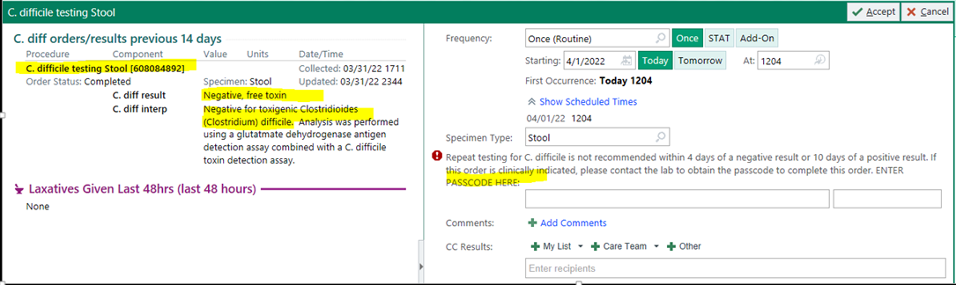
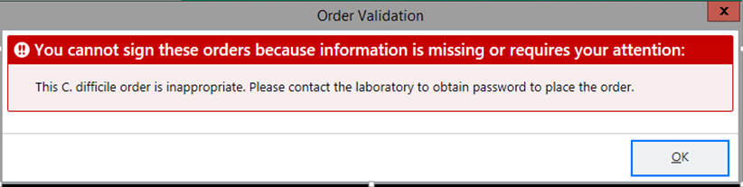
A really hard stop
Correct passcode must be entered to proceed with the order. Entering no or incorrect passcode results in:
Orig. developed by Victor Brodsky, MD

Slide 32
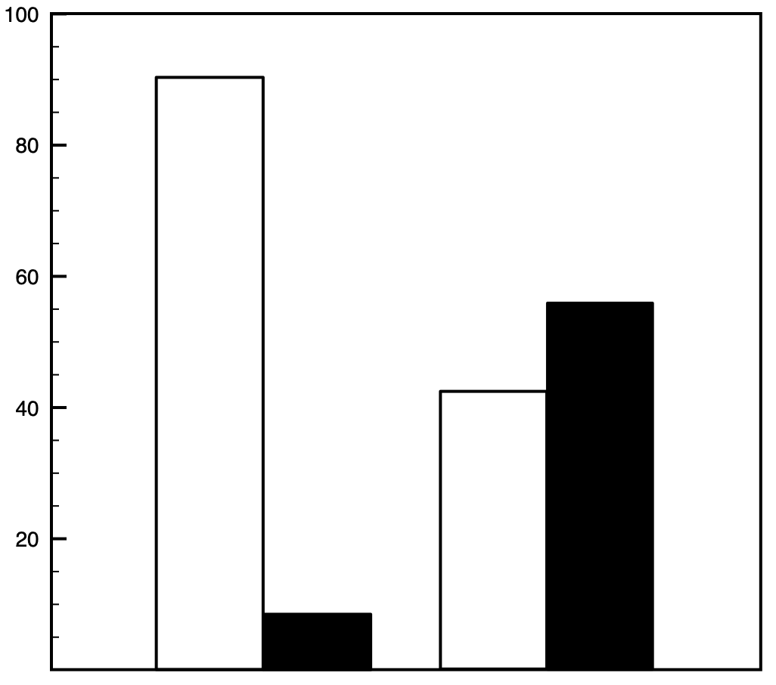
Hard vs. soft stop effectiveness
12-month review of hard and soft stop alerts to prevent duplicate ordering of >1,000 lab tests deemed rarely necessary within 24 hours
Hard stop
5,405/5,858 averted
$94,225 saved
$16.08/alert
92%
Soft stop
5,669/12,990 averted
$45,681 saved
$3.52/alert
Duplicate tests avoided
Duplicate orders placed
56%
Percent of orders
44%
8%
Hard stop
Soft stop
Adapted from Procop GW et al. Reducing duplicate testing: A comparison of two clinical decision support tools. Am J Clin Pathol. 2015;143:623-626. doi:10.1309/AJCPJOJ3HKEBD3TU

Slide 33
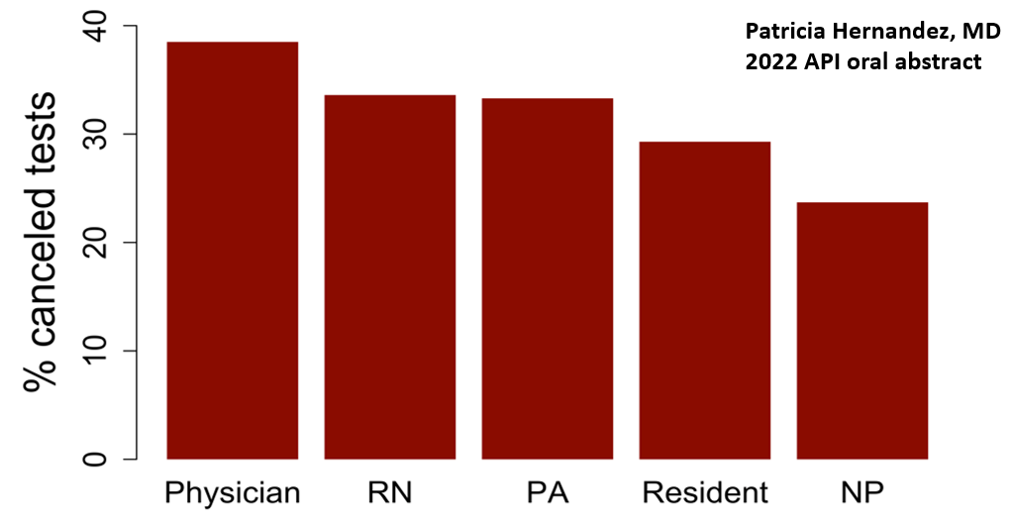
Alert acceptance rates differ by provider role C. difficile test alerts
Used with permission

Slide 34
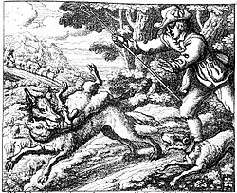
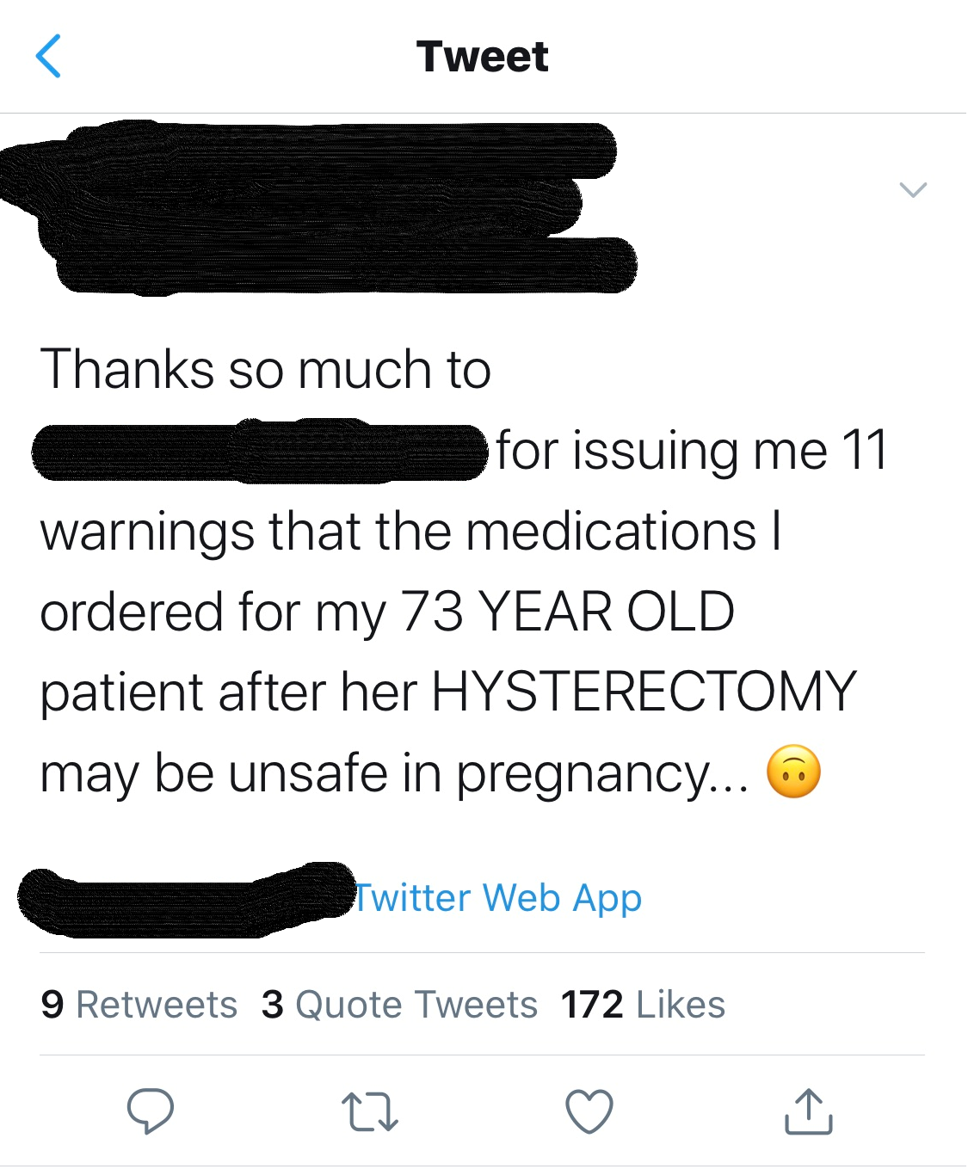

Common problems with CDS
Alert fatigue
  Desensitization to alerts because of volume and/or low value
  May limit response to future alerts (“crying wolf”)
  Poorly designed alerts may negatively affect well-designed alerts
    Monitor alert frequency and response rate, and adapt if necessary
    Balance sensitivity (true positives/real positives) and positive predictive value (true positives/all positives)
Automation bias
  Over-reliance based on perceived authority of alert message
  Risk compensation: expectation of a safety net
  De-skilling: loss of ability to make own judgements
Wikipedia
#medtwitter

Slide 35
Alert fatigue
High volume, low PPV
High overrides
Alerts perceived as not valuable
Alert response commonly declines
Automatic dismissal
Affects other alerts
Tang MS et al. AABB Annual Meeting. 2020.

Slide 36
Critique this alert
Goal: Reduce inappropriate 1,25-dihydroxy vitamin D testing and replace with appropriate 25-OH D testing
VITAMIN D 1,25 DIHYDROXY
Commonly Confused
You ordered VITAMIN D 1,25 DIHYDROXY. What would you like to do next?
1,25 Dihydroxy vitamin D assay should be ordered in presence of renal disease, hypercalcemia or primary hyperparathyroidism (pHPT) to assess vitamin D status.
Keep VITAMIN D 1,25 DIHYDROXY?
Keep
Remove VITAMIN D 1,25 DIHYDROXY from patient order?
Cancel Order
*Note: This alert content as shown was delivered in a commercial lab CDS product.

Slide 37
Critique this alert
Goal: Reduce inappropriate 1,25-dihydroxy vitamin D testing and replace with appropriate 25-OH D testing
VITAMIN D 1,25 DIHYDROXY
Commonly confused with what?
Correct action isn’t indicated
Explanatory text makes no sense in context, and is misleading
Commonly Confused
You ordered VITAMIN D 1,25 DIHYDROXY. What would you like to do next?
1,25 Dihydroxy vitamin D assay should be ordered in presence of renal disease, hypercalcemia or primary hyperparathyroidism (pHPT) to assess vitamin D status.
Deprecated action is first
Keep VITAMIN D 1,25 DIHYDROXY?
Keep
No option to substitute correct action
Remove VITAMIN D 1,25 DIHYDROXY from patient order?
Cancel Order
No feedback

Slide 38
Corrected alert
Goal: Reduce inappropriate 1,25-dihydroxy vitamin D testing and replace with appropriate 25-OH D testing
VITAMIN D 1,25 DIHYDROXY
Commonly Confused
You ordered VITAMIN D 1,25 DIHYDROXY. What would you like to do next?
25-Hydroxy vitamin D should be ordered instead of 1,25 dihydroxy vitamin D for routine assessment of vitamin D stores and deficiency.
1,25 Dihydroxy vitamin D may be used in evaluation of bone/calcium metabolism and parathyroid function, especially in renal disease.
Replace with VITAMIN D 25 HYDROXY
Replace
Remove VITAMIN D 1,25 DIHYDROXY from patient order?
Cancel Order
Keep VITAMIN D 1,25 DIHYDROXY?
Keep
This alert was ☐ helpful ☐ not helpful
Feedback:

Slide 39
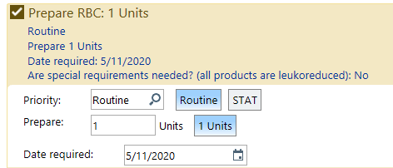
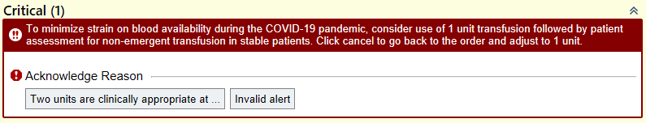
Example of success: Single unit RBC orders
Changes implemented in response to potential blood shortages during pandemic
Defaulted to 1 unit
(previously no default)
Removed 2-unit
“quick” button
Requires provider
acknowledgement

Slide 40
Impact on RBC Orders
Two-unit orders
Single-unit orders
Before
After
Tang MS et al. AABB Annual Meeting. 2020.

Slide 41
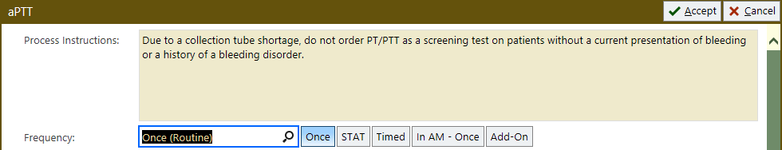
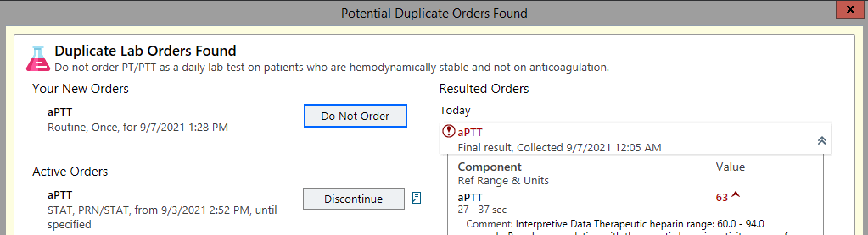
Example of success: aPTT/PT testing
Tube shortage
Routine screening
non-interruptive
Duplicate alert (<48 hr)
interruptive
Notes:
OK to use?

Slide 42
aPTT/INR orders after alerts
5000
4000
INR
Number of orders
3000
aPTT
Months
0
1
2
3
Announcement
Order changes
Adapted from Jackups R et al. Clinical decision support rapidly improves test utilization during a nationwide phlebotomy tube shortage. Clin Chem 2021;67:1426-27.

Slide 43

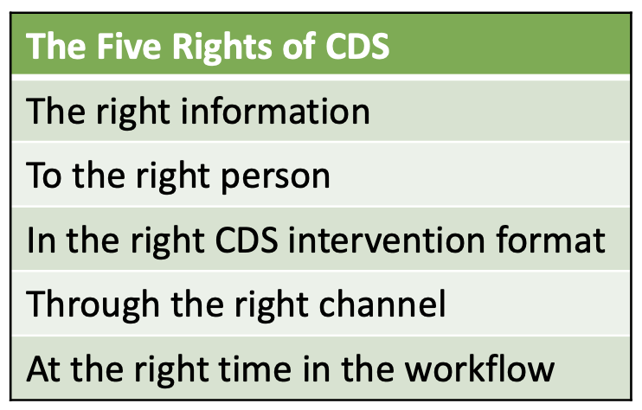
Beyond the “Five Rights”
The Ten Commandments for Effective CDS
Speed is everything.
Anticipate needs and deliver in real time.
Fit into the user’s workflow.
Little things can make a big difference.
Recognize that physicians will strongly resist stopping.
Changing direction is easier than stopping.
Simple interventions work best.
Ask for additional information only when you really need it.
Monitor impact, get feedback, and respond.
Manage and maintain your knowledge-based systems.
Bates DW et al. Ten commandments for effective clinical decision support: Making the practice of evidence-based medicine a reality. J Am Med Inform Assoc 2003;10(6):523-530. doi:10.1197/jamia.M1370

Slide 44
Evaluating the effectiveness of CDS efforts
Quality measures
  Outcome measures, e.g., total costs, mortality
    May not be sensitive enough to detect effect of CDS
    May take time to develop
  Process measures, e.g., reduction in inappropriate actions
    May not correlate to improvement in clinical outcome
Study design
  Longitudinal study: Compare outcomes before and after CDS implementation
    Bias: concurrent technological and quality improvement measures
    May require a “washout” period
  Randomized study: Implement CDS for different providers, services, or patients and compare outcomes
    Bias: Group differences vs. Hawthorne effect (awareness of being observed)
Jackups Jr R et al. Clinical decision support for hematology laboratory test utilization. Int J Lab Hematol. 2017;39(S1):128-135. doi:10.1111/ijlh.12679

Slide 45
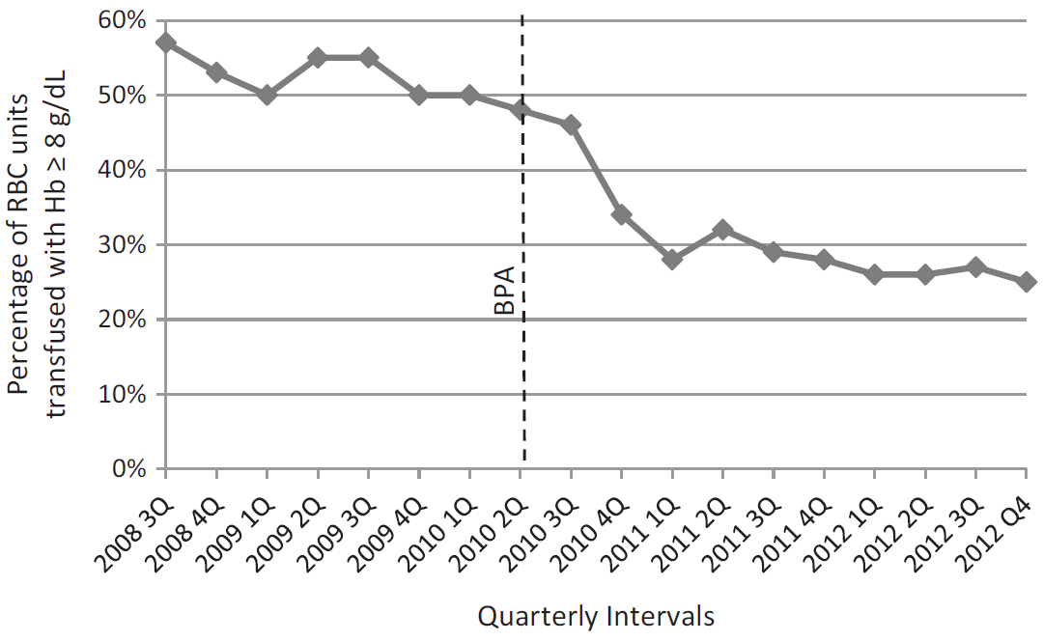
Process measure: “Appropriate” blood use
CDS
Goodnough LT et al. Improved blood utilization using real-time clinical decision support. Transfusion 2014;54:1358-65. doi:10.1111/trf.12445
Notes:
OK to use at no cost.

Slide 46
Outcome measures: mortality, LOS, cost
CDS implemented mid-2010
/1000
x1000
x1000
x10000
/100
Adapted from Goodnough LT, Shah N. The next chapter in patient blood management: Real-time clinical decision support. Am J Clin Pathol 2014;142:741-47.

Slide 47

Key Points
Clinical decision support (CDS) is a powerful tool that can improve utilization of lab testing and blood products if implemented correctly.
CDS can be delivered in several ways; the method used should be matched to the task and goal, and should consider user psychology.
Careful development and monitoring of CDS tools are required to ensure that they meet their objectives.
CDS is most effective when used as part of a program with other educational elements and incentives.
Poorly designed or unmonitored CDS will be ignored or could be harmful, and can be detrimental to other, well-designed, CDS

Slide 48

Readings
Hughes AEO, Jackups R. Clinical decision support for laboratory testing. Clinical Chemistry. 2022;68(3):402-412. doi:10.1093/clinchem/hvab201
Choosing Wisely links:
  Choosing Wisely + ASCP. https://www.ascp.org/content/get-involved/choosing-wisely/choosing-wisely-ascp#, visited 3/27/24.
  Waibel E, Garcia E, Kelly M, Soles R, Hilborne L. Systematic review of non-ASCP Choosing Wisely recommendations relevant to pathology and laboratory medicine. Am J Clin Pathol. 2018;149:267-274. doi:10.1093/ajcp/aqx159

Slide 49

Permitted uses
© 2024 James H. Harrison, Jr., and Ronald Jackups except as noted below. The original material in this slide set is made available under a Creative Commons Attribution 4.0 (CC BY 4.0) International License. The contents may be used without restriction, modified, and redistributed if they are attributed and any changes are indicated. Some graphical elements are used with permission or according to their own licenses requiring attribution. Attribution links are provided on the slide of use or on the Permitted Uses slide (this slide). These elements may be used and included in modified and redistributed work consistent with the licenses specified at the linked sites, provided that the links are included in the redistributed material.
The cover image is a composite of two laboratory images from Pixabay available for use without attribution.
Agenda, wood, technology, timer, shopping cart, target, and ten commandments icons created by Freepik – Flaticon
Decision making icons created by Uniconlabs – Flaticon
Calendar icons created by IconMarketPK – Flaticon
Stress, brain, and key icons created by juicy_fish – Flaticon
Puzzle icons created by mynamepong – Flaticon
Decision tree icon created by orvipixel – Flaticon
Book icon created by Good Ware – Flaticon

