Slide 1
Introduction to Pathology Informatics
Session 4: Interfaces and Interoperability
James Harrison, MD PhD
University of Virginia
2023
API distribution, version 1.0.2
Notes:
These 10 slide sets and term lists are being provided through the Association for Pathology Informatics (API) with a license that allows free use, modification, and redistribution with attribution (see the permitted uses slide at the end of each presentation). The design has been kept relatively basic to make editing and adaptation easier. Users are encouraged to modify and improve the slides, share the changes (with attribution of the original material), and possibly contribute the improved slide sets back to the API or other distributors. As designed, the slides are relatively wordy so that they are easier to follow without an instructor’s guide (though one may appear in the future). Feel free to edit the slides to streamline them and optimize them for local teaching style and available time. Some sessions contain optional slides with extra detail, and these are indicated in the slide notes. Some sessions contain slide builds (most are simple) that don’t print well; these sessions have optional slides for printing, and these are indicated in the slide notes.
The goal of these slide sets is to provide foundational information that will allow pathology trainees to more effectively learn and practice pathology, not to teach the performance of specific tasks in pathology. The overall learning objectives are listed on the third slide of session 0 with some explanatory comments in the notes. Subsequent sessions have agendas but not separate learning objectives because the learning objectives remain the same.
The slides have been used with a teaching schedule in which the orientation is given during the summer and then the remaining sessions are give once a month (with lunch) from September to May. They could also fit into a 2, 4, or 5-6 week teaching module if taught on a weekly/semiweekly basis.

Slide 2
Interoperability agenda
Computer interfaces and interoperability
Data standards and SDOs
Network communications and data exchange
Data interoperability and standardization
Data models
Syntax and formatting
Semantics and code systems
AP interoperability: CAP Cancer Protocols
Clinical interoperability of laboratory data
Interoperability regulations
Notes:
This session includes a number of optional slides (indicated in the notes) that can be included or not depending on how much detail is desired.

Slide 3
What is a computer interface?
Functional connection between devices that allows programs to share data for processing
Hardware connection for electrical communication
Translation of data from one encoding to another
Hardware interface
Between two devices: Serial or parallel connection
Shared between multiple devices: Network connection
Software interface
Translate complex data and requests for data processing services across hardware connections
Lab examples:
Instrument interface (instrument to middleware or LIS, hardware and software)
System interface (LIS to EHR when separate systems, software with network connections)
Hardware
connection
Translation

Slide 4
Interoperability
Data transfer between systems in an accurate and usable form
Syntactic interoperability
Common data representation
Data elements are correctly identified
Semantic interoperability
Meaning is correctly assigned to data values
Interoperability is necessary for fully integrated care, large scale outcomes assessment, broadly applicable decision support, and generalizable machine learning
Syntactic and semantic data standards are required for interoperability
Interoperability
Notes:
Syntactic interoperability: accurate transmission of data; Semantic interoperability: software can use the transmitted data correctly

Slide 5
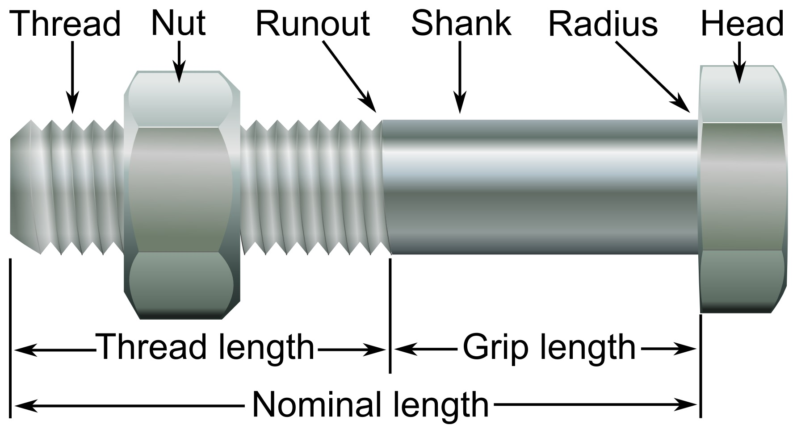
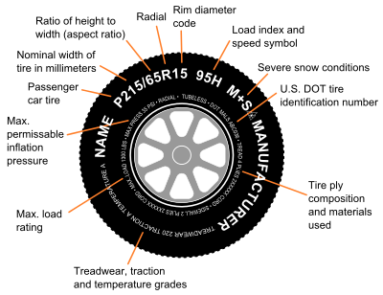
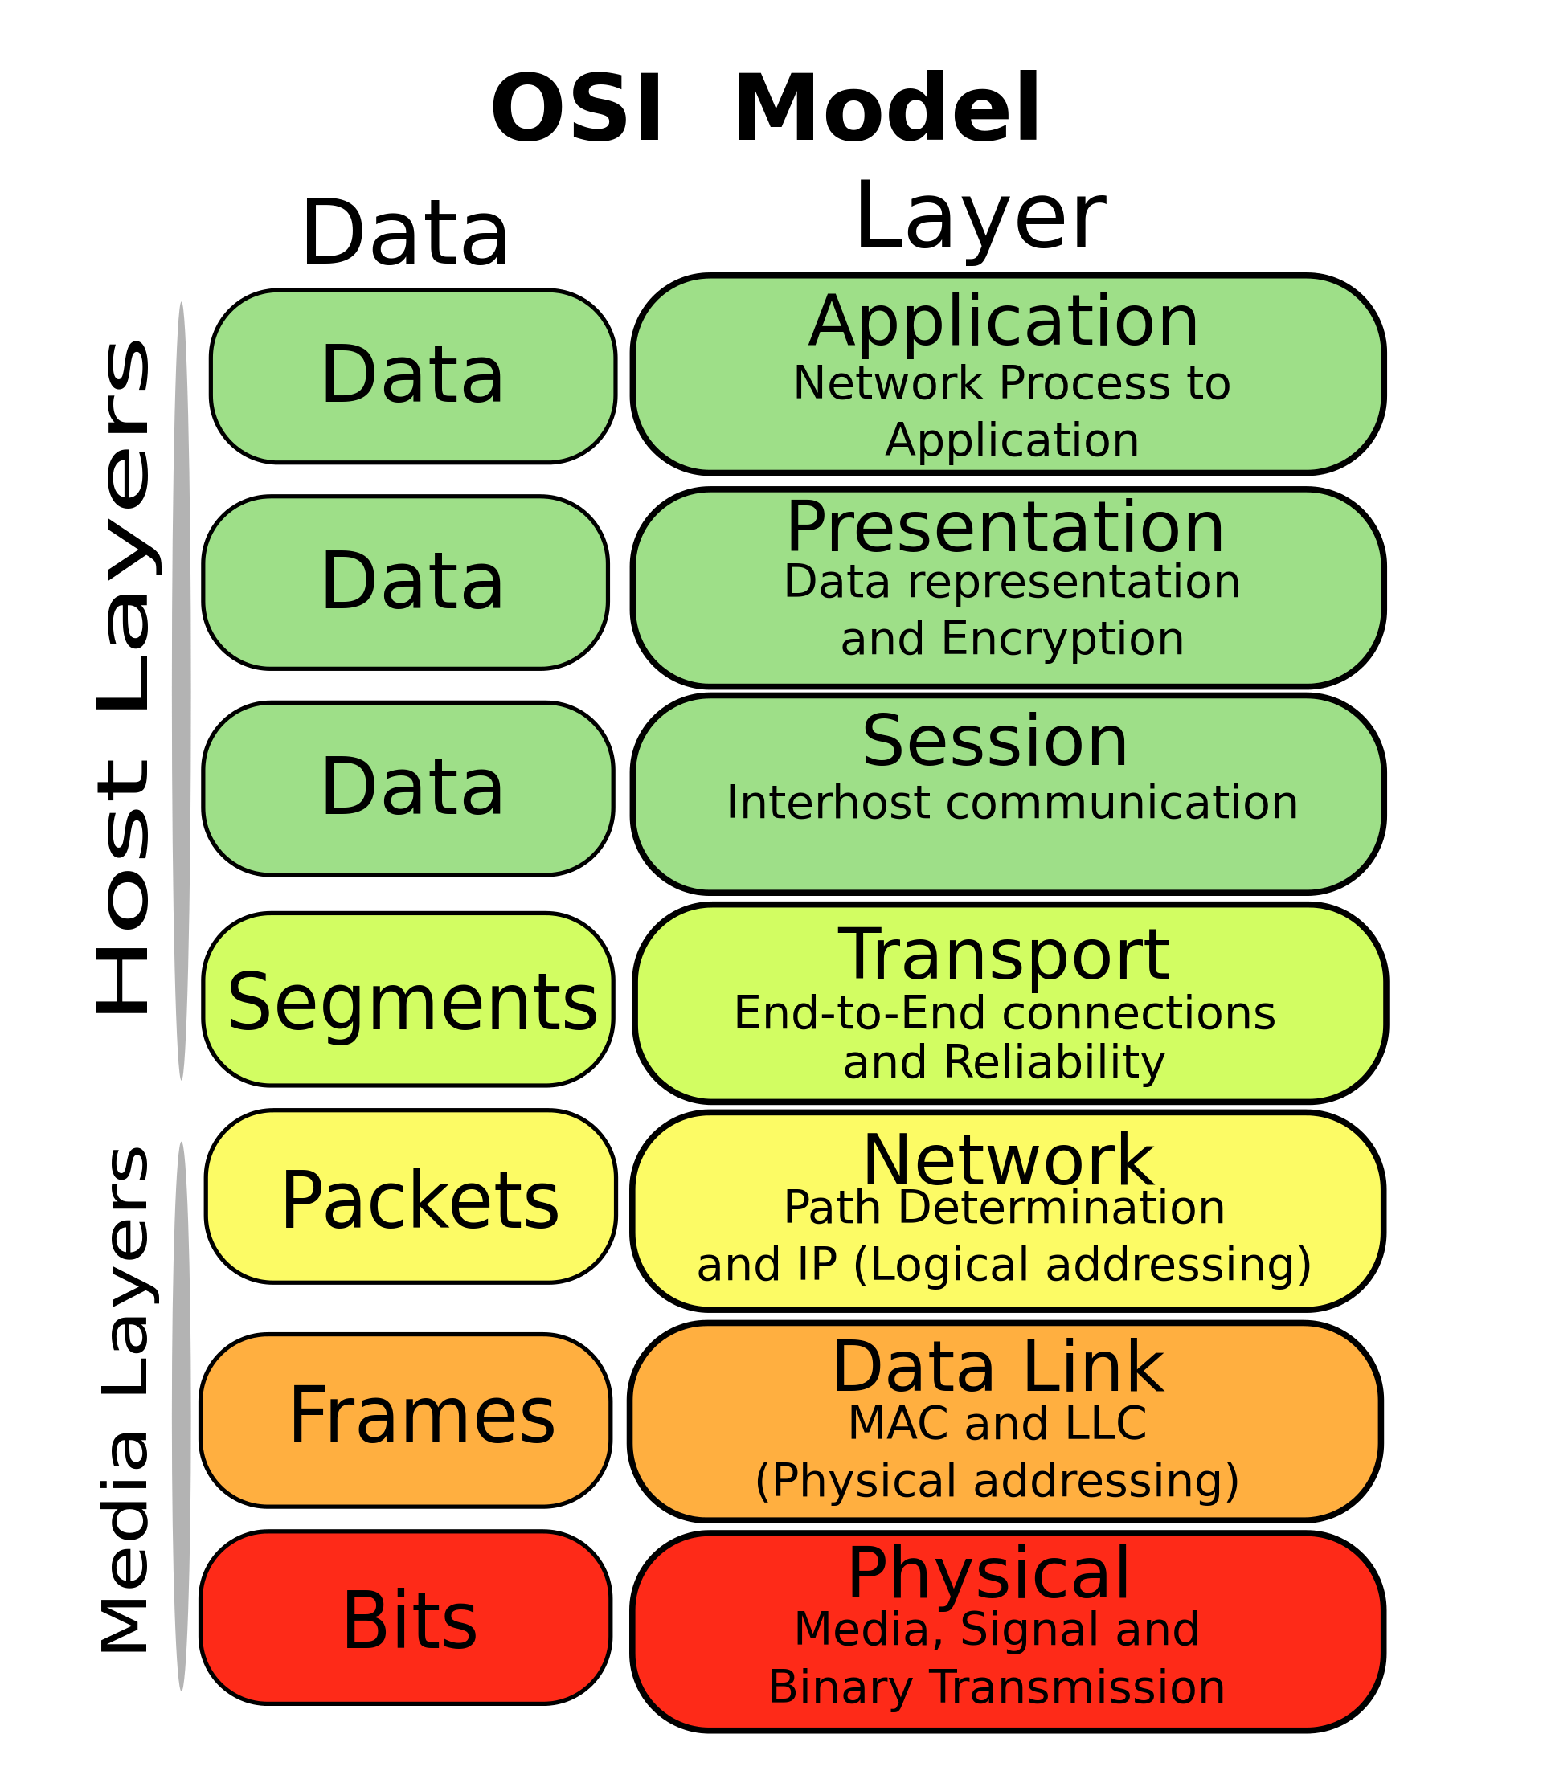
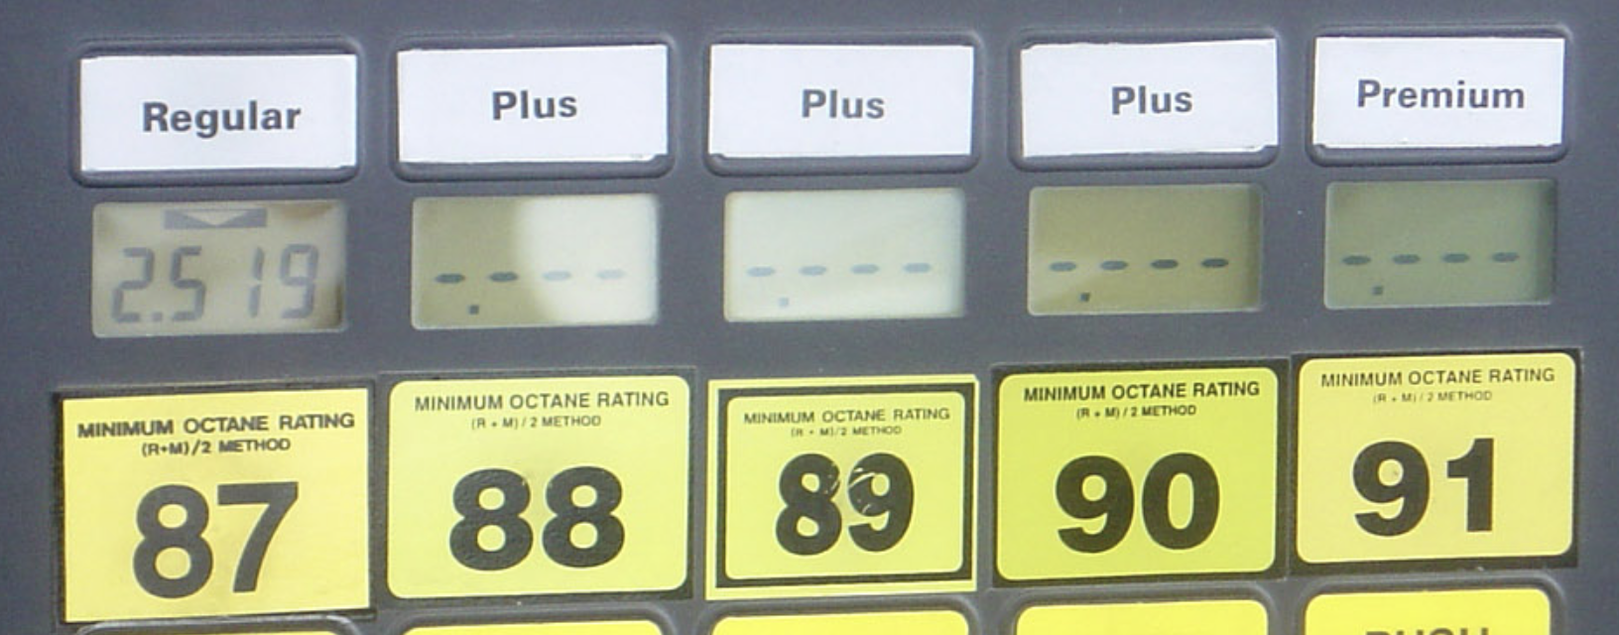
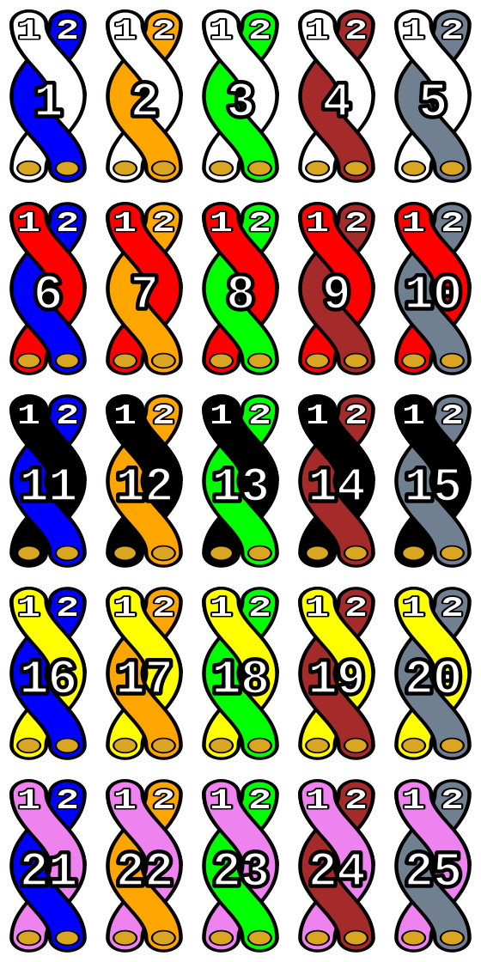
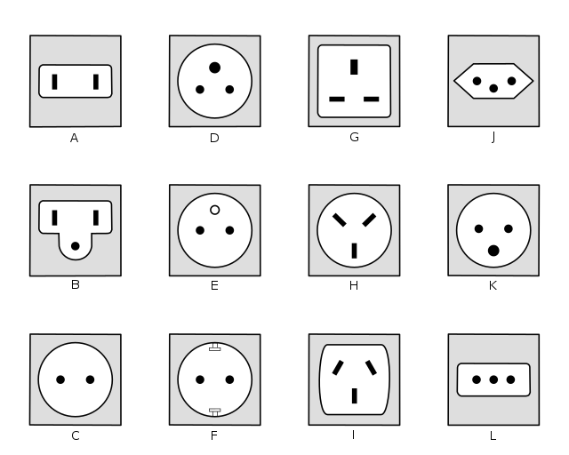
The world runs on standards
Examples
Bolt/screw threads
Traffic signs
Tire sizes
Gasoline formulation
Electrical plugs
Cable wire identification
Computer networking
De facto vs. de jure standards
“Industry standard”
Notes:
Comment on standards organizations and standards development, examples of de facto and de jure standards.

Slide 6
Standards Development Organizations (SDOs)
Wikipedia lists 86 international, 21 regional, and 126 national SDOs
Open standards development process
Examples: ISO, NIST, ANSI, IEEE, ASTM
Important in healthcare (about 40 SDOs) and pathology informatics
Health Level 7 (HL7) – health data communication standards
SNOMED International – terminology standard originally developed by CAP
Regenstrief Institute (LOINC codes and UCUM) – test names and units
DICOM – digital imaging
IHE – communication “profiles” that aggregate standards into transactions that accomplish tasks

Slide 7
Computer network interface standards
System-system communications via networks
Convert from data representation at the application level to data rep. that can be transmitted
Transmit accurately and verify receipt
OSI networking “stack,” layered software using standards for data conversion and communication
Application programs request transmission in standard ways
Layers can be swapped out conveniently to meet communication needs
7
6
5
4
3
2
1
Notes:
Example of swapping layers: Standard wired vs. wifi vs. fiberoptic communications. Applications don’t have to worry about the differences.
OSI: Open Systems Interconnection

Slide 8
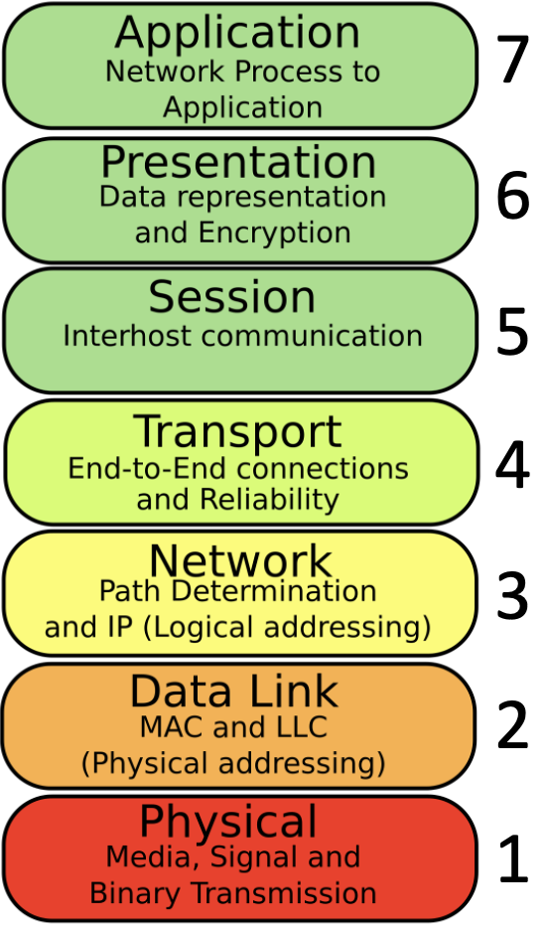
Network interface data flow
Sending Application
Receiving Application
This strategy reliably transfers data between systems.
Is it adequate for Interoperability?
Data flow
Data flow
Data flow
Notes:
Not adequate if the programs are different and use different data representations.

Slide 9
Looking deeper: Exchanging documents
Text files (character sequences)
ASCII and Unicode for character representation
Line endings depend on operating system
Formatted text with mixed primary data and formatting information
Standards: OpenDoc, Docx
RTF, published proprietary Microsoft format
De facto “standards”
Formatted text with separation of data and formatting information
Standards: XML (various flavors), html, with Cascading Style Sheets (CSS)
Can allow both effective presentation and effective data extraction
PDF (Portable Document Format)
A version became an open standard in 2007
Designed for display of text and graphics on a page
Not designed for accurate transmission and re-use of data between and by systems
Notes:
Optional for more detail

Slide 10
Looking deeper: Database data exchange
Most health information systems are database systems
Database systems work with data elements (fields) and records
How do database systems exchange data?
Data is extracted from one database and inserted into another database
Data elements must be recognized and represented accurately (syntax)
Meaning of data element content must be correctly understood (semantics)
If syntax and semantics differ…
Translation: corresponding data elements must be mapped (swapped)
Transformation: new values may need to be calculated if possible
System interfaces are software that carry out translation and transformation across a network connection

Slide 11
Network interface data flow
Sending Application (database)
Receiving Application (database)
Application Level
(level 7)
Health-related data elements
Health Level 7 (HL7)
Data flow
Data flow
Data flow

Slide 12
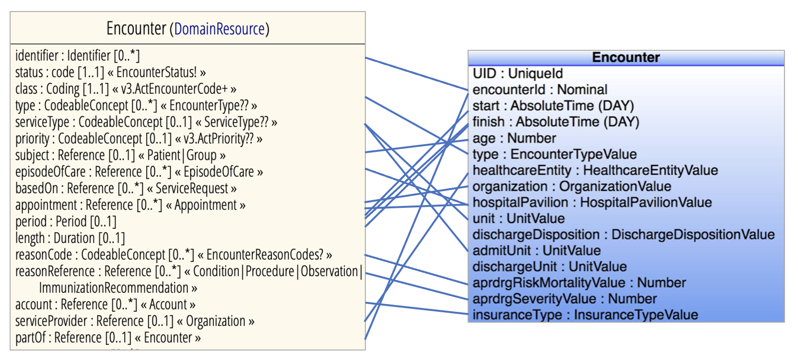
Network interface data flow
Sending Application (database)
Receiving Application (database)
Data translation
“mapping”
Data flow
Data flow
Data flow
Notes:
May involve replacing, combining, splitting data elements, or even processing data elements using logic to calculate new data elements. Some data elements may not match.
Usually done by hand now, with considerable effort and expense.

Slide 13
Individual vs. consolidated interfaces
ADT
ADT
EHR
Bill
EHR
Interface Engine
Bill
Mapping tables
Data translation tools
LIS
PHR
LIS
PHR
10 Interfaces
5 Interfaces

Slide 14
Laboratory interfaces
Instrument interfaces (relatively standardized)
Between analytical instruments and LIS or middleware
Bidirectional, receive orders & transmit results
Unidirectional, usually manual entry of testing, transmit results
Messages follow standards defined by HL7 (bi or uni) or ASTM (bi)
System interfaces (semi-standardized)
Between information systems (eg, LIS and middleware or LIS and EHR)
Bidirectional
Messages follow standards defined by HL7
Expensive and time consuming to set up, test, and manage
Not “plug-and-play” (yet…but in progress)
Notes:
System interfaces allow systems to share data and ask for data processing services
ASTM, American Society for Testing and Materials

Slide 15
Looking deeper into data interoperability
Data model
Abstract description of the organization of a data set
Data element names and relationships
Allowable content types and values
Syntax: how names and data values are represented
Semantics: the meaning of the names and data values
Standard data models for clinical use are defined by HL7 and other SDOs

Slide 16
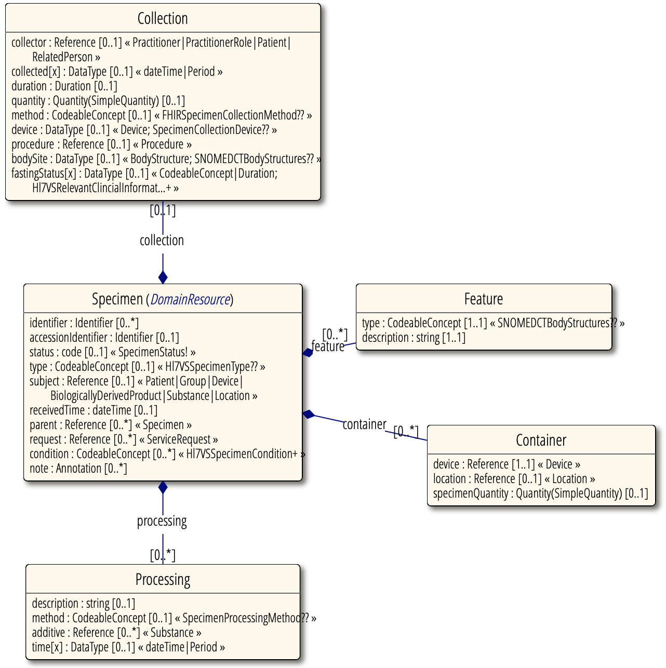
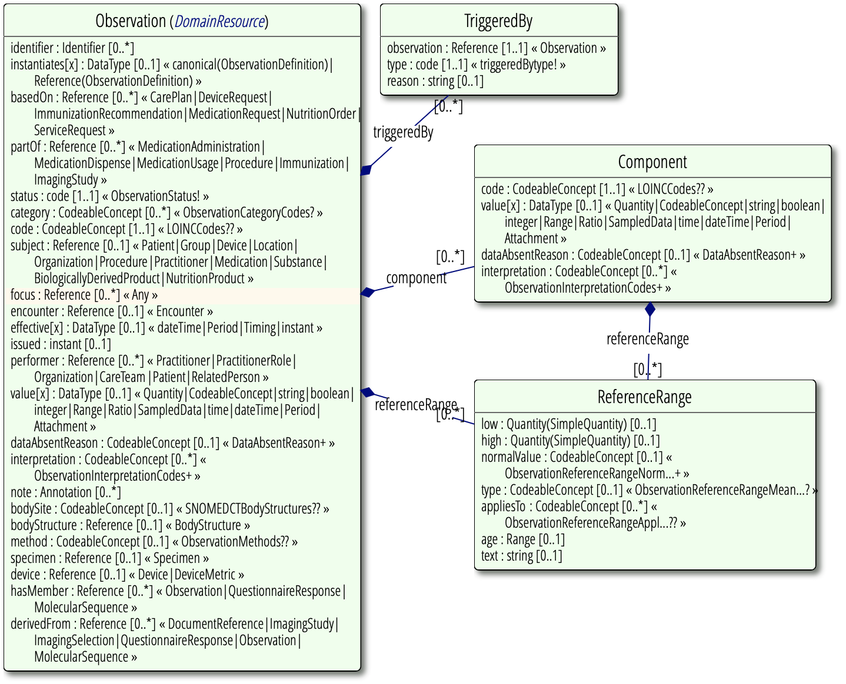
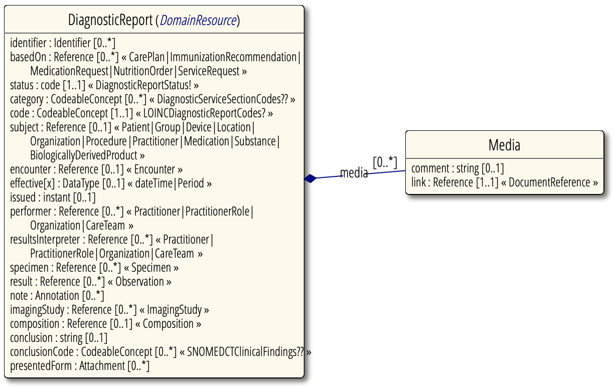
HL7 FHIR Clinical Observation
Specimen
Observation
Diagnostic
Report
HL7 FHIR Release 5 draft ballot, Diagnostics Module. https://build.fhir.org/diagnostics-module.html
Notes:
Optional for more detail. Note simple and complex data types; complex data types can contain other complex data types (Report contains Result, which is an Observation, and Specimen; Observation contains Specimen).

Slide 17
Representing data: Syntax (text structure)
Foundational technical standards
Representation of integers, floating point numbers, characters, images
Most health data currently stored and communicated as text
Text is highly flexible but is not reliably machine readable, must be constrained
Structured text: standard patterns of characters with defined meanings
Comma-separated values (CSV)
Javascript Object Notation (JSON)
Extensible Markup Language (XML)
HL7 version 2 message structure
Examples…
Previously discussed

Slide 18
HL7 v. 2 lab result message
Message structure: segments, fields, components; character delimiters
Basic metabolic panel result message (deidentified and dates removed)
MSH|^~\&|IDXLAB|UVAHSC|DADD||DateTime||ORU^R01|DateTime|P|2.2|||||
PID|||xxxxxxxx||lname^fname^mi||Date|M|^^|||||||||3116488572||
PV1||OP|STFM^||||483230^lname^^fname mi.(4201)|^||||||||||OP||||||||||||||||||||||||||DateTime||
ORC|RE|320532-0^0||||||||||4201^lname^^fname mi.(||||^||||
OBR||320532-0^0||CPBAS^BASIC METABOLIC PANEL^^CPBAS|||DateTime|||^||||DateTime|^|4201^lname^^fname mi.(4201)||||
M61675||||CHEM|F|CPBAS^CPBAS|^^^^^R|^~^~^|||||||
OBX|1|NM|NA^SODIUM|1|137|mmol/L|136-145||||F|||DateTime|UVA^|2886^AUTO^VERIFY|
OBX|2|NM|K^POTASSIUM|1|4.0|mmol/L|3.5-4.5||||F|||DateTime|UVA^|2886^AUTO^VERIFY|
OBX|3|NM|CL^CHLORIDE|1|101|mmol/L|98-107||||F|||DateTime|UVA^|2886^AUTO^VERIFY|
OBX|4|NM|CO2^CO2|1|24|mmol/L|23-31||||F|||DateTime|UVA^|2886^AUTO^VERIFY|
OBX|5|NM|BUN^UREA NITROGEN|1|23|mg/dL|8.4-25.7||||F|||DateTime|UVA^|2886^AUTO^VERIFY|
OBX|6|NM|CREAT^CREATININE|1|1.0|mg/dL|0.7-1.3||||F|||DateTime|UVA^|2886^AUTO^VERIFY|
OBX|7|NM|GLUC^GLUCOSE|1|135|mg/dL|74-99|H|||F|||DateTime|UVA^|2886^AUTO^VERIFY|
OBX|8|NM|CALCM^CALCIUM|1|9.8|mg/dL|8.4-10.2||||F|||DateTime|UVA^|2886^AUTO^VERIFY|
OBX|9|ST|GFRCAL^CALC GFR (mL/min/1.73m2)|1|>60||||||F|||DateTime|UVA^|2886^AUTO^VERIFY|
Notes:
ORC-1, Order control code; RE = Observation (performed service) to follow. What if this contains an AP report?
Limited by lack of specification of field contents, and in what can be carried in fields (field size, delimiters, formatting information)
Text reports like AP broken down into lines, one line per numbered OBX in the result field

Slide 19
Healthcare text message standards: HL7
HL7 v. 2: delimited text, widely used in the US
Limited specification of field contents: extensive mapping usually required
HL7 Clinical Document Architecture (CDA): XML documents
Based on HL7 v. 3 with a comprehensive clinical data model
Clinical data sharing
Fast Healthcare Interoperability Resources (HL7 FHIR)
Next version of HL7 messaging, may ultimately support “plug-and-play”
Web-style communications, implementations in XML and JSON
Strong specification of field contents, reduces mapping requirement
Conversion of v. 2 messages to FHIR in progress (several more years to go)

Slide 20
FHIR XML Glucose result
<Observation xmlns="http://hl7.org/fhir">
… (header sections removed)
<code>
<coding> <system value="http://loinc.org"/> <code value="15074-8"/> <display value="Glucose [Moles/volume] in Blood"/></coding>
</code>
<subject>
<reference value="Patient/f001"/>
<display value="P. van de Heuvel"/>
</subject>
<effectivePeriod> <start value="2013-04-02T09:30:10+01:00"/> </effectivePeriod>
<issued value="2013-04-03T15:30:10+01:00"/>
<performer> <reference value="Practitioner/f005"/> <display value="A. Langeveld"/> </performer>
<valueQuantity>
<value value="6.3"/>
<unit value="mmol/l"/>
<system value="http://unitsofmeasure.org"/>
<code value="mmol/L"/>
</valueQuantity>
<interpretation>
<coding>
<system value="http://terminology.hl7.org/CodeSystem/v3-ObservationInterpretation"/>
<code value="H"/>
<display value="High"/>
</coding>
</interpretation>
<referenceRange>
<low> <value value="3.1"/> <unit value="mmol/l"/> <system value="http://unitsofmeasure.org"/> <code value="mmol/L"/> </low>
<high> <value value="6.2"/> <unit value="mmol/l"/> <system value="http://unitsofmeasure.org"/> <code value="mmol/L"/> </high>
</referenceRange>
</Observation>
Notes:
Optional for more detail

Slide 21
Representing data: Semantics (text meaning)
Free text (highly flexible but not reliably machine-readable)
Text needs to be constrained to be interoperable
Standard terminologies
Formally-accepted language, nomenclature, or classification
List of terms and definitions, usually with a compact representation (code)
Standard terminology design is an important sub-domain of informatics
A standard terminology may also be a taxonomy or ontology
A set of formally-accepted terms within a domain, and…
A set of defined relationships that connect the terms
Are local terminologies (codes) necessary?
Local performance tracking and order targeting (eg, multiple local lab locations)
Notes:
Taxonomy is a classification with hierarchical relationships (more specific terms under more general terms), ontology is a set of concepts with a variety of defined relationships.

Slide 22
Desirable features for a standard terminology
Comprehensive coverage of concepts (difficult the dynamic setting of healthcare)
Terms represent specific concepts clearly (avoid vagueness, ambiguity, nonredundancy)
Terms must be permanent (not deleted or reused, can be inactive)
Terms should be non-semantic (not intrinsically meaningful)
Meaningful names can be defined as synonyms
Polyhierarchy (hierarchical with multiple parent terms possible)
Formal concept definitions
No “not otherwise specified”
Multiple granularities (general to specific concepts in hierarchy, allows grouping & rollup)
Consistent representation irrespective of path to concept
Consistent rules for combining concepts (ie, a grammar) for use in different contexts
Ability to change and be updated gracefully
Ability to recognize redundancy created by combining concepts or creation of new concepts
Cimino JJ. Desiderata for controlled medical vocabularies in the twenty-first century. Methods Inf Med. 1998;37(4-5):394-403. PMC3415631
Notes:
Nonvague: must be associated with a concept
Nonambiguous: must be associated with only one meaning
Nonredundant: each meaning must have only one canonical term
Polyhierarchy: hepatorenal syndrome
Consistent representation: one representation for a concept no matter where it is located in the hierarchy or path taken to get to it

Slide 23
Medical terminologies (of importance to pathology)
Standard terminologies
CPT
HCPCS
ICD-10
LOINC
UCUM
HL7 value sets for some message data elements
Ontology examples
SNOMED-CT (https://www.snomed.org)
Gene Ontology (GO, http://geneontology.org)
Unified Medical Language System (UMLS, NLM; terminology mapping)

Slide 24
Coding for reimbursement
Current Procedural Terminology (CPT), 5 digit numerical code
Developed and maintained by the AMA
Physician and outpatient procedures (medical, surgical, diagnostic), submitted on reimbursement claims
Procedure codes (cat I), supplemental codes for performance assessment (cat II), new techniques (cat III)
Healthcare Common Procedure Coding System (HCPCS), alphanumeric code
Developed and maintained by CMS
Level I = CPT
Level II codes cover medical products, services, and supplies not covered by CPT; 17 categories
International Statistical Classification of Diseases and Related Health Problems (ICD-10), alphanumeric code
ICD-10-CM (clinical modification), developed and maintained by the CDC
Diagnosis codes for billing and tracking diseases in public health
ICD-10-PCS (procedure coding system) CMS
Hospital inpatient procedures, not submitted on claims but used to determine DRG-related charges

Slide 25
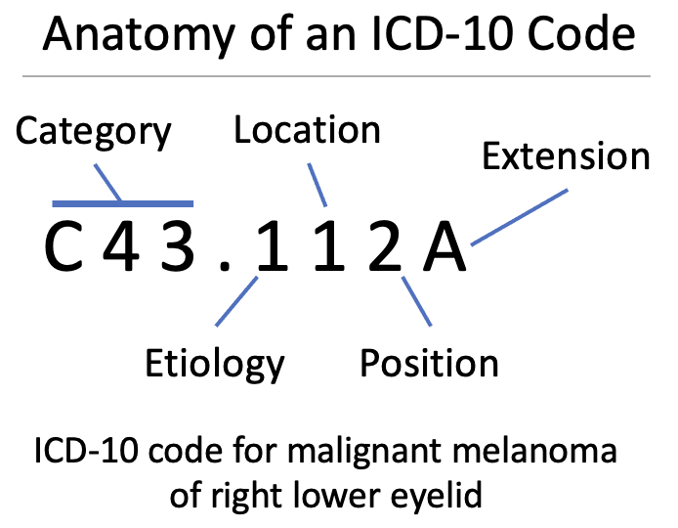
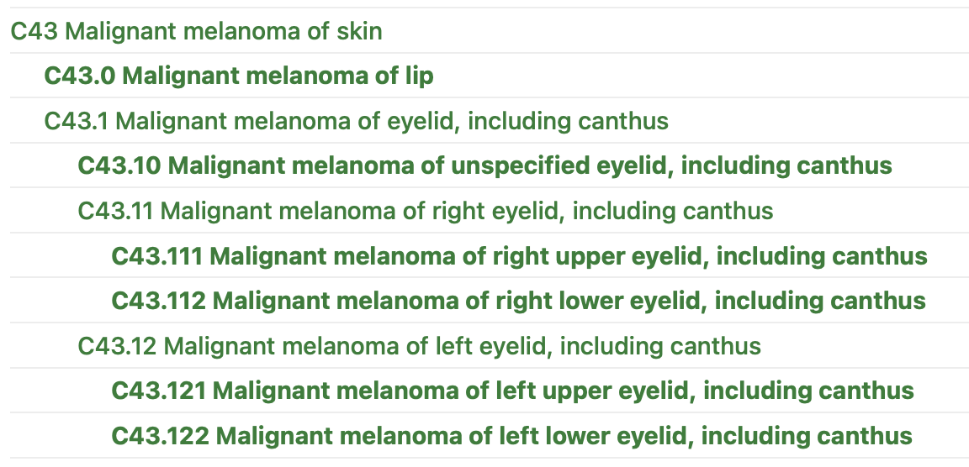
International Classification of Diseases (ICD)
ICD-10-CM Hierarchical disease names, course of care (68,000 codes)
For disease tracking, not clinical care (lacks clinical detail)
Used for population research, with limitations
1st visit
Followup
Sequelae
Alphanumeric: Etiology, location, position, etc.
CDC ICD-10 Browser, https://icd10cmtool.cdc.gov/
Notes:
ICD is a taxonomy (hierarchical standard terminology)
Extensions: 1st visit vs. subsequent visits for billing; In ICD-11 extensions can represent disease stage, severity, histopathology, treatment and other details

Slide 26
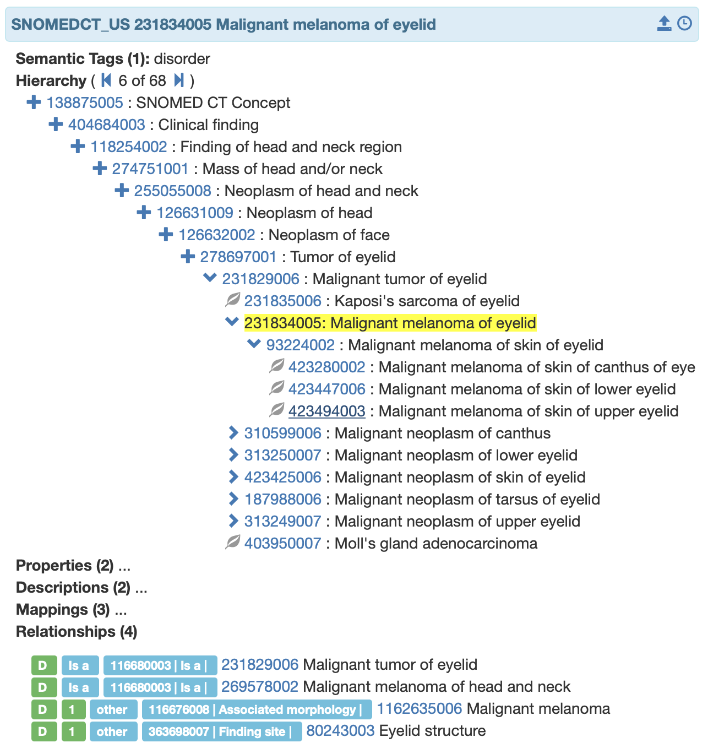
Coding for medical characteristics: SNOMED-CT
Over 350,000 numerical concept codes (concept IDs)
19 hierarchies (axes)
Ontology with > 40 relationship types, 1 million defined (is_a, causitive_agent, due_to, has_interpretation, etc.)
Not open, licensed nationally
SNOMED-CT Axes
1. Body structure
2. Clinical Finding
3. Context-dependent category
4. Environments and geographical locations
5. Event
6. Linkage concept
7. Observable entity
8. Organism
9. Pharmaceutical / biologic product
10. Physical force
11. Physical object
12. Procedure
13. Qualifier value
14. Record Artifact
15. Social Concept
16. Special concept
17. Specimen
18. Staging and scales
19. Substance
SNOMED US Edition Terminology Server, https://snomed.terminology.tools/terminology-ui/index.html
Notes:
Disease is a clinical finding, there are more than 1 million defined relationships; is_a relationships make it a taxonomy, other relationships make it an ontology

Slide 27
LOINC: Logical Observation Identifiers Names and Codes
Open standard codes for lab tests and other observations (lab/rad/PE)
Mandated by regulation (MU, MIPS)
Indicates what is being measured, the matrix for measurement, and the kind of measurement
No information about the result value or reference range
Initially a flat list
No hierarchy or relationships
Current efforts to connect to SNOMED
Initially individual test/result only
Now order, panel order, result
5193-8:Hepatitis B virus surface Ab:ACnc:Pt:Ser:Qn:EIA
(LOINC fully-qualified name)
5193-8 | LOINC Code
Hepatitis B virus surface Ab | Component
Acnc (arbitrary conc.) | Property measured
Pt | Timing
Ser | System
Qn | Scale
EIA | Method*
There are six LOINC axes
*Method is optional
Notes:
MU: Meaningful use; MIPS: Merit-based incentive payment system

Slide 28
Limitations in LOINC
Curation has been lax and by non-laboratorians (overlapping codes)
Method optional, different codes with and without methods
Assigning codes can be difficult and time-consuming
Up to 20% of assigned LOINC codes may be erroneous
Most labs not fully “mapped” (reg requirement based on test volume)
Lack of a natural hierarchy or other method for aggregating similar tests
Does not guarantee clinical equivalence of results (safety issue)
Limitations for representing genomics testing (dynamic gene panels)

Slide 29
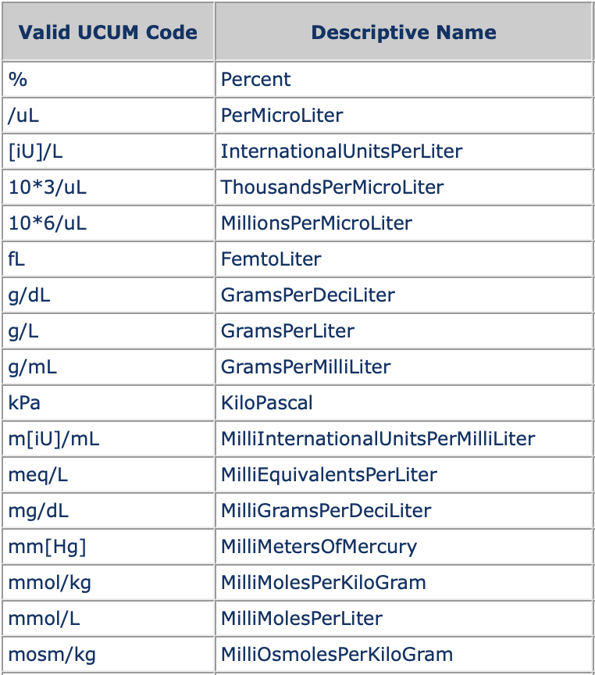
UCUM
Unified Code for Units of Measure
https://ucum.org
Consistent grammar and syntax rules for representing units with standard text characters
Broad range of units represented
Relatively simple for most common units
See Schadow and McDonald. The Unified Code for Units of Measure. https://ucum.org/ucum.html
UCUM examples: https://ucum.nlm.nih.gov/example-UCUM-Codes-v1.4.pdf

Slide 30
AP Interoperability: CAP Cancer Protocols
Questions and responses for cancer sign-out and biomarker reporting
Written and edited by CAP, 101 protocols over 14 organ systems/contexts
Expresses much of the information in pathology reports as name:value pairs in a structured report (XML)
Questions designated by “C-keys” (codes) with defined answer lists
Electronic form (electronic Cancer Protocols, eCP) for import into LIS
Standardizing the name:value pairs
Linkage of eCP with standard terminologies (U. Neb. & others)
LOINC considered for linkage to C-keys, now using SNOMED observables axis
Answers linked to SNOMED disease, structure, and clinical finding axes
Potential for interoperable AP reports with accurately sharable “Q&A”
Notes:
Optional for more detail. Electronic Cancer Protocols were formerly Electronic Cancer Checklists, eCC

Slide 31
Clinical interoperability of lab data
Test names with standard syntax and semantics
LOINC, with reservations
Test results?
Categorical results
SNOMED, HL7 value sets, standard grading/staging (AJCC)
Numerical values are not adequately defined currently
What is semantic interoperability for numerical values?
UCUM for units
Communication of method? Type of kit and kit vendor?
Standard calibration (traceability to standard reference materials) not in data model
For clinical interoperability, both the test name and the results must be syntactically and semantically interoperable
Notes:
AJCC = American Joint Committee on Cancer

Slide 32
Interoperability and information blocking
MU and MIPS for EHR previously required some use of LOINC
21st Century Cures Act (2016) requires data release in a usable form to patients and legitimate others
Failure to provide data when requested constitutes “information blocking” and will be penalized (currently driving release of data to patients)
Release of data for public health and health surveillance may have more impact on pathology in the longer term
Lab data important for national public health, disease surveillance, and quality monitoring
Likely to be requested frequently
Requirement for release in “usable form” implies interoperability with requestor systems
Notes:
MU = meaningful use; MIPS = Merit-based Incentive Payment System

Slide 33
Key points
Interoperability means that data generated in one system can be used in another system
Pathology data must be interoperable to be useful
Interoperability requires common or translatable data syntax (data models and formats) and semantics (standard terminologies and meanings)
Data is shared between interoperable systems using hardware/software interfaces and data standards
Pathology information systems are highly interfaced
A variety of healthcare data standards support local data sharing
Healthcare data standards are incomplete and still in development
Additional standards development is needed for true clinical interoperability
Greater interoperability will be required by regulation in the future

Slide 34
Readings
Harrison J. Management of Pathology Information Systems, Chapter 6. In: Laboratory Administration for Pathologists. 2nd ed. CAP Press; 2019. Data standards p. 96, System interfaces and HL7 p. 101-102, Interface management p. 107-108. Available for download from the Pathology Informatics Essentials for Residents curriculum page.
Bietenbeck A, Streichert T. Preparing laboratories for interconnected health care. Diagnostics. 2021;11(8):1487. doi:10.3390/diagnostics11081487
Stram M, Gigliotti T, Hartman D, et al. Logical Observation Identifiers Names and Codes for laboratorians: Potential solutions and challenges for interoperability. Arch Pathol Lab Med. 2020;144(2):229-239. doi:10.5858/arpa.2018-0477-RA
Torous VF, Allan RW, Balani J, et al. Exploring the College of American Pathologists Electronic Cancer Checklists: What they are and what they can do for you. Arch Pathol Lab Med. 2021;145(4):392-398. doi:10.5858/arpa.2020-0239-ED

Slide 35
Permitted uses
© 2023 James H. Harrison, Jr. except as noted below. The original material in this slide set is made available under a Creative Commons Attribution 4.0 (CC BY 4.0) International License. The contents may be used without restriction, modified, and redistributed if they are attributed and any changes are indicated. Some graphical elements are used with permission or according to their own licenses requiring attribution. Attribution links are provided on the slide of use or on the Permitted Uses slide (this slide). These elements may be used and included in modified and redistributed work consistent with the licenses specified at the linked sites, provided that the links are included in the redistributed material. The cover image is a composite of two laboratory images from Pixabay available for use without attribution.
Bolt thread, tire size, gasoline, electrical plug, wire color, and OSI images are from Wikimedia Commons (CC-BY-SA 3.0 license)
Road signs are from US DOT
HL7 online content is released with a CC-0 license
Agile, check, plug, computer, database, smartwatch, invoice, drug, doctor, and calendar icons created by Freepik - Flaticon
Compatibility icon created by LAFS – Flaticon
Patient icon created by Eucalyp – Flaticon
Telephone icon created by DinosoftLabs – Flaticon
Line graph icon created by Skyclick – Flaticon
Gaming icon (key) created by juicy_fish – Flaticon
Book icon created by Good Ware – Flaticon

