Slide 1
Introduction to Pathology Informatics
Session 3: Laboratory Information Systems (LIS) and Health Information Systems (HIS)
James Harrison, MD PhD
University of Virginia
2023
API distribution, version 1.0.1
Notes:
These 10 slide sets and term lists are being provided through the Association for Pathology Informatics (API) with a license that allows free use, modification, and redistribution with attribution (see the permitted uses slide at the end of each presentation). The design has been kept relatively basic to make editing and adaptation easier. Users are encouraged to modify and improve the slides, share the changes (with attribution of the original material), and possibly contribute the improved slide sets back to the API or other distributors. As designed, the slides are relatively wordy so that they are easier to follow without an instructor’s guide (though one may appear in the future). Feel free to edit the slides to streamline them and optimize them for local teaching style and available time. Some sessions contain optional slides with extra detail, and these are indicated in the slide notes. Some sessions contain slide builds (most are simple) that don’t print well; these sessions have optional slides for printing, and these are indicated in the slide notes.
The goal of these slide sets is to provide foundational information that will allow pathology trainees to more effectively learn and practice pathology, not to teach the performance of specific tasks in pathology. The overall learning objectives are listed on the third slide of session 0 with some explanatory comments in the notes. Subsequent sessions have agendas but not separate learning objectives because the learning objectives remain the same.
The slides have been used with a teaching schedule in which the orientation is given during the summer and then the remaining sessions are give once a month (with lunch) from September to May. They could also fit into a 2, 4, or 5-6 week teaching module if taught on a weekly/semiweekly basis.

Slide 2
LIS and HIS agenda
Database systems in healthcare
General architecture of health information systems
Pathology information systems
LIS, APLIS, and associated systems
Managing pathology systems: Building a test in the LIS
Pathology systems in the larger healthcare IT environment
Limitations of healthcare and Pathology information systems

Slide 3
Database systems in healthcare
The health care information ecosystem
Clinical core systems and ancillary/clinical-service systems
Business systems
Pathology information systems
A clinical service system
Core systems: LIS, APLIS and associated software
Blood bank, molecular diagnostics LIS and others
Outreach systems
Notes:
Clinical service systems are sometimes called “departmental” systems

Slide 4
General architecture of HIS
A client-server database system
One or more workflow systems built on top
Workflow systems support use cases
Independent vs. integrated systems
Workflow-specific
screens & data
Outpatient
Database
Queries & Updates
Inpatient
Operating
room
Database and
Database management system
(back end)
Application server
Implements workflows
Stored DB queries & updates
Client computers
User interface
Display workflows
Notes:
Independent systems have separate databases, integrated systems have a single database

Slide 5
HIS implementation
Client-server architecture
Front end and back end
Often implemented as thin clients
SaaS implementation “software-as-a-service” & “cloud systems”
“Thin” clients
Thin client
server
Web, Citrix
App
server
Database
server
(back end)
Internet
Thin client, App,
and database
servers at vendor
Clients on premises
Notes:
Add new server for workflow

Slide 6
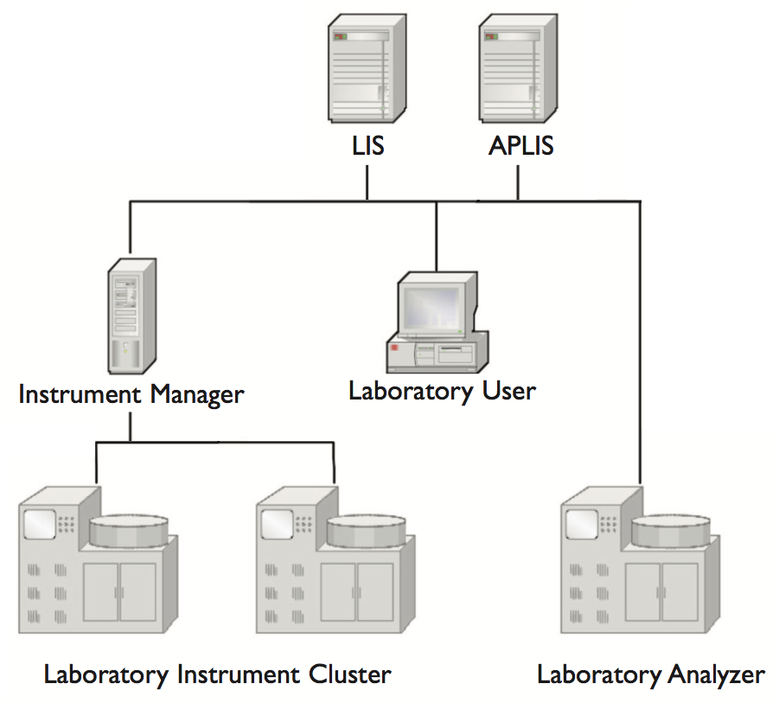
Pathology information systems
Clinical lab LIS
Clinical lab orders and results
Clinical lab workflows & operational data
Mostly discrete data elements
Anatomic pathology LIS
AP orders and results
AP workflows, incl. signout, & operational data
Discrete and natural language data
Specialized systems
On-board instrument software and computers attached to instruments/tracks
Instrument managers
Blood bank, molecular diagnostics, POC, phlebotomy, laboratory outreach, voice recognition (dictation), digital pathology*
Research support: LIMS (e.g., biobank)
Modified from Harrison J. Management of Pathology Information Systems, CAP Press, 2019.
Notes:
*digital pathology may comprise a number of systems—will be address in an upcoming dedicated session.
Standalone labs may run their own billing systems (out of scope for this talk).
LIMS: laboratory information management systems, generally used for non-clinical (research) lab systems

Slide 7
Laboratory Information Systems (LIS)
Standalone or integrated into EHR
MUMPS or relational DB
Specimen-oriented
Barcoding & labeling
Instrument and system interfaces
Workflow screens/user interface
Work/pending lists and other data views
Record selection, data entry, & update tools
QC/QA & lab management reporting
Maintenance tables
System operation and configuration
Dictionaries (data about the lab)
Record tables
Orders and Results, mostly structured data
Specimen tracking
Dictionary contents: lab information
Lab users & roles
Lab & patient locations
Clinician names & information
Instruments & connection data
Referral labs & connection data
Orders & test types
Codes/names, requirements, reference ranges, critical values, methods, billing
Specimen types & containers
Standard comments & codes
Calculations (eg, eGFR)
Rules
Autoverification, delta checks, reflex testing, duplicate order checking
Notes:
Dictionaries define what’s in all popup/selection lists
Structured data: well-defined data elements with content from controlled lists

Slide 8
Maintenance example: Building a test
Lab users request build
Collect and vet test information
Enter information into the LIS (build)
Test the build
Copy to production
Monitor

Slide 9
Requesting a test and collecting information
Issue tracking system with standard request form
Spreadsheet or online form for detailed information
Performing lab
Local code & LOINC code
Method
Order name & synonyms
Label abbreviation
Test name for report
STAT orderable?
Lab section
Order limitations (personnel, location)
Order questions (“ask at order entry”)
How to handle duplicates
How many labels to print
Collection (unit, clinic, lab, external)
Collection instructions
Shipping/handling instructions
Container type
Specimen type
Specimen source(s)
Collect volume (min)
Collect instructions
Test comments
Billing information
Reflex actions
Reference ranges
Result data type
Result units
Result precision
Critical values & call parameters
Linearity limits
Delta checks
Autoverification parameters
Calculations
Instrument/reagents
Aliquotting
QC setup
Reportable to state
Result header
Position in result tree
Interface mapping for sendouts

Slide 10
Information hierarchy
Enterprise
Facility
Laboratory
Lab section
Test
Inherited information avoids duplication e.g., label format, collection workflow

Slide 11
System “environments” isolate changes
High reliability systems have separate work environments in which changes can be made and tested without affecting routine operations
Changes in the maintenance environment(s) do not affect the operational (“production”) system until activated
Changes may be copied between environments without re-entry
LIS systems typically have separate “build,” “test,” and “production” environments to allow for ongoing change in the lab

Slide 12
Building the test
Cystatin C with eGFR – General Setup
General setup
Test information
Accessioning setup
Requisition defaults
Result setup
Result entry
Verification setup
Result reporting
Print event setup
Specialty testing
Key mappings
Reflex tests
Result checking
Order linking
Comments
Name Cystatin C
Abbreviation CYSTC
Status Active
Synonyms CYSC
CYSTC
Report name Cystatin C
Report parameters
Done by IT in the “build environment”
Create the test
Define the test parameters
Some screens are complex
Report display
and printing details
Notes:
Screen redrawn with to avoid display permission issues

Slide 13
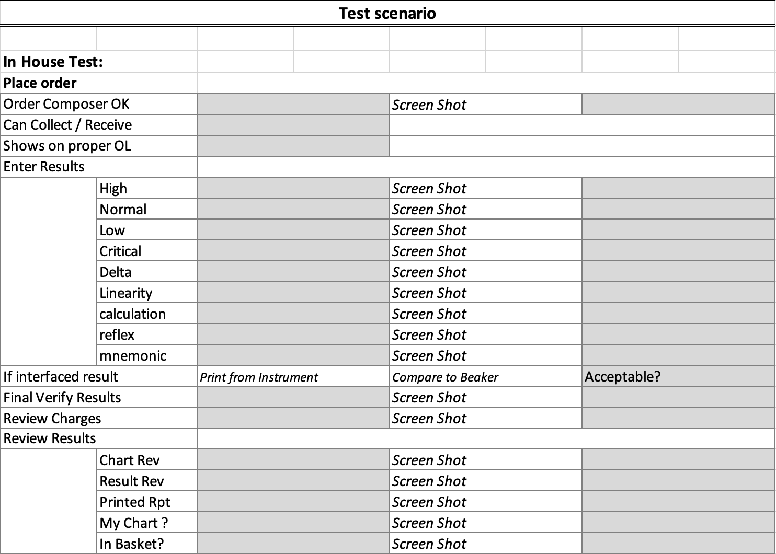
Testing the build
Carried out in the developmental environments
Test in “build” and again in “test”
Dev environments not identical to production
Document with screen shots
Review by supervisor, lab/section director signoff
Review at change control meeting
Schedule transfer to “production” environment
Copy to production environment
Testing in “production” may be awkward
Important to monitor for problems after change
Separate scenario for reference lab tests
Interface testing if applicable:
Notes:
Environments are as close as possible to production but differ from each other and production, so testing in each setting is important

Slide 14
Anatomic Pathology LIS
Case-oriented (groups containers/specimens/parts into cases)
Tissue specimen categories & types
Histology methods & protocols
Tissue/block/slide tracking
Connection to devices for cassette handling and tissue processing
Orientation to relatively unstructured textual data (text “blob”s)
Textual data entry workflow including speech-to-text and digital signature
Textual report formatting
Text search & retrieval (free text vs. coded)
Structured and synoptic reporting (CAP Cancer Checklists/Protocols)
Notes:
Case orientation requires building a case (tools provided)
Discuss report formatting problems and PDF, need to be effective on mobile devices.
Cancer checklists are adding structure to previously mostly unstructured text.

Slide 15
AP-specific build data elements
Required for setting up cases and processing workflows
Case type
Are there automatic links to other cases (by type)?
Processing tasks per block/slide
Protocols (groups of processing tasks) by case type and/or specimen
Default cassette labels by protocol
Synoptic reports by protocol
Default text comments by protocol

Slide 16
LIS/APLIS: Nuances
Specimen-oriented with an order-result paradigm
An order is usually required and is a primary trigger for system actions
Specimen, patient, physician, and order are linked in the LIS at labeling or accessioning
Label requirements: Two separate identifiers (local policy, e.g., name, DOB, MRN, account#, SS#)
APLIS may build cases at accessioning, linking multiple specimens into a case
Barcode or manual data entry at accessioning, barcode tracking after accessioning
Extensive inter-system communications (interfaces)
Instrument/track, other systems, ref labs
With separate LIS/EHR systems, patient and order data are acquired through system interfaces and results are returned for display via a system interface
The lab director must review and approve the result display in the first downstream system where clinical decisions are made (CAP accreditation requirement)
Blood bank systems require FDA approval
Special labeling requirements for specimens and products
Notes:
Order may need to be created if it doesn’t exist
In some cases, lab labels with barcodes are created at accessioning (paper requisitions)
Acceptable identifiers are defined by local policy
Expense of interfaces, standardization efforts in progress.
BB require FDA approval because they support administration of products to patients. Because of this requirement not all integrated systems provide blood bank modules.

Slide 17
Outreach systems
VPN
Outreach system
vendor site
Secure (encrypted) connections to physician offices
User interface for direct order entry and result reporting
System interface to office EHRs for order and result transfer
Map LIS order and test codes to physician system order and test codes (translation table)
Local installation or vendor supported cloud system (SaaS)
TCP/IP
Physician office
computer or EHR
VPN
connection
TCP/IP
Firewall
TCP/IP network
Modified from Harrison J. Management of Pathology Information Systems, CAP Press, 2019.
Notes:
A cloud system is shown, where clients and the lab both connect to the outreach system vendor site. The vendor is responsible for connecting with multiple client (office or clinic) systems and translating data accurately.

Slide 18
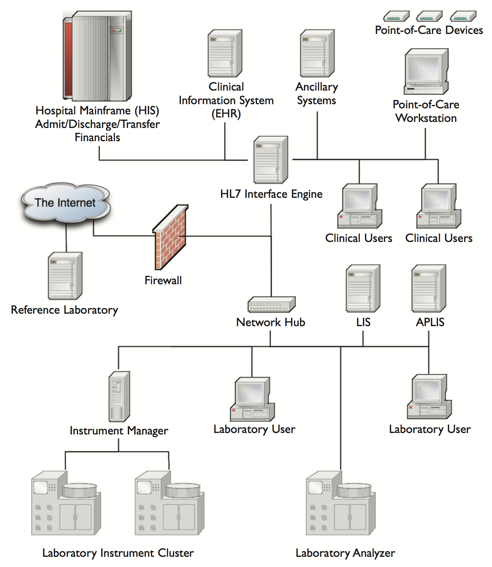
The larger context…
Connected medical systems
ADT system (may include MPI)
Electronic Health Record (EHR)
Clinical ordering (CPOE) with decision support
Laboratory results display
Ancillary (departmental) systems
Pathology LIS, APLIS
Radiology, pharmacy, OR scheduling, etc., etc.
Point of care devices
Institutional financial/billing/HR systems, etc.
Research support (CDW, CTMS)
Many system interfaces
“Interface engine” for connection
Outreach
Integrated
vs.
“Best of breed”
Modified from Harrison J. Management of Pathology Information Systems, CAP Press, 2019.
Notes:
MPI: master patient index
CPOE: Computerized physician order entry
Other foundational systems: asset and workforce management (HR), materials management, payroll
CDW: clinical data warehouse, CTMS: clinical trials management system

Slide 19
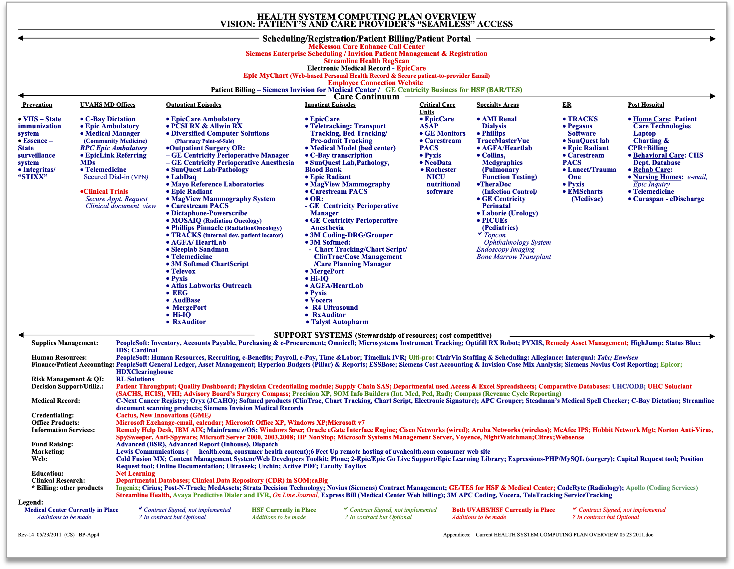
Example health IT system portfolio
Scheduling/registration/billing
Clinical Care
Public health
MD offices
Outpatient
Inpatient
Critical care
Specialty
Emergency room
Post hospital
Support systems
Supplies management
Human resources
Finance
Risk management
Dictation
Credentialing
Marketing
Web
Education
Etc.
Notes:
Optional slide for more detail

Slide 20
HIS/EHR selected additional points/limitations
Most sites have a combination of integrated and interfaced systems
Complex, extensive testing and validation is required
EHR have benefits, but design is not yet optimal (work in progress):
Clinical workflow flexibility and efficiency issues, may contribute to burnout
Search and summary capability is limited
Tracking team care and handoff of care; data/result routing (affects the lab)
Support for handheld devices at early stage of development
Coding automation remains limited
Data interoperability between applications and sites
Influence of regulatory data collection requirements (MIPS/QPP by CMS/ONC)
Functional requirements for EHR certification (not yet LIS)
Tendency to design systems satisfying regulatory and billing needs
Notes:
EHR systems are basically teenagers, with all that entails.
Initially, incentivization of EHR installation followed by Meaningful Use requirements with EHR certification to get the incentives. Then MU replaced by MIPS/QPP. Push starting now for interoperability, supported by the 21st Century Cures Act and stimulated by problems revealed by the pandemic.
Usability testing required by ONC for certification but may not have physician participants. Systems may be designed to fulfill billing, payer, and regulatory requirements rather than support efficient and effective clinical workflow. Creates a user experience laden with data entry. Buyers of systems may run down checklists of features rather than do actual usability testing or talk with end users.
Pathologists not substantially impacted by MU or MIPS/QPP (not major EHR users), labs may be impacted by future interop requirements. Requirements and incentive/penalty not clear yet.
MIPS: Merit-based incentive payment system
QPP: Quality payment program

Slide 21
Data challenges in the lab: Orders
No standard test naming strategy
How to handle duplicate and future orders
Communication of explanations, clinical data, and special instructions for specific specimens (to clinicians and to the lab)
Order sets, rules, decision support, and other complex system configurations are not tracked for currency and validity
Methods and rules for lab ordering decision support are not standardized
Correction of erroneous/miscoded orders is awkward
Notes:
Optional slide for more detail.
Interoperability problems make system interfaces more expensive and limited the use of data for decision support & artificial intelligence as well as remote care and public health.

Slide 22
Data challenges in the lab: Results
Effective display of extended text and complex lab results (surgical pathology, mol dx, micro, flow, etc.)
Restriction of laboratory data access and view can limit problem-solving
Managing the attention of physicians to important results, including communicating critical results
Interoperability of laboratory results (clinical care/public health/automation)
Notes:
Optional slide for more detail

Slide 23
Key points
Pathology operations depend critically on many IT systems
LIS and APLIS are the primary pathology systems
Many associated systems with more coming for digital pathology
Pathologists have responsibility for management and quality
LIS contain diverse information about the lab and are designed for ongoing modification to support evolving laboratory operations
The health IT ecosystem is broad & complex
ADT, EHR, billing systems are primary
Systems are functional but complex, not optimized, and still developing

Slide 24
Readings
Harrison J. Management of Pathology Information Systems, Chapter 6. In: Laboratory Administration for Pathologists. 2nd ed. CAP Press; 2019. General characteristics of laboratory information systems p. 96-97, Database applications p. 97-100. Available for download from the Pathology Informatics Essentials for Residents curriculum page.
Henricks WH. Laboratory Information Systems. Clin Lab Med. 2016;36(1):1-11. doi:10.1016/j.cll.2015.09.002
Sirintrapun SJ, Artz DR. Health Information Systems. Clin Lab Med. 2016; 36(1):133-152. doi:10.1016/j.cll.2015.09.012
Tutty MA, Carlasare LE, Lloyd S, Sinsky CA. The complex case of EHRs: examining the factors impacting the EHR user experience. J Am Med Inform Assoc. 2019; 26(7):673-677. doi:10.1093/jamia/ocz021

Slide 25
Permitted uses
© 2023 James H. Harrison, Jr. except as noted below. The original material in this slide set is made available under a Creative Commons Attribution 4.0 (CC BY 4.0) International License. The contents may be used without restriction, modified, and redistributed if they are attributed and any changes are indicated. Some graphical elements are used with permission or according to their own licenses requiring attribution. Attribution links are provided on the slide of use or on the Permitted Uses slide (this slide). These elements may be used and included in modified and redistributed work consistent with the licenses specified at the linked sites, provided that the links are included in the redistributed material. The cover image is a composite of two laboratory images from Pixabay available for use without attribution.
Agenda and database icons created by Freepik – Flaticon
Server icons created by Sumitsaengtong and Vector Squad – Flaticon
Workstation icon created by Muhammad Ali – Flaticon
Strategic-plan icon created by Nualnoi Kinkaeo – Flaticon
Brick icon created by Smashicons – Flaticon
Testing icon created by smashingstocks – Flaticon
Production icon created by Icon home – Flaticon
Monitoring icon created by Afian Rochmah Afif – Flaticon
Gaming icon (key) created by juicy_fish – Flaticon
Book icon created by Good Ware – Flaticon

