Slide 1
Introduction to
Pathology Informatics
Session 2:
Databases
James Harrison, MD PhD
University of Virginia
2024
API distribution, version 1.0.2
Notes:
These 10 slide sets and term lists are being provided through the Association for Pathology Informatics (API) with a license that allows free use, modification, and redistribution with attribution (see the permitted uses slide at the end of each presentation). The design has been kept relatively basic to make editing and adaptation easier. Users are encouraged to modify and improve the slides, share the changes (with attribution of the original material), and possibly contribute the improved slide sets back to the API or other distributors. As designed, the slides are relatively wordy so that they are easier to follow without an instructor’s guide (though one may appear in the future). Feel free to edit the slides to streamline them and optimize them for local teaching style and available time. Some sessions contain optional slides with extra detail, and these are indicated in the slide notes. Some sessions contain slide builds (most are simple) that don’t print well; these sessions have optional slides for printing, and these are indicated in the slide notes.
The goal of these slide sets is to provide foundational information that will allow pathology trainees to more effectively learn and practice pathology, not to teach the performance of specific tasks in pathology. The overall learning objectives are listed on the third slide of session 0 with some explanatory comments in the notes. Subsequent sessions have agendas but not separate learning objectives because the learning objectives remain the same.
The slides have been used with a teaching schedule in which the orientation is given during the summer and then the remaining sessions are give once a month (with lunch) from September to May. They could also fit into a 2, 4, or 5-6 week teaching module if taught on a weekly/semiweekly basis.

Slide 2

Databases agenda
Quick review of basic data types
Definition of databases and
database management systems
Why databases? … Specialized database functions
Types of databases and their properties
Database system components

Slide 3

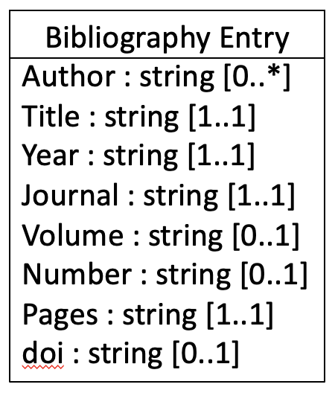
Review: Data types
Basic data types
  Boolean 0,1 or T/F
  Integer 1, 2, 3…
  Floating point 1.2
  Character “A” (ASCII or Unicode standards)
  Character string “Doom tuba of news.”*
Complex data type
  Data class
*Colbert, S. “Meanwhile.” May 16, 2023

Slide 4
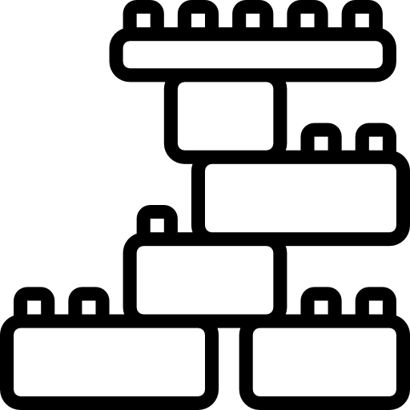
Data Structures
RAM
List
Tree-Graph
Table
Data2
>>
Linked list:
Data
>>
Data3
>>
Data4
>>
Binary Tree
General Tree
Graph

Slide 5

Databases
A set of related data elements structured for
rapid and convenient search, retrieval, and update
Database management system (DBMS)
  Collection of programs for creation, maintenance, and use of databases (support CRUD actions: Create, Read, Update, Delete data)
  Index and sort data to allow rapid numerical and text query
  May provide error checking and other data integrity features
  May allow databases that are larger than RAM
  Often control access to data by multiple users who may have various roles
Notes:
Access by users with particular roles may be controlled overall and by data element

Slide 6
Basic database terms
Field: a single data element
  Usually a simple data type (Boolean, character, number, short text string, date)
  Binary large object (“BLOB”): long text or image
  If more than one data element per field: overloaded field
    Ex: Lab accession number: 22H-034AC01398 (chained data elements)
    Requires programming to extract individual elements if needed
Record: a set of related data elements that are meaningful as a group
  May include metadata (data about the main data)
Query: a database search
Report: a formatted query result containing 0 or more records
  ad hoc (on demand definition and execution), predefined, automated
Notes:
Accession number: year, lab, julian day, lab section, sequential counter (resents annually)
Consider an overloaded field as containing a complex data type with multiple data elements.
Metadata: date, time, & location of a photograph; record of lab test and result with method

Slide 7
Specialized database functions
Indexing
  Choose a particular data element to represent records
  List its unique values with links to the records (the index)
  Keep and update indexes that will be re-used
  Free text? Text search vs. indexing
Sorting
  Put an index into a defined sequence, efficiently
Searching
  Find items in an index and retrieve the records they represent
Data integrity
  Support accurate data entry (value restrictions) and protect data from inappropriate change
  Do not allow data to lose connections to other data upon which it depends

Slide 8


Specialized database functions
Indexing
  Choose a particular data element to represent records
  List its unique values with links to the records (the index)
  Keep and update indexes that will be re-used
  Free text? Text search vs. indexing
Sorting
  Put an index into a defined sequence, efficiently
Searching
  Find items in an index and retrieve the records they represent
Data integrity
  Support accurate data entry (value restrictions) and protect data from inappropriate change
  Do not allow data to lose connections to other data upon which it depends
Indexes
Records

Slide 9
Specialized database functions
Indexing
  Choose a particular data element to represent records
  List its unique values with links to the records (the index)
  Keep and update indexes that will be re-used
  Free text? Text search vs. indexing
Sorting
  Put an index into a defined sequence, efficiently
Searching
  Find items in an index and retrieve the records they represent
Data integrity
  Support accurate data entry (value restrictions) and protect data from inappropriate change
  Do not allow data to lose connections to other data upon which it depends
2
6
8
4
3
9
7
2
6
4
3
7
8
9
2
3
6
4
7
8
9
2
3
4
6
7
8
9
Quicksort

Slide 10

Specialized database functions
Index
Indexing
  Choose a particular data element to represent records
  List its unique values with links to the records (the index)
  Keep and update indexes that will be re-used
  Free text? Text search vs. indexing
Sorting
  Put an index into a defined sequence, efficiently
Searching
  Find items in an index and retrieve the records they represent
Data integrity
  Support accurate data entry (value restrictions) and protect data from inappropriate change
  Do not allow data to lose connections to other data upon which it depends
Record
Binary Search

Slide 11

Specialized database functions
Indexing
  Choose a particular data element to represent records
  List its unique values with links to the records (the index)
  Keep and update indexes that will be re-used
  Free text? Text search vs. indexing
Sorting
  Put an index into a defined sequence, efficiently
Searching
  Find items in an index and retrieve the records they represent
Data integrity
  Support accurate data entry (value restrictions) and protect data from inappropriate change
  Do not allow data to lose connections to other data upon which it depends
Deletion
propagates

Slide 12

Query performance
(Information retrieval)
Software &
Hardware &
Network
Speed/latency/throughput
  Time to retrieve records or complete transactions
Recall (%)
  Relevant records retrieved / all relevant records
  Equivalent to sensitivity
Precision (%)
  Relevant records retrieved / all records retrieved
  Equivalent to positive predictive value
F-score: Balances recall and precision
  F1 score (harmonic mean) = 2 • (R • P) / (R + P)
Data model &
Data accuracy &
Query design
Recall ~ 75%
Precision ~ 50%
Notes:
Optional slide for more detail
Speed/latency/throughput: Adequate hardware and networking for query and data volume
Recall & Precision: Adequate database structure and data model for the task

Slide 13

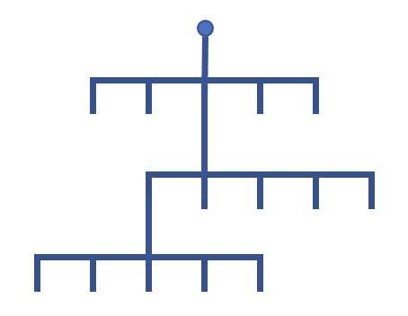
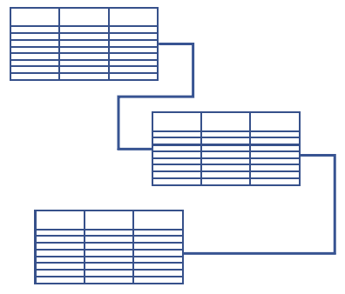
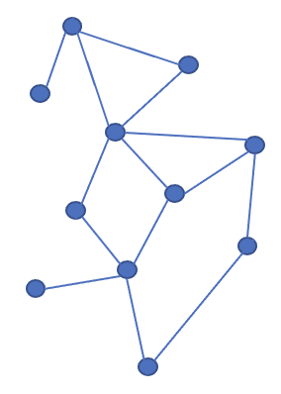
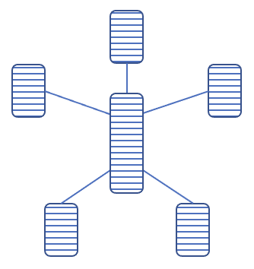
Types of databases (by data organization)
Flat file
  Simple: single table, rows (records) and columns (fields)
  Rigid structure, redundant data, slow with large data volume
Hierarchical
Relational
Other
Analytic databases

Slide 14

Why have different kinds of databases?
Represent relationships in data; avoid wasted space and redundancy
1 to 1
1 to many
many to many
Patient
Patient
Patients
PCP
Test results
Physicians
Flat file
Hierarchical
Relational
Flat file
Hierarchical
Relational
Flat file
Hierarchical
Relational
Notes:
Optional slide, for more detail

Slide 15
Hierarchical databases
Patient
Tree structure
One-to-many relationships (cardinality)
Fast update and search along defined paths
Large data volumes
Performance is design-dependent
Redundancy?
MUMPS*
  Epic Chronicles, Sunquest
Demographics
OP Visits
IP Admissions
Visit1
Visit2
Visit3
…
Problem List
History
Exam/Vitals
Labs
Imaging
Meds
Physician
AP
Med Lab
PFT
EKG
EEG
Test1
Test2
Test3
…
Order
Timestamp
Result
RR
Units
*Massachusetts General Hospital
Utility Multi-programming System
Based on http://www.cs.uni.edu/~okane/
Notes:
Fields are nodes, records are high level nodes with their underlying trees. Redundancy examples: physician listing for each encounter with many the same; separate problem list for each admission, which may have similar entries.
MUMPS is a modified hierarchical system.

Slide 16
Hierarchical databases
Patient
Tree structure
One-to-many relationships (cardinality)
Fast update and search along defined paths
Large data volumes
Performance is design-dependent
Redundancy?
MUMPS*
  Epic Chronicles, Sunquest
Demographics
OP Visits
IP Admissions
Visit1
Visit2
Visit3
…
Problem List
History
Exam/Vitals
Labs
Imaging
Meds
Physician
AP
Med Lab
PFT
EKG
EEG
Test1
Test2
Test3
…
Labs
Order
Timestamp
Result
RR
Units
*Massachusetts General Hospital
Utility Multi-programming System
Based on http://www.cs.uni.edu/~okane/
Notes:
Fields are nodes, records are high level nodes with their underlying trees. Redundancy examples: physician listing for each encounter with many the same; separate problem list for each admission, which may have similar entries.
MUMPS is a modified hierarchical system.

Slide 17
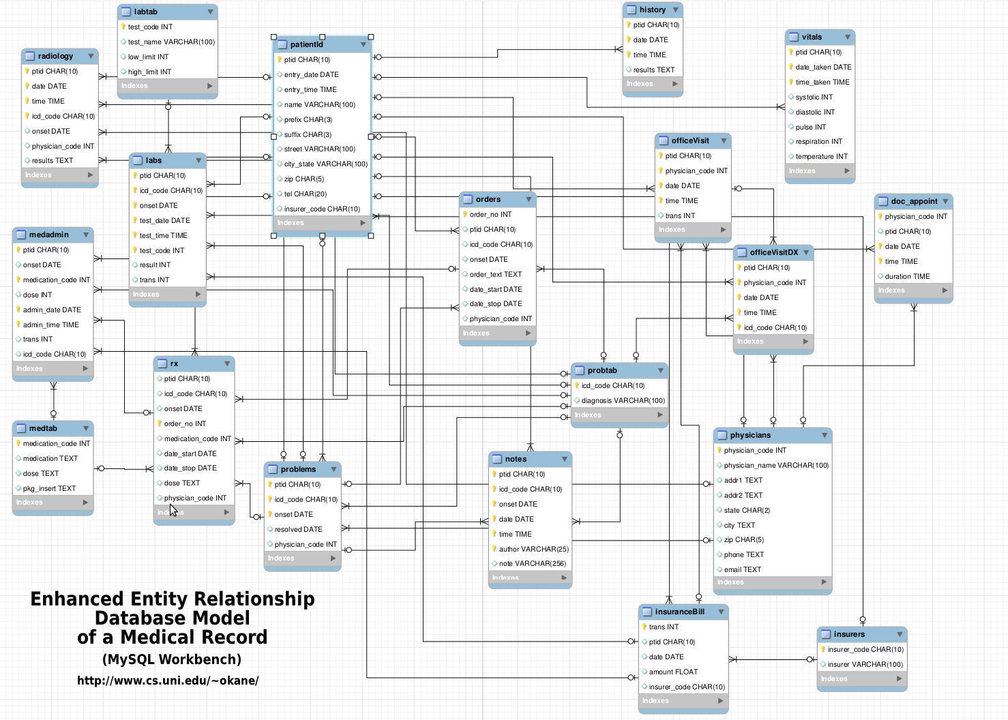
Relational databases
Codd’s rules (1985)
Multiple linked tables
Tables represent “entities”
Links are relationships
Flexible cardinality
Slower updating and retrieval than hierarchical*
Multiple query paths
with decent performance
Transactional/rollback (“ACID”)
SQL query language
Epic Clarity, Cerner,
CoPath APLIS
Labs
Notes:
RDB defined by EF Codd in 1985 (Codd’s 12 rules, actually 13 because they’re numbered 0 to 12); the point is that RDB are formally defined and well understood, not to know the individual rules.
Moves elements that would be redundant in flat files into separate linked tables
Fields are columns in the tables, records are rows in the tables
Slower than hierarchical in queries along the hierarchical branches. Much faster for queries across the branches (ie all patients with lab tests of a particular type that have values in a particular range)
Features of transactions: ACID = Atomic, Consistent (correct), isolated (independent), durable

Slide 18
Many-to-many relationships in RDB
Linking table
PATIENTS
ENCOUNTERS
PHYSICIANS
•
•
•
•
•
•
•
•
•
One patient
Many encounters
Many physicians

Slide 19
Many-to-many relationships in RDB
Linking table
PATIENTS
ENCOUNTERS
PHYSICIANS
•
•
•
•
•
•
•
•
•
Many patients
Many encounters
One physician

Slide 20
RDB keys, relations, and cardinality
PK
PK
Shared keys define links between tables (relations)
  Primary key (PK)
  Foreign key (FK)
  Matching on shared data
Cardinality
  1 to many (*)
  Many to 1
  Many to many
  1 to 1 (not shown)
  Optionality (0..)
PATIENT
PHYSICIANS
Pat_ID MRN Name…
Phys_ID Name Specialty…
•
•
•
•
•
•
1
1
PK
FK
FK
ENCOUNTERS
Enc_ID Date Pat_ID Phys_ID…
•
•
•
0..*
0..*
Notes:
Optional slide for more detail on linking tables
Many to many reduces redundancy (takes care of repeated physicians from pure hierarchicial DB)
Importance of data integrity and not orphaning data
May skip this slide to save time.

Slide 21
Describing RDB structure and contents
Schema: table structure with relations
and required data types
  Entity-relationship (ER) diagram
  Normalized schema (“normal form”)
    Optimum structure without inappropriate
    data dependencies or redundancy
    Relaxed in practice for speed
Data dictionary: list of data elements
(column names from tables)
Notes:
Multiple levels of normal form, relaxation of normalization is a judgement call per database

Slide 22
RDB Query: Structured Query Language (SQL)
Standard (sort of) query language for all relational databases
Statements for creating, managing, updating, querying, deleting records
Query statement:
…returns a single table of matching data elements
JOIN tables using matching key values to query multiple tables
SELECT <column names>
FROM <table> JOIN <table> ON <column>
WHERE <query parameters>
ORDER BY <sorting parameters>
SELECT <column names>
FROM <table>
WHERE <query parameters>
ORDER BY <sorting parameters>
Notes:
Optional slide for more detail

Slide 23
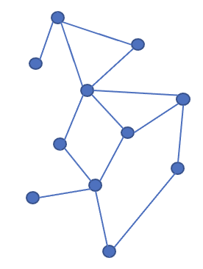
Alternative database systems
NoSQL databases (they’re not relational and don’t use SQL)
  High efficiency databases for very large data sets (“big data”)
  Often network design
    Child data elements can have multiple “parents” (vs. hierarchical)
    Data relationships designed to support anticipated update and query patterns
    Design is unique to a DB and its needs, complex DBs may be demanding to build
    Can represent RDF triples (ie, RDF “triple stores”) to allow reasoning with ontologies
Object-oriented databases
  Complex data types (images, video, audio, complex documents)
  Entities are data objects with specialized internal structure dependent on the type of object, the database supports working with these objects
Notes:
OODB might be used in a system that stores DICOM images and understands the internal structure of DICOM files.

Slide 24
Analytic databases
Transactional databases
  Designed for high rates of standard transactions
  Small updates and queries in support of routine business operations
  In healthcare, EHR and departmental operational systems like LIS
Analytic databases
  Designed for data exploration and analysis
  Flexible structure to support unpredictable queries
  May integrate data from multiple transactional systems (ie, EHR and billing)
  Data warehouse, data mart, data cube, “business intelligence”

Slide 25
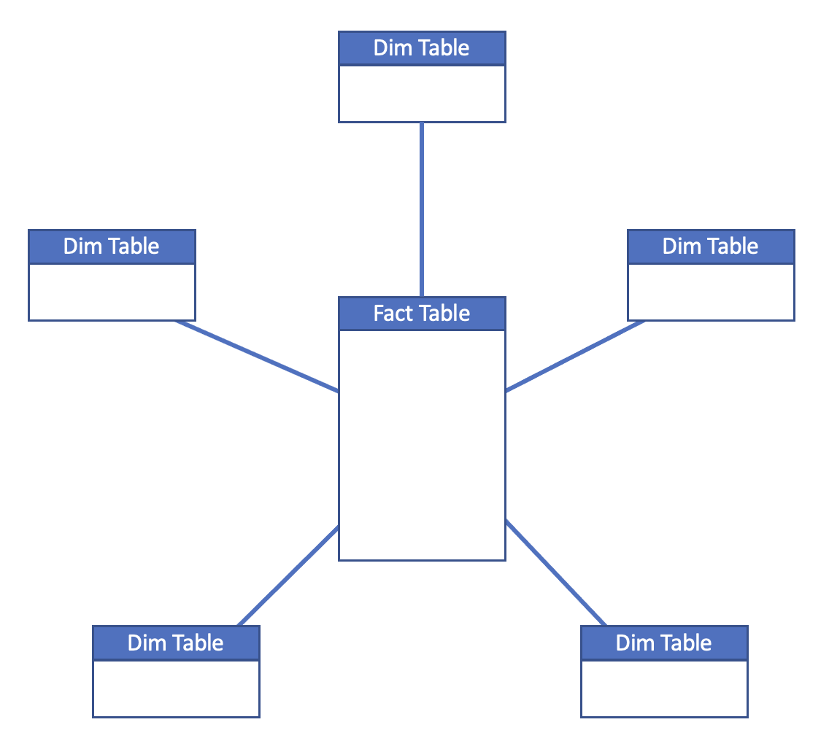
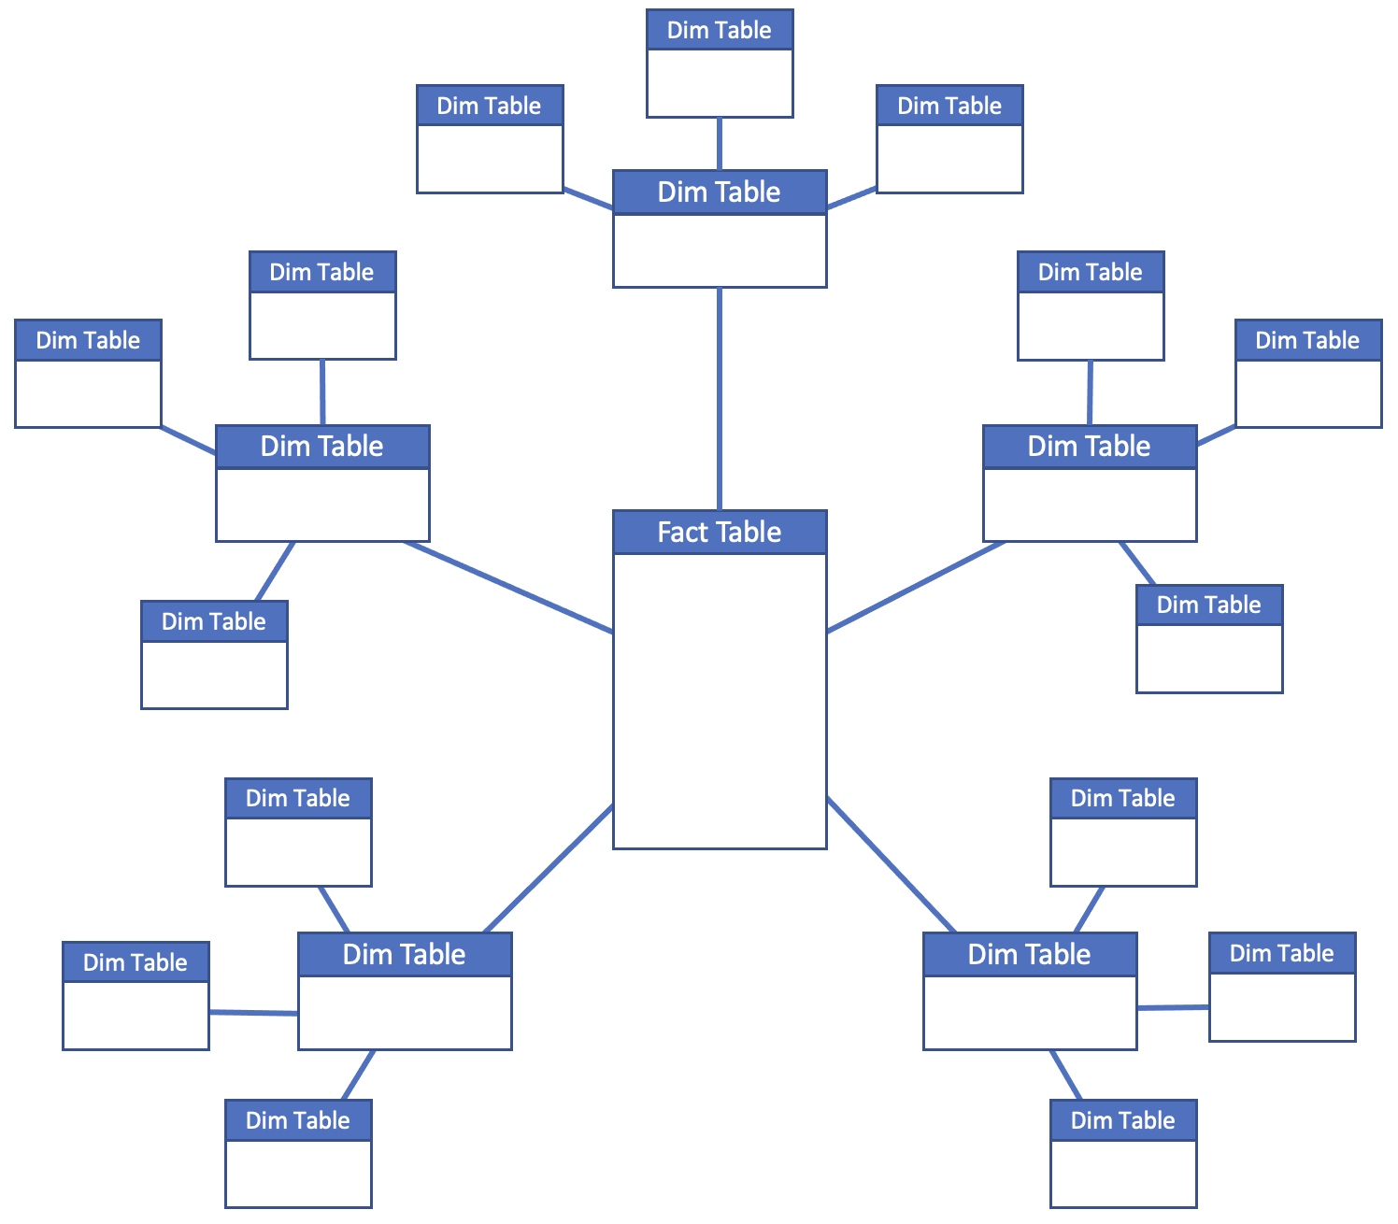
Data Warehouse
A large scale, integrated database optimized for analytical query
  Originally from retail
  Star or “snowflake” schema
  Central fact table
  Dimension tables
  Subdimension tables
  Data comparison
  and correlation-finding
Slow loading/rapid query
  Many table updates on load
Star
Snowflake
“Subdimension” tables
Topic-specific data extracts sometimes called
“data marts” or “data cubes”

Slide 26
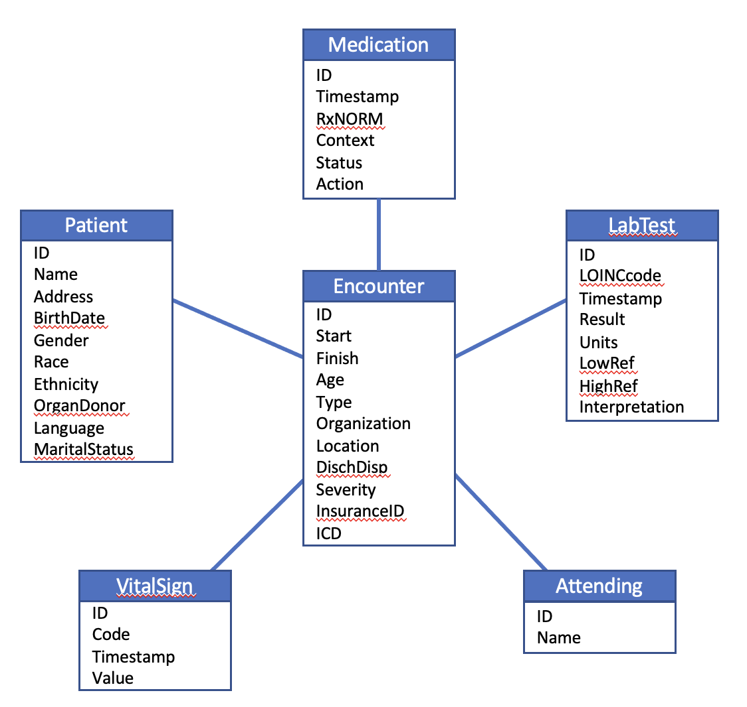
Data Warehouse
A large scale, integrated database optimized for analytical query
  Originally from retail
  Star or “snowflake” schema
  Central fact table
  Dimension tables
  Subdimension tables
  Data comparison
  and correlation-finding
Slow loading/rapid query
  Many table updates on load
Notes:
Additional terms: data cube, data lake
Compare two medications effects on a lab test

Slide 27
Database review
Hierarchical
Relational
Network
Warehouse
Fast, large data vol
Inflexible
Speed has significant structural dependency
Not standardized
Very flexible
Tables (entities)
Transactional
Standard language, SQL
Slow peak performance
NoSQL
Fast, large data vol
Structural dependency
Design complexity
Not standardized
Tables in a star schema
Fast query for correlations
Large data vol
Slow loading (not good for business operations)

Slide 28



Database systems
TCP/IP network
SQL, etc.
SQL, etc.
Client-server architecture
  Front end and back end, TCP/IP communications
  Front end supports users’ interactions with data
“Fat” vs. “thin” clients
  Web browsers, http over TCP/IP
On-premises vs. SaaS
“software-as-a-service” & “cloud systems”
Client devices
(front end)
Database server
(back end)
TCP/IP network
http
http
SQL, etc.
TCP/IP network
“Thin” clients
Internet
http
SQL, etc.
Thin client
server
Web, Citrix
Database
server
(back end)
http
Database server(s)
at vendor
Thin clients on premises
Notes:
Medical systems including LIS are databases with front ends that support medical workflows.
SaaS systems managed by application service providers, may be called “cloud-based” or “in the cloud”, vendor takes care of software management. Can be fat or thin clients.

Slide 29

Key points
Databases are collections of data organized for efficient use
Database management systems use and protect data, and manage access to data
Different types of databases support different kinds and uses of data
Relational databases are widely used for flexibility and multiple perspectives on data, at a performance cost
Alternative database systems support specialized use cases
Analytic databases support integrative query and data analysis

Slide 30

Readings
Harrison J. Management of Pathology Information Systems, Chapter 6. In: Laboratory Administration for Pathologists. 2nd ed. CAP Press; 2019. General characteristics of laboratory information systems p. 96-97, Database applications p. 97-100. Available for download from the Pathology Informatics Essentials for Residents curriculum page.

Slide 31

Permitted uses
© 2024 James H. Harrison, Jr. except as noted below. The original material in this slide set is made available under a Creative Commons Attribution 4.0 (CC BY 4.0) International License. The contents may be used without restriction, modified, and redistributed if they are attributed and any changes are indicated. Some graphical elements are used with permission or according to their own licenses requiring attribution. Attribution links are provided on the slide of use or on the Permitted Uses slide (this slide). These elements may be used and included in modified and redistributed work consistent with the licenses specified at the linked sites, provided that the links are included in the redistributed material. The cover image is a composite of two laboratory images from Pixabay available for use without attribution.
Agenda, database, list, printing, close, and correct icons created by Freepik – Flaticon
Repeat icon created by Grand Iconic – Flaticon
Block icon created by Smashicons – Flaticon
Database icon with clock created by Icongeek26 – Flaticon
Server icons created by Sumitsaengtong and Vector Squad – Flaticon
Workstation icon created by Muhammad Ali – Flaticon
Gaming icon (key) created by juicy_fish – Flaticon
Book icon created by Good Ware – Flaticon

Slide 32
Editable images
Indexes
Records
2
6
8
4
3
9
7
2
6
4
3
7
8
9
2
3
6
4
7
8
9
2
3
4
6
7
8
9

