Slide 1
Introduction to Pathology Informatics
Session 0: Orientation
James Harrison, MD PhD
University of Virginia
2023
Version 1.0
Notes:
These 10 slide sets are being provided through the Association for Pathology Informatics (API) with a license that allows free use, modification, and redistribution with attribution (see the permitted uses slide at the end of each presentation). The design has been kept relatively basic to make editing and adaptation easier. Users are encouraged to modify the slides to make them better, share the improved slides, and possibly contribute improved slide sets back to the API or other providers. As designed, the slides are relatively wordy so that they are easier to follow without an instructor’s guide (though one may appear in the future). Feel free to edit the slides to streamline them and optimize them for local use. Some sessions contain optional slides with extra detail, and these are indicated in the slide notes. Some sessions contain slide builds (most are simple) that don’t print well; these sessions have optional slides for printing, and these are indicated in the slide notes.
The goal of these slide sets is to provide foundational information that will allow pathology trainees to more effectively learn and practice pathology, not to teach the performance of specific tasks in pathology. The overall learning objectives are listed on the third slide of session 0 with some explanatory comments in the notes. Subsequent sessions have agendas but not separate learning objectives because the learning objectives remain the same.
The slides have been used with a teaching schedule in which the orientation is given during the summer and then the remaining sessions are give once a month (with lunch) from September to May. They could also fit into a 2, 4, or 5-6 week teaching module if taught on a weekly/semiweekly basis.

Slide 2
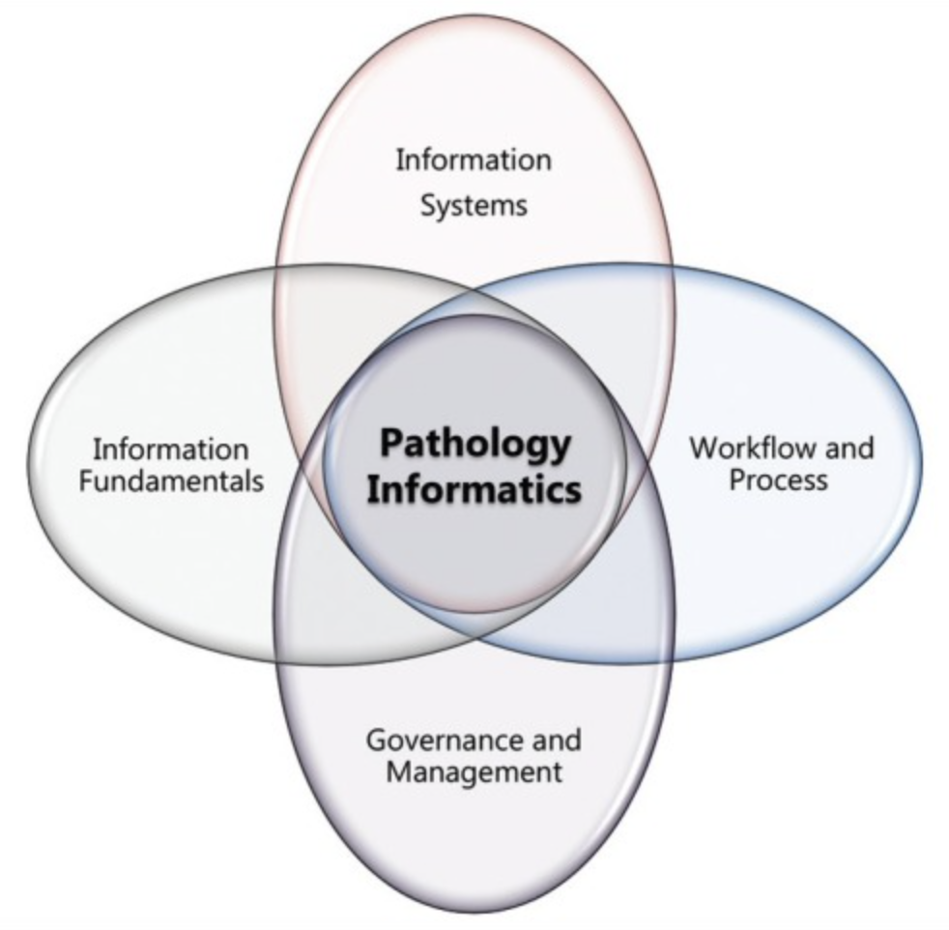
Topics in Pathology Informatics
Orientation
Computer basics
Hardware, networking, software, data files
Data and databases
Health information systems/LIS/EHR
Interoperability and interfaces
Digital imaging in Pathology
Clinical decision support
Artificial intelligence in pathology
Data access and cybersecurity
LIS system implementation and management
McClintock DS, Levy BP, Lane WJ, et al. A core curriculum for clinical fellowship training in pathology informatics. J Pathol Inform. 2012;3(1):31. doi:10.4103/2153-3539.100364
Notes:
There are term lists & readings for each topic

Slide 3
Overall learning objectives
Understand the role digital information technology (IT) plays in the practice of pathology
“Level up” knowledge in digital IT
Understand important concepts
Read and understand important terms, and use them correctly
Answer board questions
Judge the face validity of statements by IT staff and vendors
Carry out pathology IT supervisory and approval tasks effectively
Read and understand pathology informatics articles
Build a foundation for additional learning
Notes:
Pathology trainees typically come to their training programs with a deep background in the natural sciences and much of pathology training is aimed at organizing and building on this knowledge, and learning how to perform tasks that use it. Pathology trainees typically do not have a fund of knowledge in digital information systems, data, and system management. Therefore they are not ready to be taught measureable tasks. Instead, they need their information system knowledge “leveled up” to their natural science knowledge as a foundation for learning tasks and judgement. That is a primary purpose of these slide sets.

Slide 4
Orientation agenda
Definitions, concepts, and important questions in informatics and Pathology Informatics
Key concepts to understand…
Data literacy
Laboratory information stewardship
Introducing data: Representation, quality, and organizational flow

Slide 5
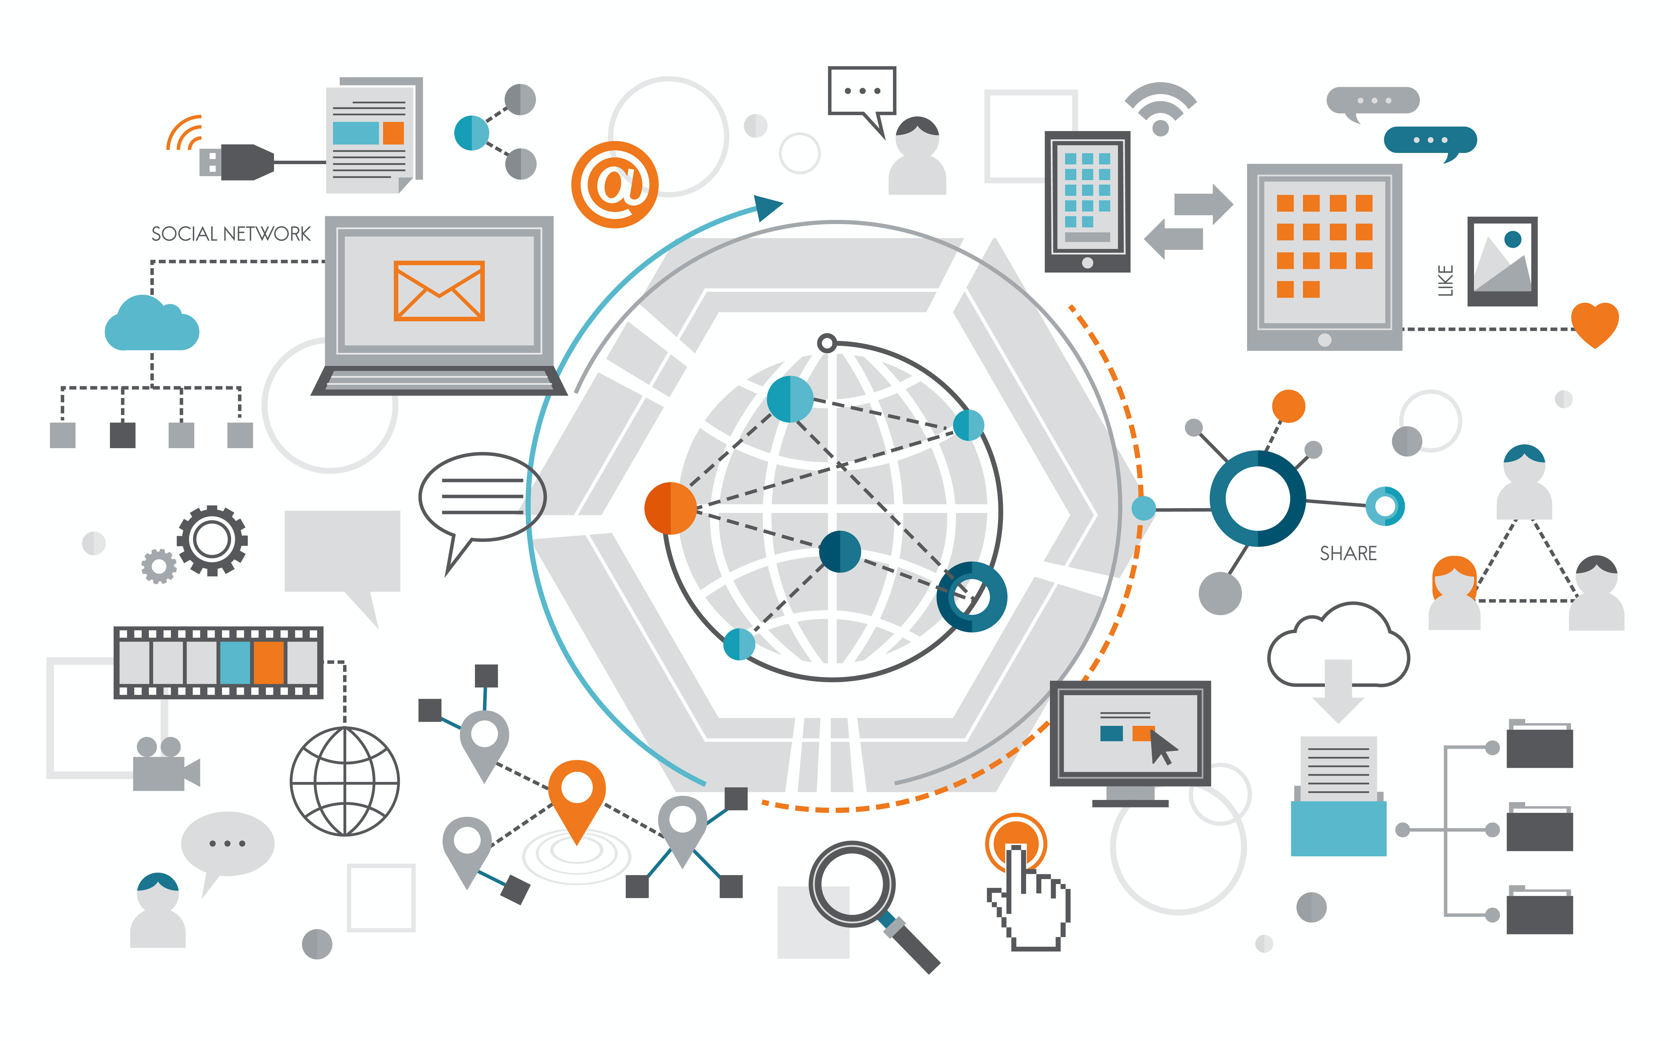
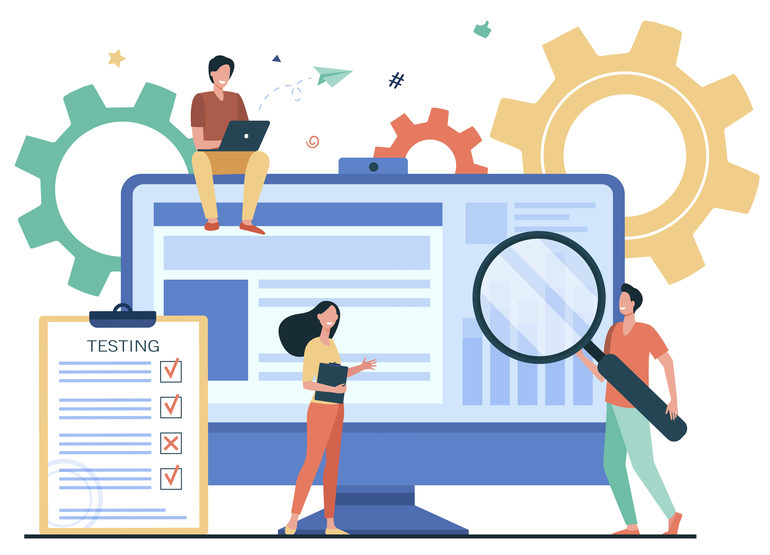
Informatics vs. information technology
IT is about installing, managing, and supporting computing hardware, software, and communications
Broadly applicable across many settings
Informatics is about optimal design and effective use of computational tools
Applies domain knowledge
Makes evidence-based choices to assemble and manage systems that work well
Notes:
Informatics includes creating successful IT-supported processes in particular domains like Pathology; it creates a way of approaching a domain or a domain framework within which IT can be successful.

Slide 6
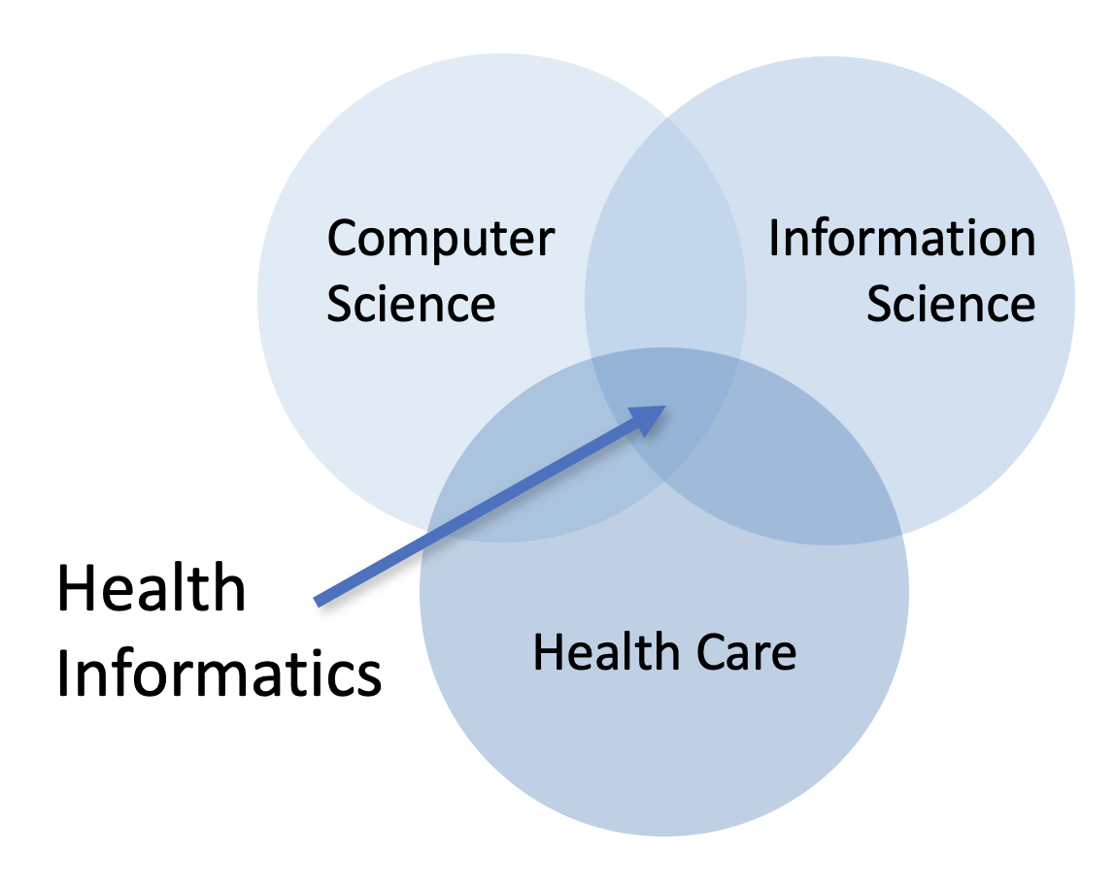
What are the sub-disciplines of Biomedical Informatics?
Biomedical research informatics
Bioinformatics (gene sequence data)
Health informatics
Medical or clinical informatics
Pathology informatics
Radiology informatics
Nursing informatics, etc.
Public health informatics
Health knowledge informatics
Consumer health informatics (information support, remote monitoring, health sensors)

Slide 7
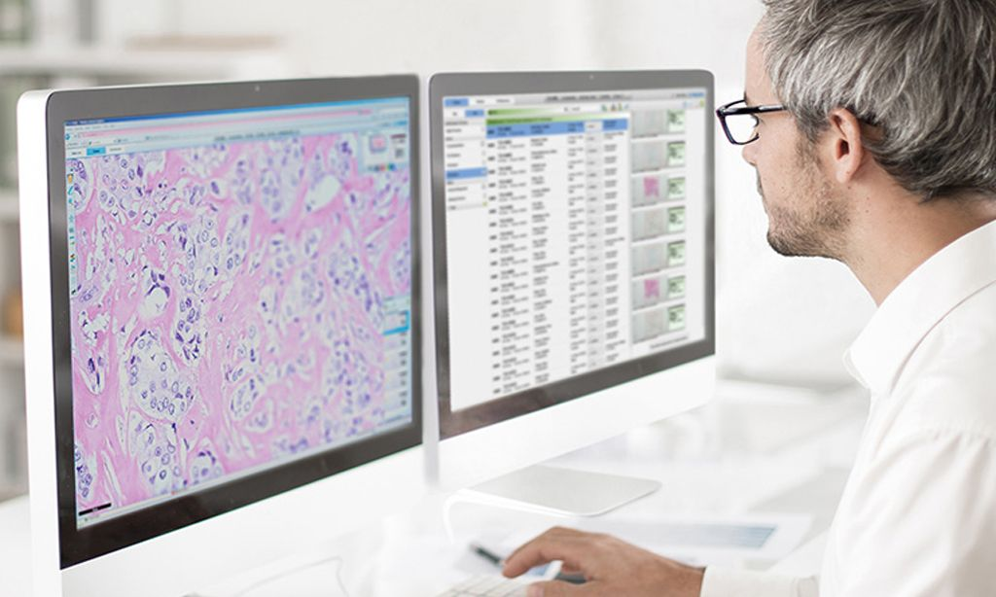
How does Pathology data differ from that of other sub-disciplines of Health Informatics?
Specimen-centric rather than patient- or encounter-centric
Diagnostic testing with order-to-result data flow
Laboratory operations and quality management
Odd dichotomy in result data
Highly structured (clinical lab)
Unstructured narrative (AP)
Creation, processing, and management of very-high-resolution color images
Philips
Notes:
The clinical data is specimen-centric. Operational data applies across specimens analogously to operational data in clinics applying across patients.

Slide 8
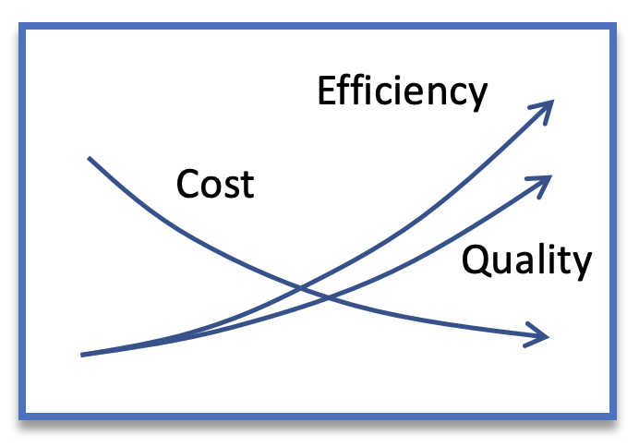
What is the relationship between Pathology Informatics and Pathology practice?
IT systems provide a foundation for all pathology activities
Represent and communicate primary work products (orders and results/reports)
Provide tools for managing the laboratory, optimizing laboratory workflows, and controlling the accuracy of results
Pathology informatics focuses on optimizing:
The design of data and tools to work with it
The configuration of the tools
How the tools are used

Slide 9
How much should a practicing Pathologist know about Pathology Informatics?
Understand generally how things work
Work with vendors and own support staff
Judge face validity of assertions
What is practical to request and what is not
Be able to use pathology data for patient care and to improve pathology practice (be data literate)
Understand the appropriate division of responsibilities
Understand regulatory requirements and responsibilities for review and oversight
Notes:
Understand at a high level how the pathology systems interact with other health information systems including EHR and financial systems.
Pathologists who act as informatics champions or informatics specialists would need additional knowledge. As pathologists rise to the role and responsibility of CLIA directors in labs, there is an increasing need to understand the interplay between IT and laboratory operation.

Slide 10
Data literacy for Pathology practice
Knowledge
Knows how to distinguish between different basic forms of data Is familiar with ways that data is collected, structured and stored Grasps fundamental principles of analysis and statistics and when they apply Understands ways to visualize data and their respective benefits and drawbacks
Attitudes
Believes that data is a language that anyone can learn to read and speak Feels confident using data as a resource to answer questions & identify new ones Is alert to common pitfalls into which people fall when working with data Considers ethical use of data and its impact on society to be critically important
Behaviors
Seeks out and creates data as a means of gathering information and problem-solving Identifies areas for improvement in data and associated analyses Advocates for the effective usage of data in communication and decision-making Spreads data literacy through the active and competent use of the language
Skills
Reads and understands visual displays of data created by others Communicates effectively using data and derived information Cleans dirty data and combines multiple data sets together for analysis Explores data sets and identifies relevant facts, patterns and trends Creates clear visual displays of data to reveal insights to others
Modified from Jones B. Seventeen key traits of data literacy.
https://coco-net.org/wp-content/uploads/2020/09/17_Key_Traits_of_Data_Literacy_Spread_Layout.pdf
Notes:
This discussion targets the first two skills. The last three skills (gray) for whom data is a primary focus of their work.
Consider adding a pathology example verbally to illustrate behaviors and skills in routine practice.

Slide 11
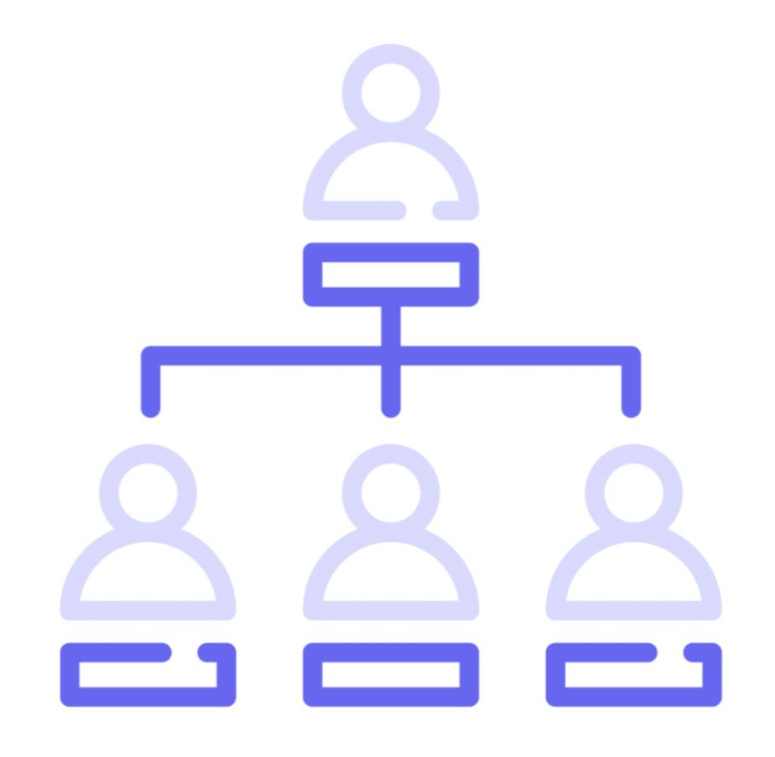
What is the relationship between Pathology Informatics and clinical IT in a health system?
Business IT: Chief Information Officer (CIO), IT managers, and staff
Clinical IT: Chief Medical Information Officer (CMIO)
Provides medical perspective on IT
Collaboration relationship with IT managers under the CIO like pathologist relationship with lab admin
Associate CMIOs with medical service focus (also nursing)
Pathologists may be CMIO or ACMIO
Pathologists may be effective partners with CIO/CMIO without the actual title
Pathology as a discipline can be obscure to business and clinical leaders, and contributors from pathology are generally welcome
Notes:
Note that clinical IT and the “C’s” noted here report to the CEO of the hospital and are part of hospital/clinic administration. Pathologists are part of the medical hierarchy. Those two hierarchies need to work together in an effective partnership (pathologists may or may not have formal roles in hosp. admin).

Slide 12
What is meant by laboratory information stewardship?
Taking an interest in and responsibility for patients’ laboratory information wherever it is used in the organization
Working to ensure its integrity
Working to ensure its optimal use for the benefit of the patient
Proactively identifying and removing barriers to optimal use of laboratory information
Previously, boundaries were implied by systems (LIS)
Now with LIS becoming integrated into EHR, scope of pathologists’ interest can be broader (expands rather than diminishes pathologists reach).

Slide 13
What are some roles that pathologists can play in the current EHR-based laboratory IT environment?
Optimal configuration of clinical ordering and decision support at order entry, including order entry alerts
Management of the test menu, test naming, and test catalog information in the EHR
Optimal presentation of laboratory results and reports, including graphics and flowsheets
Determine how coding systems are used in laboratory orders and reports
Coordinate and communicate new and modified test definitions in the EHR
Approve the testing and performance of interfaces between the EHR and external systems that communicate laboratory information

Slide 14
Questions to consider
What are some examples of pathology informatics that you’ve encountered during your training?
How are the goals of the laboratory supported in these examples?
Are there aspects of pathology informatics that are particularly interesting or important to you?
In what ways are you likely to encounter pathology informatics in the future?
What kind of background do you need to be prepared for these possibilities?

Slide 15
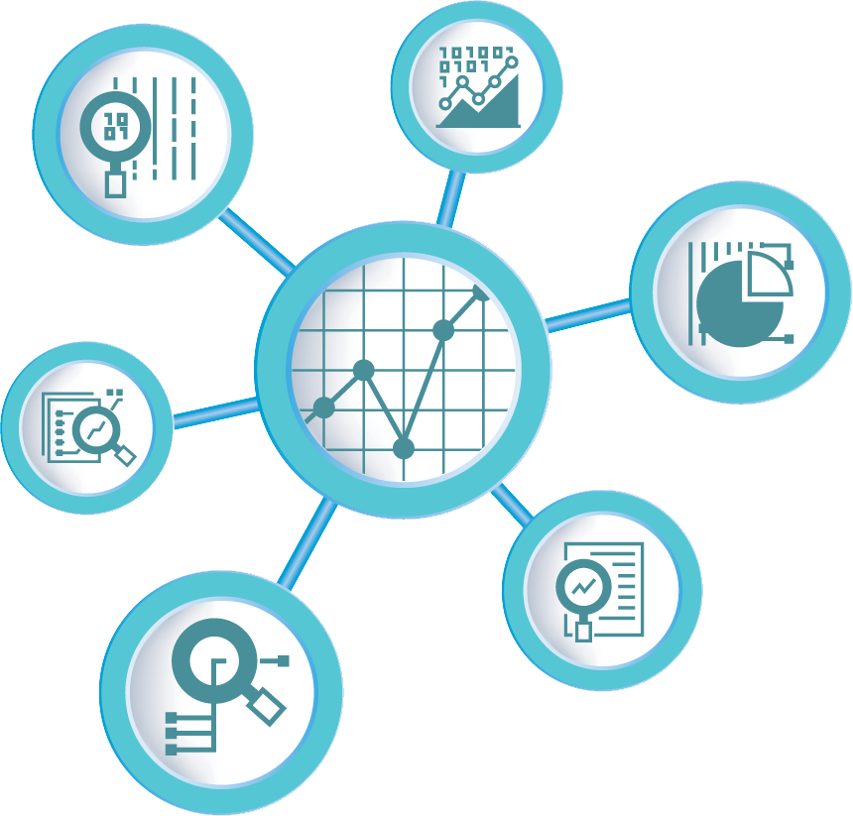
Data in informatics
What is the purpose of data?
Understanding and correct action
Informatics is the study of data
Its creation, management, and effective use
Foundational concepts related to data:
Data representation
Data quality
Data flow in an organization from creation to use
Notes:
Informatics can be considered the study of data creation, management, and use in a domain

Slide 16
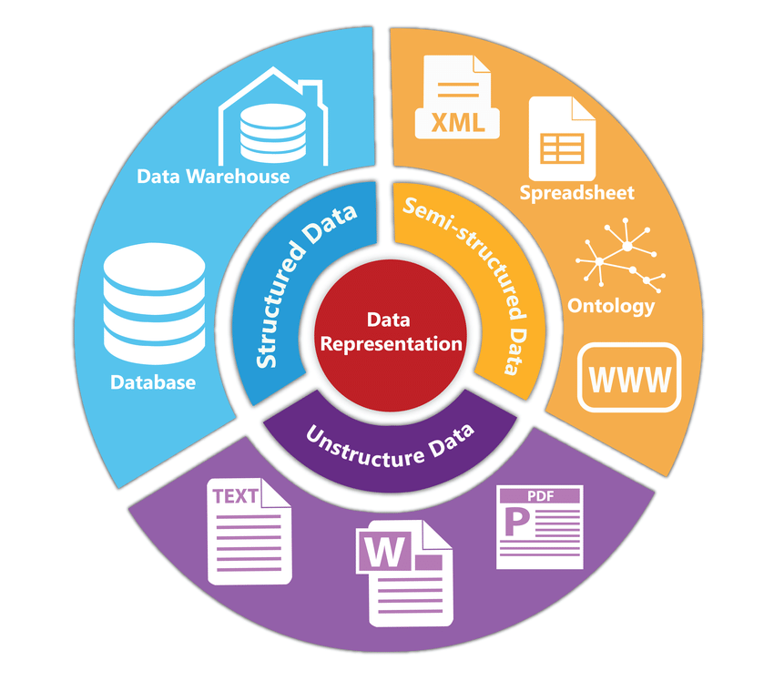
Data representation
Assignment of meaning to physical artifacts
Characters, numbers, words, phrases
Electronic states of computer memory
Human language: Unstructured data
Extremely flexible
Form and usage varies with location and time
Context-dependent
Structured data
Constrained language
Well-defined syntax and semantics
Data standard: Formal agreement on data representation
Siriyasatien et al. IEEE Access 2018.
doi:10.1109/ACCESS.2018.2871241
Notes:
Pre-computer we usually meant visual artifacts
Data standards allow data sharing and interoperability

Slide 17
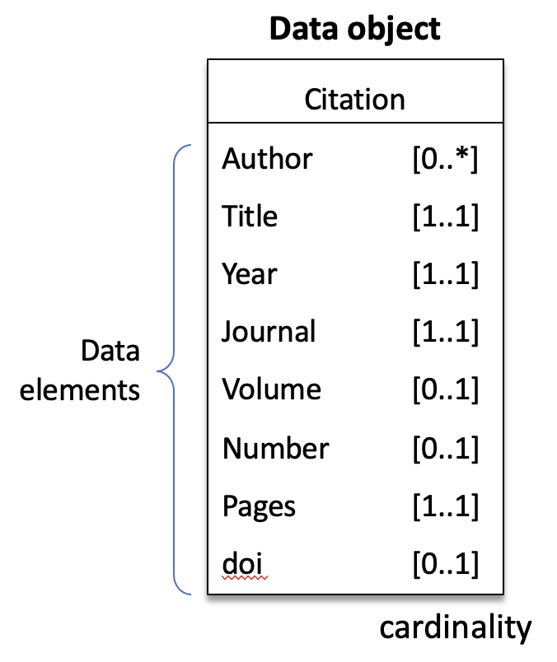
Structured data
Simple data types
Numbers, characters, & character sequences (words, phrases, or codes)
Technical details to come
Complex data types
Represent concepts or physical things in the real world
Often called “objects” or “entities”
Built of constituent data types referred to as “data elements” or attributes
Interoperability of data
Portability of data across information systems
Requires common syntax and semantics, or data conversion
Notes:
Data objects have a name and then one or more attributes composed of name-value pairs (the name may be implicit) with the value being a simple or complex data type.

Slide 18
Data quality
Completeness | Is data present and available?
Correctness | Is data true?
Concordance | Is there agreement and consistency between data elements?
Plausibility | Does data make sense in the clinical context?
Currency | Is data a relevant representation at a defined point in time?
Weiskopf NG, Weng C. Methods and dimensions of electronic health record data quality assessment: enabling reuse for clinical research. J Am Med Inform Assoc. 2013;20(1):144-151. doi:10.1136/amiajnl-2011-000681
Notes:
Why is data quality important for computers? Humans become conservative when data is uncertain and the stakes are high computers don’t unless programmed in, handling uncertainty, incorporating low quality into result (result quality may reflect lowest quality data), garbage in & garbage out

Slide 19
EHR data quality
Type of data | Relative quality | Comments
Demographics | Relatively high | Patients alive are overestimated because of limited processes to update patients’ statuses unless they expire in the hospital
Lab results | Very high | Dependent on clinical ordering; testing at different locations may not be shared; absent results are not the same as negative results
Medication orders | Very high | Prescriptions written may not be filled or taken
Vital signs | High | Data collected for immediate clinical need
Test orders | High | Reflect immediate clinical need, may not be shared across locations
Diagnoses | Medium | Variable, may be missing or may represent possibilities
Family & past hx. | Low | Often missing, better if standardized collection of specific elements
Other incl. notes | Variable | Depends on data element and incentive for accurate collection
Sutherland SM, et al. Electronic Health Record-enabled research in children using the Electronic Health Record for clinical discovery. Pediatr Clin North Am. 2016;63(2):251-268. doi:10.1016/j.pcl.2015.12.002
Notes:
Quality varies across data elements. Part of the reason is that data is entered by a variety of people with different levels of training and data entry support (error checking). Note “copy paste” issues with relatively static information may lead to omission of elements or failure to include new elements.

Slide 20
Data flow in summary: Creation to action
Sources
Storage/management
EHR databases
Data warehouses
Use
Capture, communication, and mapping
Analytics and reporting
Information systems
Data organization
Preservation & access
Cleaning and consistency checking
Presentation
Interpretation
Understanding
Effective action
Variable representation and quality
Notes:
Goal is evidence-based action; laboratory information stewardship encompasses this entire process as it relates to lab data

Slide 21
Key points
Informatics studies and advances the design and effective use of IT systems
The Pathology Informatics subdiscipline focuses on effective pathology practice
Data literacy in pathology is having adequate knowledge of pathology data and IT systems to use them effectively
The relationship between pathology informatics and institutional IT is similar to that between pathology and laboratory administration
Laboratory information stewardship means taking responsibility for optimizing the utility of laboratory data
The purpose of data in healthcare is to support understanding of and correct action for patients
IT systems capture, translate, manage, and present data for correct action
Data literacy is important for effective use and evaluation of these systems
Notes:
Effective use includes ability to recognize suboptimal performance and identify need for improvement when appropriate.
All pathologists should be lab information stewards.

Slide 22
Readings
Harrison J. Management of Pathology Information Systems, Chapter 6. In: Laboratory Administration for Pathologists. 2nd ed. CAP Press; 2019. pp. 91-94. Also provides historical background. Available for download from the Pathology Informatics Essentials for Residents curriculum page.
Henricks WH, Wilkerson ML, Castellani WJ, Whitsitt MS, Sinard JH. Pathologists as stewards of laboratory information. Arch Pathol Lab Med. 2015;139(3):332-337. doi:10.5858/arpa.2013-0714-SO
Jones B. 17 key traits of data literacy. Published online 2018. https://coco-net.org/wp-content/uploads/2020/09/17_Key_Traits_of_Data_Literacy_Spread_Layout.pdf

Slide 23
Permitted uses
© 2023 James H. Harrison, Jr. except as noted below. The original material in this slide set is made available under a Creative Commons Attribution 4.0 (CC BY 4.0) International License. The contents may be used without restriction, modified, and redistributed if they are attributed and any changes are indicated. Some graphical elements are used with permission or according to their own licenses requiring attribution. Attribution links are provided on the slide of use or on the Permitted Uses slide (this slide). These elements may be used and included in modified and redistributed work consistent with the licenses specified at the linked sites, provided that the links are included in the redistributed material.
The cover image is a composite of three laboratory images from Pixabay available for use without attribution.
Knowledge icon created by Dewi Sari - Flaticon
Agenda, organization, microscope, and dashboard icons created by Freepik – Flaticon
IT illustrations designed by rawpixel.com & pch.vector / Freepik
Big data illustration available from Subpng
Patient icon created by photo3idea_studio – Flaticon
Medical analyzer icon created by Eucalyp – Flaticon
Database icons created by Smashicons – Flaticon
Analytics icons created by Becris – Flaticon
Gaming icon (key) created by juicy_fish – Flaticon
Book icon created by Good Ware – Flaticon

