Slide 1
Introduction to Pathology Informatics
Session 1: Computer Hardware, Software, Networking, and Data Files
James Harrison, MD PhD
University of Virginia
2023
API distribution, version 1.0.1
Notes:
These 10 slide sets and term lists are being provided through the Association for Pathology Informatics (API) with a license that allows free use, modification, and redistribution with attribution (see the permitted uses slide at the end of each presentation). The design has been kept relatively basic to make editing and adaptation easier. Users are encouraged to modify and improve the slides, share the changes (with attribution of the original material), and possibly contribute the improved slide sets back to the API or other distributors. As designed, the slides are relatively wordy so that they are easier to follow without an instructor’s guide (though one may appear in the future). Feel free to edit the slides to streamline them and optimize them for local teaching style and available time. Some sessions contain optional slides with extra detail, and these are indicated in the slide notes. Some sessions contain slide builds (most are simple) that don’t print well; these sessions have optional slides for printing, and these are indicated in the slide notes.
The goal of these slide sets is to provide foundational information that will allow pathology trainees to more effectively learn and practice pathology, not to teach the performance of specific tasks in pathology. The overall learning objectives are listed on the third slide of session 0 with some explanatory comments in the notes. Subsequent sessions have agendas but not separate learning objectives because the learning objectives remain the same.
The slides have been used with a teaching schedule in which the orientation is given during the summer and then the remaining sessions are give once a month (with lunch) from September to May. They could also fit into a 2, 4, or 5-6 week teaching module if taught on a weekly/semiweekly basis.

Slide 2
Computer basics agenda
The primary parts of a computer and what they do
The organization and operation of computer networks
The major types of software that computers use
Basic and complex data types
Storage of data in files

Slide 3
Let’s start with a metaphor
Workspace
Numbered letter boxes
Files
/
Procedures
Data
/ / / / / / / / / / / / / / / / / / / / / /
/ / / / / / / / / / / / / / / / / / / / /
/ / / / / / / / / / / / / / / / / / / / / / / / / / /
/ / / /
/ / / / / / / / / / / /
Notes:
This little animation sequence uses letter boxes to illustrate some things about how computers operate. The file cabinets are the non-volatile storage (discs, etc.), the letter boxes are volatile storage (RAM) and are cleaned out every night. The desk is the CPU with its vertical file representing CPU cache (which is also cleaned out every night). The initial file in location 1 is a set of instructions for which file to load first each morning (the BIOS). That first file has instructions for the day, which involve loading a file from the file cabinet, with each page going sequentially into neighboring letter boxes. The worker keeps track of which file is where in the letter boxes and how far along in it they are. Based on the first file, the worker loads a second file and proceeds to work with its pages. As the worker progresses down the pages, they are moved to the vertical file on the desk for convenience and speed. Sometimes the worker creates new pages and loads them into the letter boxes. At the end of the day, the new pages that will be saved are loaded from the letter boxes in the file to preserve them. At the end of the day, the worker leaves and the letter boxes and vertical file are emptied.

Slide 4
Let’s start with a metaphor
Workspace
Numbered letter boxes
Files
Procedures
Data
Notes:
This little animation sequence uses letter boxes to illustrate some things about how computers operate. The file cabinets are the non-volatile storage (discs, etc.), the letter boxes are volatile storage (RAM) and are cleaned out every night. The desk is the CPU with its vertical file representing CPU cache (which is also cleaned out every night). The initial file in location 1 is a set of instructions for which file to load first each morning (the BIOS). That first file has instructions for the day, which involve loading a file from the file cabinet, with each page going sequentially into neighboring letter boxes. The worker keeps track of which file is where in the letter boxes and how far along in it they are. Based on the first file, the worker loads a second file and proceeds to work with its pages. As the worker progresses down the pages, they are moved to the vertical file on the desk for convenience and speed. Sometimes the worker creates new pages and loads them into the letter boxes. At the end of the day, the new pages that will be saved are loaded from the letter boxes in the file to preserve them. At the end of the day, the worker leaves and the letter boxes and vertical file are emptied.

Slide 5
Computer hardware diagram
Random access memory (RAM)
CPU
clock
BIOS
Battery
System bus
Input/output (I/O)
Storage
Graphics processing
Network interface
Audio
Mouse, keyboard,
printers, scanners,
removable storage
Hard drives, solid state storage
Video display
Camera
Local area network (LAN)
Ethernet
Wifi
Speakers

Slide 6
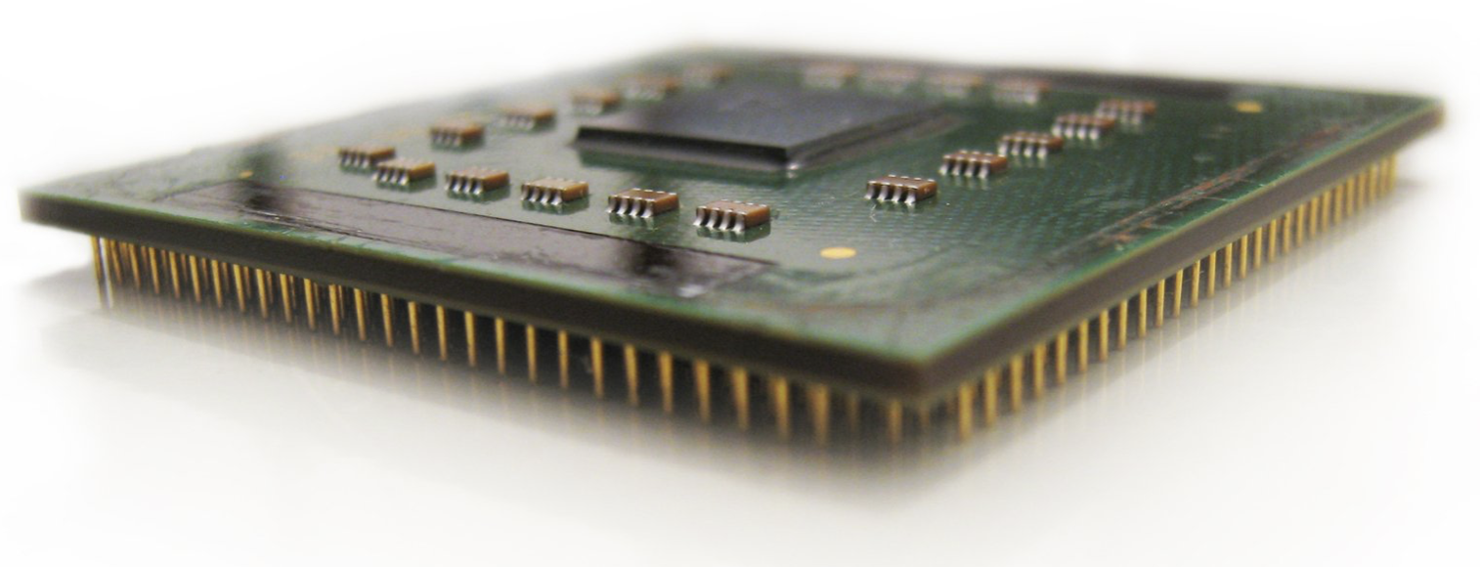
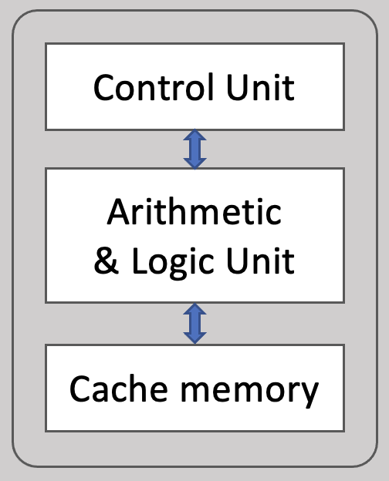
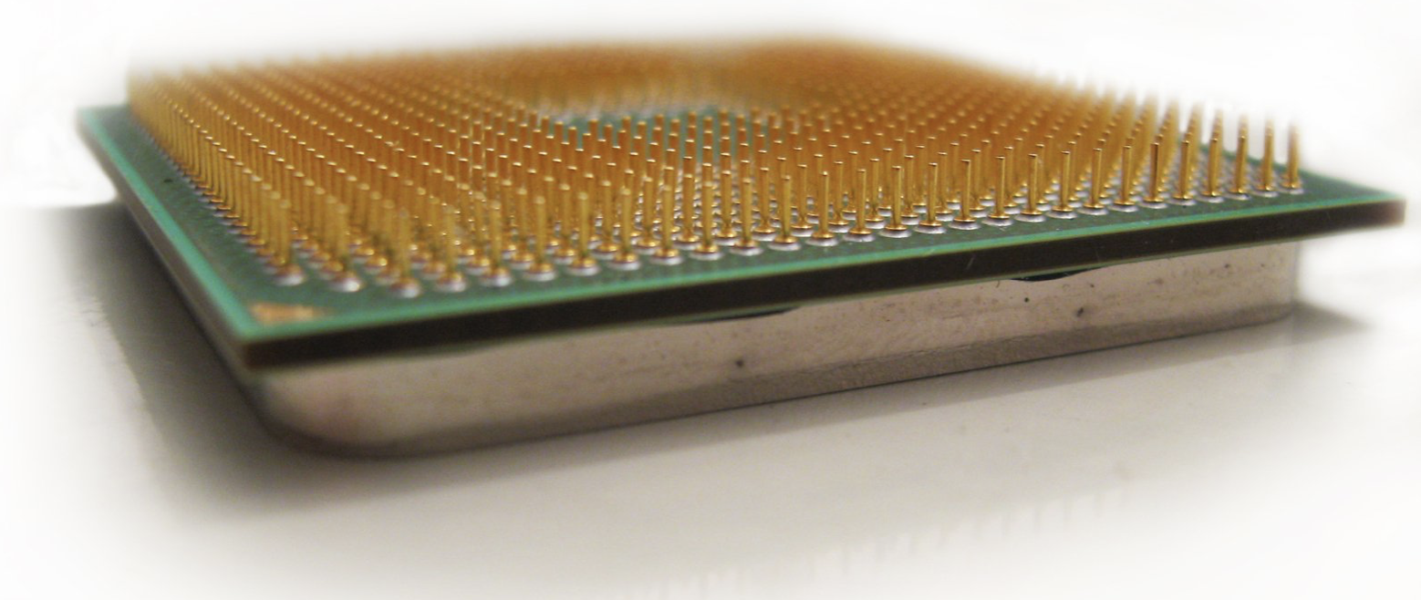
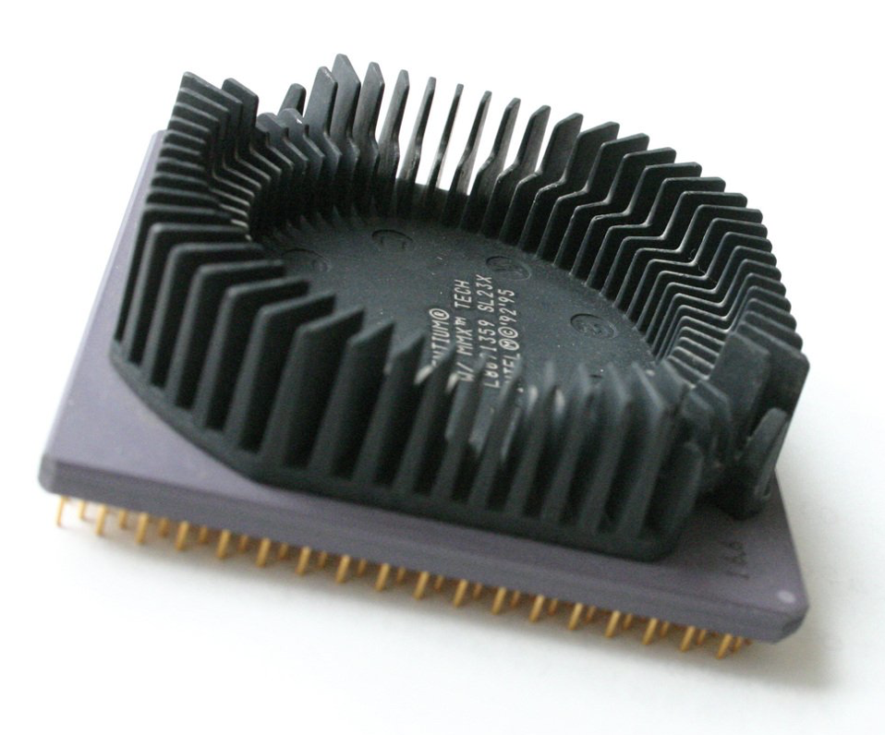
The Central Processing Unit (CPU)
Single Core
Multi-Core
Control Unit
Arithmetic & Logic Unit
Controller
I/O
Input
Output
Shared Cache
Cache memory
RAM
RAM
Notes:
20 billion transistors on Apple’s M2 chip

Slide 7
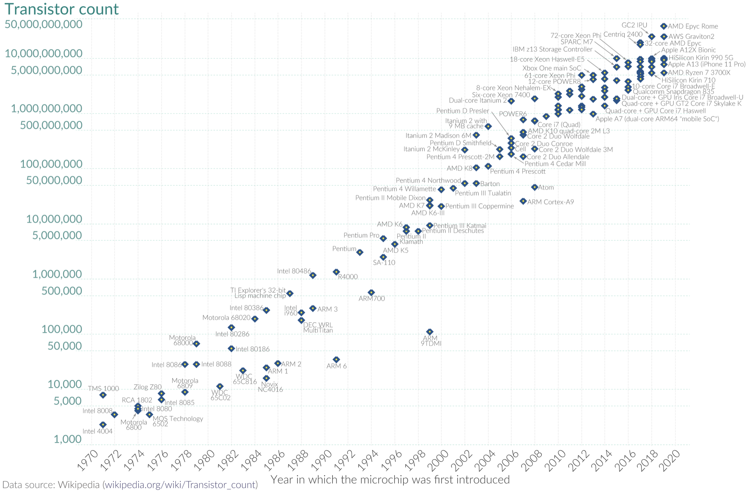
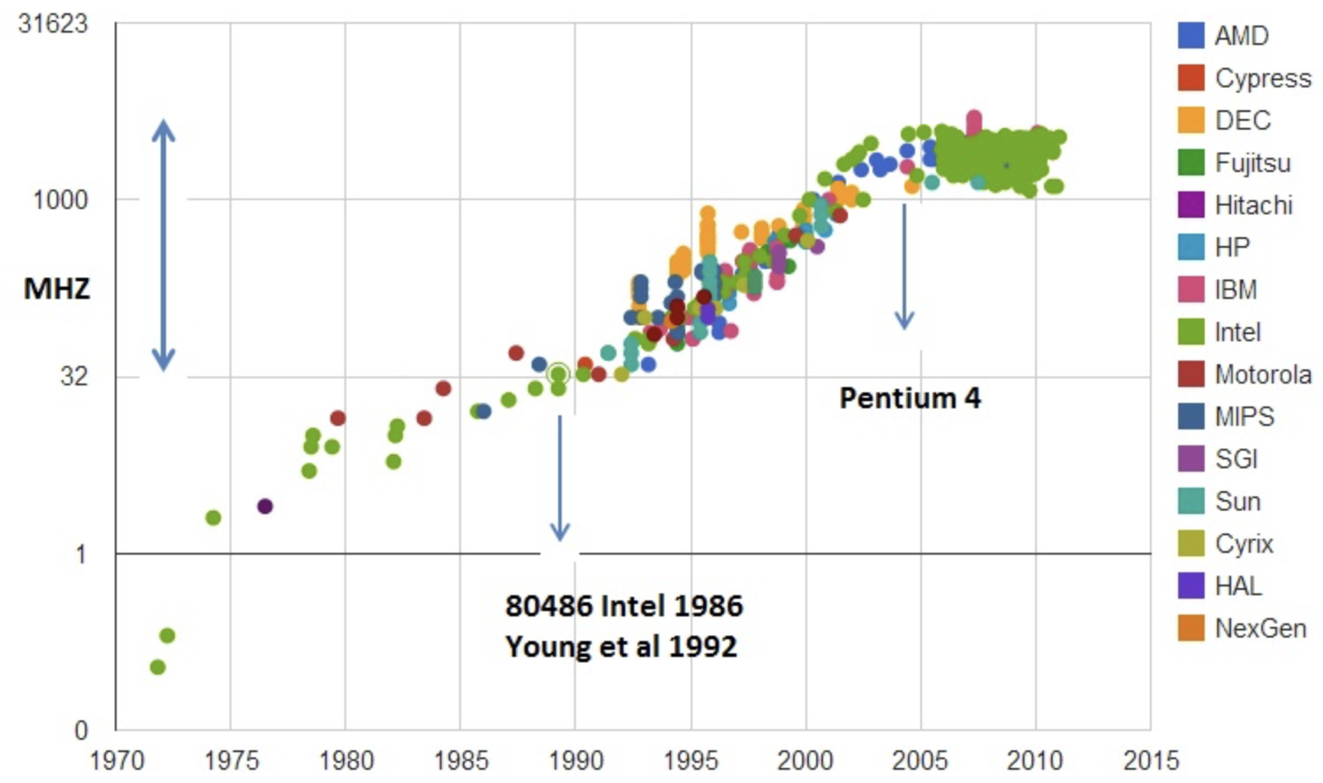
Moore’s Law
Gordon Moore, 1965
The number of transistors on microchips doubles every two years
Widely misquoted that the speed of microprocessors doubles every two years
Clock speed
https://commons.wikimedia.org/wiki/File:Moore%27s_Law_Transistor_Count_1970-2020.png

Slide 8
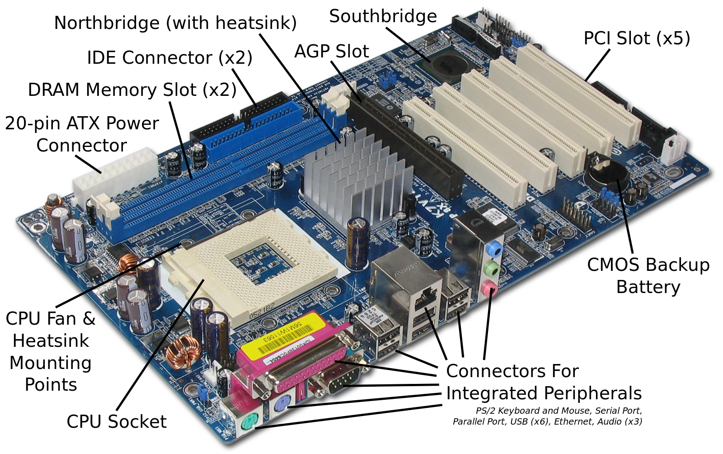
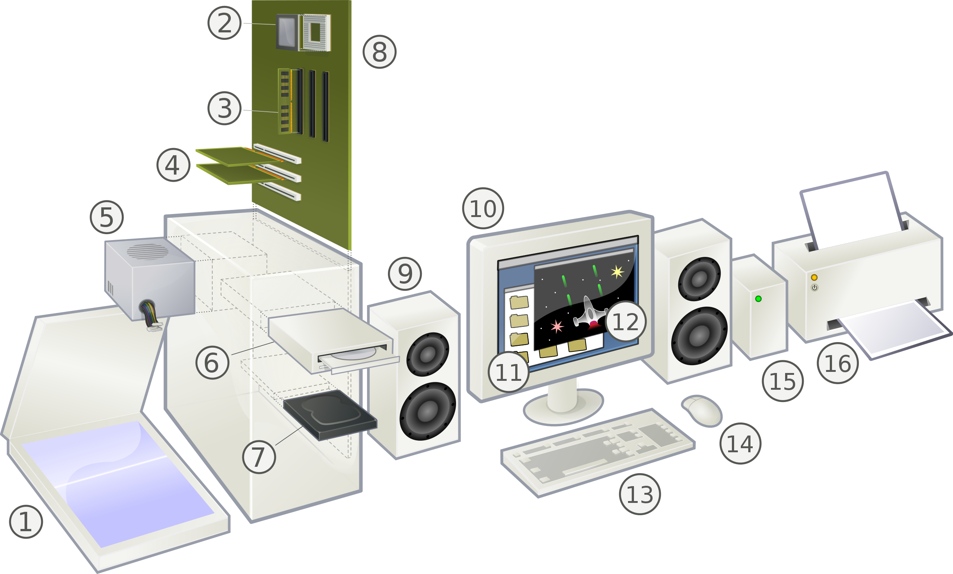
Putting it together…
Assembled Computer
Motherboard
CPU, RAM,
Network, graphics, sound cards
Motherboard
Peripherals
https://commons.wikimedia.org/wiki/ File:ASRock_K7VT4A_Pro_Mainboard_Labeled_English.svg
https://en.wikipedia.org/wiki/Personal_computer#/media/
File:Personal_computer,_exploded_6.svg
Notes:
CMOS = Complementary metal-oxide-semiconductor (the kind of chip that holds the BIOS)
Peripherals also include wired/wireless network hubs, external drives, and instruments or other devices connected to the computer via the integrated connectors or cards.
1 Scanner
2 CPU (microprocessor)
3 Memory (RAM)
4 Expansion cards (graphics cards, etc.)
5 Power supply
6 Optical disc drive
7 Storage (hard disk or SSD)
8 Motherboard
9 Speakers
10 Monitor
11 System software
12 Application software
13 Keyboard
14 Mouse
15 External hard disk
16 Printer

Slide 9
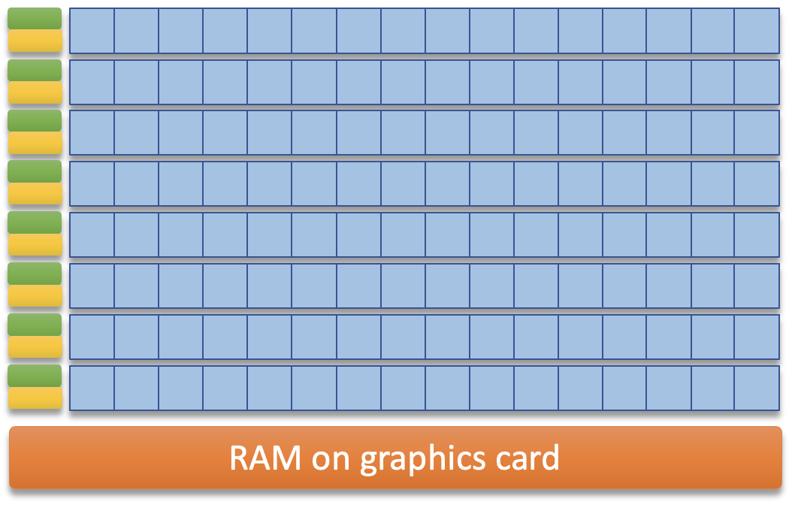
Graphical processing units (GPU)
The primary microprocessor on a graphics card
Arrays of specialized computational units for visual displays
Hundreds to thousands of cores, each must execute the same instructions
Highly parallel, more efficient than CPU for…
Image processing (applying similar computations across many pixels in an image)
Construction and manipulation of visual worlds in games
High volume data processing in bioinformatics
High volume data processing in machine learning
Control
units
Arrays of processor cores
Caches

Slide 10
Network communications
Data from RAM to NIC
Data from NIC to RAM
Encoding Decoding
Network protocol
Ethernet the most widely used local network protocol
Each NIC (network interface card ) has a unique MAC address (media access control)
Distance between the cards is limited depending on the medium (wire, fiberoptic, radio)
Data is sent in short bursts (datagrams, packets)
Effective speed is limited by collisions when several devices try to communicate at once
“Bandwidth” is jargon for the maximum reliable data rate of a network (in bits per sec)

Slide 11
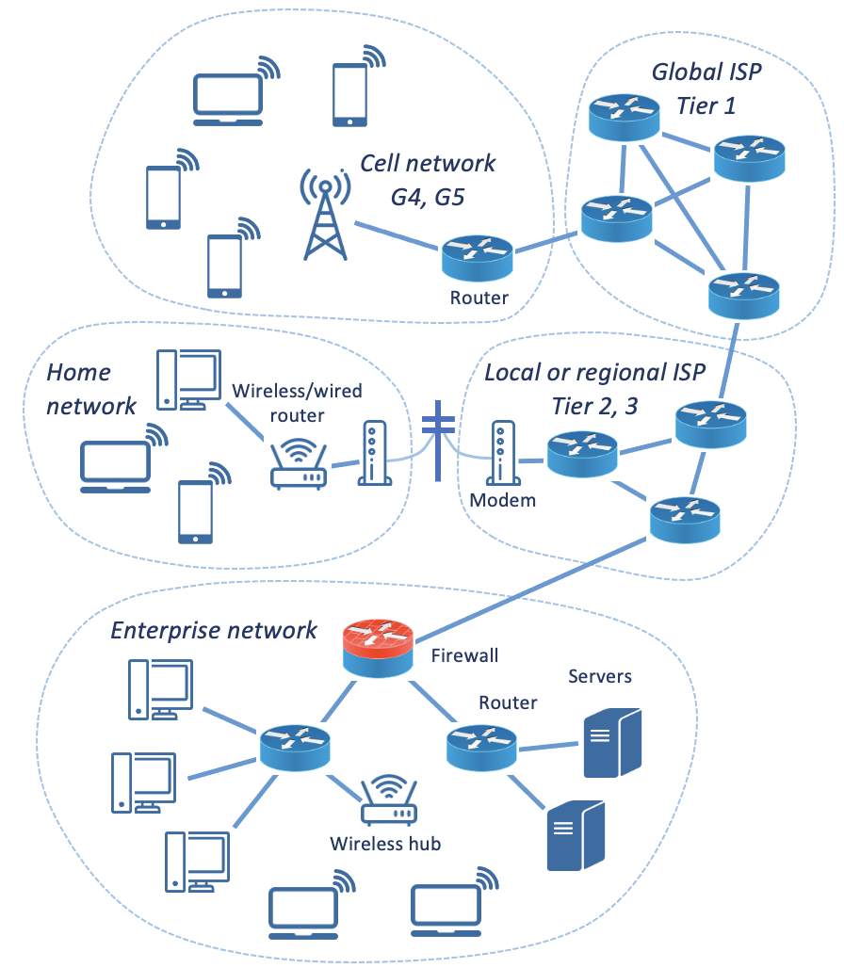
Network Architecture
Wide area networks (WAN)
Miles in length
Internet service providers (ISP)
Tier 1 ISPs (Internet backbone)
Local area networks (LAN)
Meters in length
Wired (Ethernet)
Wireless (Wifi)
Gateways (DSL/Cable modems)
Firewalls
Routers, Switches, Hubs
WANs
LANs

Slide 12
Network communication protocols
Wired LAN: Ethernet
~100 m max length, speed traditionally 10 Mb/sec, now up to 40 Gb/sec
Wireless LAN: Wifi (spread spectrum radio)
150 – 300 ft, up to 500+ Mb/sec
Cell
1-2 miles, practical best case up to 10 miles, G5 avg > 100 Mb/sec
WAN
Range of technologies and protocols
Undersea fiberoptic cables: thousands of miles, terabytes/sec
Routine land WAN, miles and up to 150 Mb/sec

Slide 13
Packet-switching Networks
Circuit-switching vs. packet-switching
Phone system vs. post office
TCP/IP
Transmission control protocol/ internet protocol
TCP: specifies packet structure, addressing, error checking
IP: specifies device addressing
128.143.36.11 (organization, subnet, device)
Fixed vs. dynamic addresses
Domain name servers convert from domain names (jhh.hscs.virginia.edu) to numerical IP addresses (128.143.36.11)

Slide 14
Software
System software
Operating system (Linux, Unix, Windows, MacOS)
Controls the computer, manages other programs and supports common software tasks, defines the computer’s “personality”
Device Drivers
Specific to interface cards and peripherals
Other utilities (run by the OS when necessary)
Application software
General purpose (word processors, spreadsheets)
Domain specific (lab instrument software, LIS, EHR)

Slide 15
Architecture of software
Data files
Application
programs
Device driver
Disk drive
Device driver
Network card
Operating
System
Device driver
Graphics card
Device driver
Serial port

Slide 16
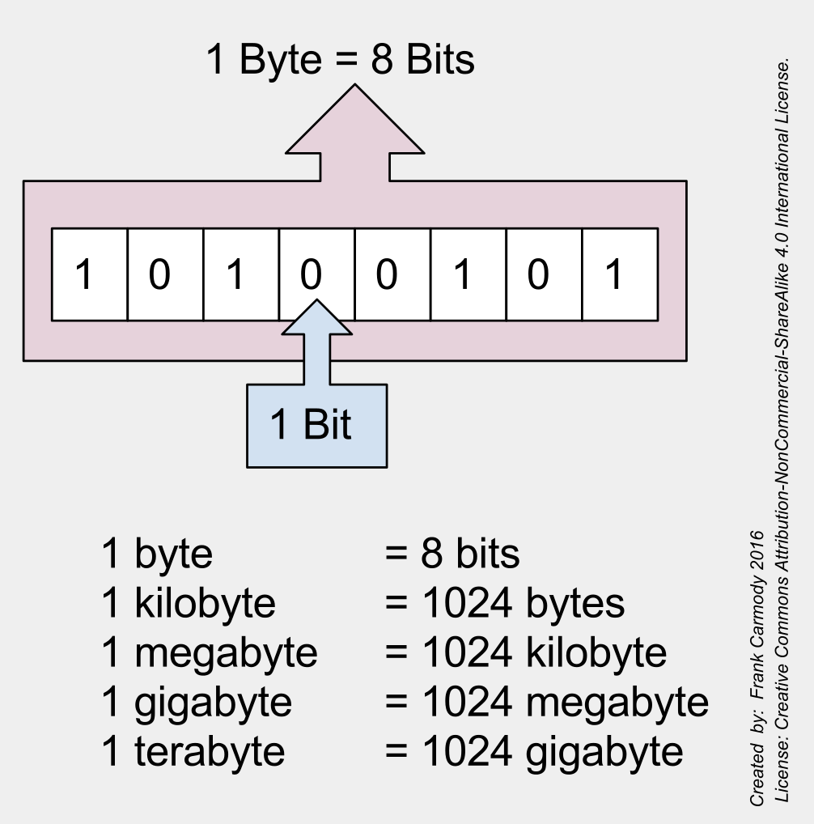
Hardware to data: How are data represented digitally?
Computer memory is an array of switches that can be off or on
Easy to distinguish and copy accurately
Binary numbers match the capability of these switches
0 and 1 are the only digits, match off and on state of switches
A single memory switch (location) is a “bit”
Memory is typically used in groups of 8 bits, called a “byte”
Columns from the right represent 1s, 2s, 4s, 8s, 16s, 32s, 64s, 128s
Represents 256 numbers: 00000000 = zero; 11111111 = 255
https://commons.wikimedia.org/wiki/File:Bits_and_Bytes.svg
Notes:
How do you use all this hardware to work with data?

Slide 17
Simple (primitive) data types
Boolean
Two values: pos/neg, T/F, Y/N, 1/0; 1 bit
Integers
Whole numbers, ± ~10 quintillion; 64 bits (8 bytes)
Floating point numbers
Decimal, 15 significant figures; inexact for 1/3, pi, etc.; 64 bits (8 bytes)
Characters
ASCII or Unicode encoded; upper and lower case, numerals, symbols, non-printing characters; represented by numbers using 1 or 2 bytes
Character strings
Sequences of characters with a variable number of bytes based on length
Representation of image data will be discussed in a later session

Slide 18
Representation has functional implications
How many ways can “100” be represented in a computer?
All representations are binary
Integer (can’t divide with decimal result or include in text)
Floating point (inexact, can’t include in text)
Character string (can’t do math without conversion)
Medical systems represent and store numbers as text
Space saving with usual sized numbers (less space to store a few chars)
Display as characters is often primary purpose
Math not often needed and can convert when necessary

Slide 19
Representation of concepts
Association of concepts with text strings (“codes”)
Standard terminologies (controlled vocabularies, coding systems)
Types of coding systems
Value sets (HL7 Table 78, Abnormal Flags, 18 values)
Flat lists (LOINC)
Hierarchical lists (ICD, disease types with specific diseases)
Polyhierarchies (SNOMED CT, 19 axes like “body structure,” “clinical finding”)
Multiple parents for a concept
Ontologies (SNOMED CT, concept descriptions, 99 relationships between concepts like “is_a,” “has_diagnosis,” “associated_morphology”)

Slide 20
How are complex data types constructed?
A defined combination of primitive data types with constraints
Constraints are rules that limit the values of the primitive data types
The components of a complex data type are its data elements
Example: accession number, 22H-034AC01398
Data elements are 3 constrained numbers and 2 constrained character strings
22H-034AC01398
Constraints:
Character length
Numerical value
Set
Two digit
year
Lab
code
Julian
day
Lab
section
Sequential
counter
Notes:
Consider accession number for an example complex data type: 22H-034AC01398 (year, lab, julian day, lab section, sequential counter that resets annually)

Slide 21
What is a data model?
A description of the structure of a complex data type
Class diagrams commonly used to depict data models
List of data element (attribute) names, data types, and cardinality
Accession number
Year: string (num)
Lab code: string
Julian day: string (num)
Section code: string
Counter: string (num)
Address
Name: string
Street number: string
Street name: string
Apt number:string
City: string
State: string (codeset)
Zip code: str (num, 5)
Bibliography Entry
Author : string [0..*]
Title : string [1..1]
Year : string [1..1]
Journal : string [1..1]
Volume : string [0..1]
Number : string [0..1]
Pages : string [1..1]
doi : string [0..1]
Cardinality
[Min # .. Max #]
* Any number
[0..1] optional
[1..1] required
22H-034AC01398
Notes:
Accession number: 22H-034AC01398 (year, lab, julian day, lab section, sequential counter that resets annually)

Slide 22
How are relationships represented?
Example: Resource Description Framework (RDF) triple
Three data elements
Two concepts (subject and object)
Connected by a relationship concept (predicate, “is-a,” “has-finding,” etc.)
Simplest representation of association or interaction
Databases of RDF triples allow “reasoning” within a domain
Constraints:
Structure (3 elements)
Content (value lists)
May be simple or complex data types

Slide 23
How do computers store data?
Data in working memory is volatile
Lost if powered down
Non-volatile media (disks, tape, solid state storage, optical)
Maintains state without power
Data can be preserved by copying it to non-volatile media in files
Files are a block of binary data with a known size and position in the media
Files have names, creation dates, and modification dates
Filename extensions may indicate the type of file or creating program
Internal structure allows data to be accurately recognized
File structure may be proprietary or an open standard

Slide 24
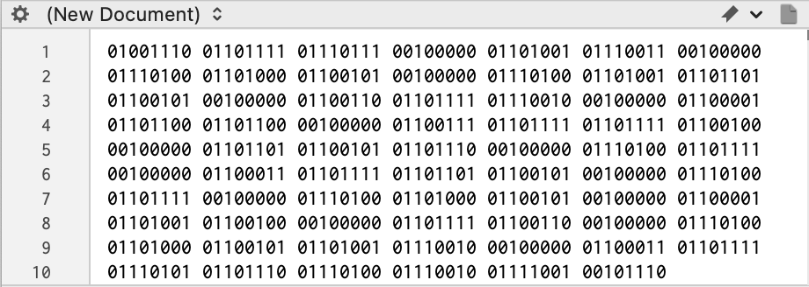
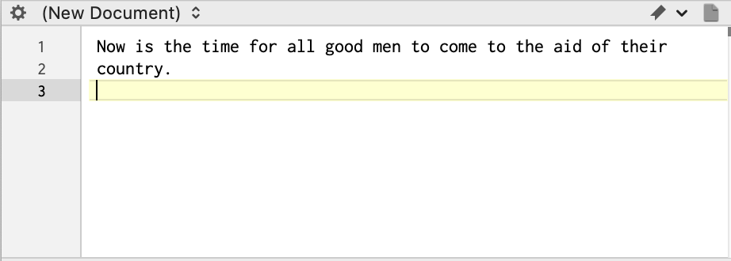
Storing data in files
Binary files
Binary encoding, meaning is software-specific and defined by the software authors
Native Word, Powerpoint, and Excel files
Text files
Store data as characters, including numbers
Plain text (“flat file” or unstructured text, a character string in Unicode or ASCII)
Rich text format (RTF), character sequences indicate formatting
Delimited files
Comma separated values (CSV), quoted CSV, tab delimited, space delimited
Structured text (eg, json or xml)
Databases
Files specially structured for rapid and reliable data storage, update, search, and retrieval
ASCII-encoded text

Slide 25
Delimited files
Comma separated values (CSV)
Quoted CSV

Slide 26
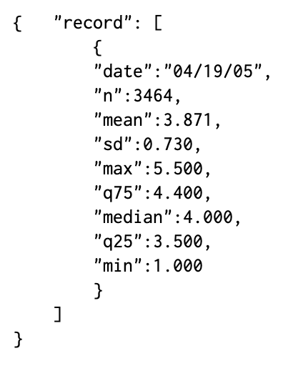
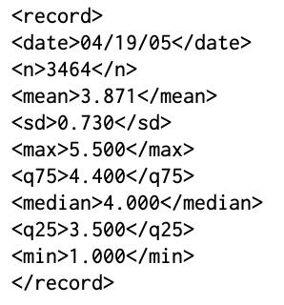
Structured text
Javascript Object Notation (JSON)
Extensible Markup Language (XML)
Tags “contain” values
Opening and closing tags
Nested tags
Larger files but most flexible
Attribute-value pairs
Requires attribute names for all values
Notes:
The CSV file is maintained at the top for comparison. A data standard defines the structure of complex data elements in a domain, including the delimiting scheme, names or codes for the attributes (data elements) with definitions, and standard constraints for attribute content with definitions of content meaning.

Slide 27
Databases: Data storage plus
A file or files of related data elements structured for rapid and reliable data storage update, search, and retrieval
Database management system (DBMS)
Collection of programs that allows multiple users to create, maintain, and use databases
Controls user access to the data
Indexes and sorts data to allow rapid numerical and text query
May provide error checking and other data integrity features
May allow databases that are larger than RAM
To be discussed in detail in our next session…

Slide 28
Key points
Major computer components and what they do
Organization and structure of networks
Network communication protocols
Major types of software
Simple and complex data types, data models
Data files for persistent data
Binary and text data
Unstructured and structured text

Slide 29
Readings
Harrison J. Management of Pathology Information Systems, Chapter 6. In: Laboratory Administration for Pathologists. 2nd ed. CAP Press; 2019. Sections: “Computer Basics, Data Representation, Computer Networking.” Available for download from the Pathology Informatics Essentials for Residents curriculum page.

Slide 30
Permitted uses
© 2023 James H. Harrison, Jr. except as noted below. The original material in this slide set is made available under a Creative Commons Attribution 4.0 (CC BY 4.0) International License. The contents may be used without restriction, modified, and redistributed if they are attributed and any changes are indicated. Some graphical elements are used with permission or according to their own licenses requiring attribution. Attribution links are provided on the slide of use or on the Permitted Uses slide (this slide). These elements may be used and included in modified and redistributed work consistent with the licenses specified at the linked sites, provided that the links are included in the redistributed material.
The cover image is a composite of two laboratory images from Pixabay available for use without attribution.
CPU images from freeimages.com
Thermometer icon and large gear icon created by DinosoftLabs – Flaticon
Computer icon #242784, Laptop icon #192916, and network icons from icon-library.com
Graphics card and NIC icons created by Eucalyp – Flaticon
Agenda, PDA, router, modem, cell tower, and wifi symbol created by Freepik – Flaticon
Files, application, RAM, CPU, graphics card, and disk drive icons created by Freepik – Flaticon
Network card icon created by srip – Flaticon
Serial port icon created by Muhammad Ali – Flaticon
Gaming icon (key) created by juicy_fish – Flaticon
Book icon created by Good Ware – Flaticon

Slide 31
Editable diagrams
Global ISP
Tier 1
Cell network
G4, G5
Router
Home network
Wireless/wired router
Local or regional ISP
Tier 2, 3
Modem
Enterprise network
Firewall
Servers
Router
RAM on graphics card
Wireless hub

